Slide 1


The FASD adolescent
Prevention
Conversation:
A Shared Responsibility
Notes:
Ask group:
If they ever plan to drink and/or have sex?
Ask if they have heard of FASD… let them know they will have an idea of this by the end of the conversation.

Slide 2

1
Let’s Get Real About Drinking Alcohol
2
Alcohol, the Brain & Body
Brainstorming
3
4
Alcohol and Pregnancy
5
What is FASD?
6
Cannabis

Slide 3

THIS IS A
BRAVE SPACE
Notes:
Topics in this presentation are of a sensitive nature.
Sometimes, as youth, it may be difficult to talk about alcohol and sex. We recognize this and encourage open and honest conversation by stressing the nature of a safe and accepting space during the presentation.
Everyone is here to learn
Some may know more than others
No questions or comments are silly

Slide 4

_{Prevention}
_{Conversation}
LET’S GET REAL
ABOUT
Drinking ALCOHOL

Slide 5
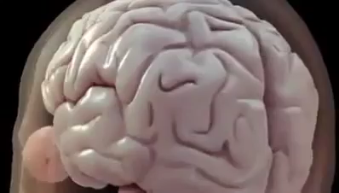
How Does Alcohol Affect the Brain?
FIRST LET’S TALK ABOUT:
• WHAT the brain does
• WHAT alcohol does to the brain
• WHAT that does to you!
Alcohol and Your Brain – Get the Facts. YouTube, uploaded by Bob Sto Domingo 28 May 2013
Notes:
BEFORE VIDEO:
This video gives us a clear explanation on those different parts of the brain, and how alcohol changes the way that part of the brain functions.
AFTER VIDEO:
What is the most important organ in our body?
The major target of alcohol is…THE BRAIN!
Every time you drink alcohol it affects the brain
YOU CAN ALWAYS TAKE A BEHAVIOR AND TRACK IT BACK TO THE BRAIN!

Slide 6
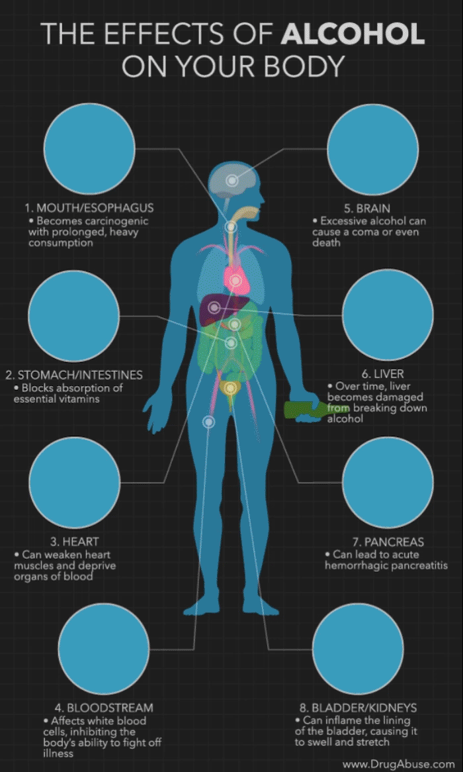
What is Alcohol Really?
Alcohol is a depressant.
Depressant drugs slow down the parts of your brain that affect your thinking, behaviour, breathing and heart rate.
This affects how you react to your environment.
Alcohol blocks some of the messages trying to get to your brain. This changes how people feel and move, as well as their vision and hearing.
Notes:
Simply read this slide. Point out on the right how alcohol affects each organ/body part.
7. PANCREAS: (Hemorrhagic Pancreatitis= Inflammation of the pancreas)

Slide 7

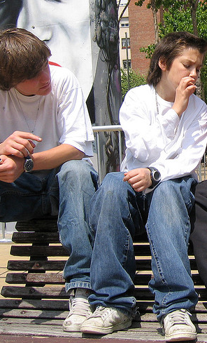
Why do you think Teens might want to Drink / use substances?
Notes:
Debrief:
• Debrief mental health issues, trauma, to cope with problems, or addiction, by acknowledging that this is a reality for some youth,
Why do teens use?
• Chill-out/relax • Deal with stress • Addiction
• Media influences • Curious • Mental health issues • Trauma
• Fun/like it • Be social • Peer Pressure • Family is using
• Help cope/forget problems
Why don’t teens use?
• Past experience • Values • Substance use by friends or family
• Fear of overdosing • Worry about addiction • Don’t like hangovers
•Are driving • Are pregnant
• Focus on sports/academics • Future goals
• Worry about getting in trouble • Don’t want to make impaired decisions/look foolish or stupid
• Worry about being vulnerable/assault

Slide 8


How Does Alcohol Show Up In All Of Our Lives?
Where do we see alcohol in our day-to-day lives?
How do you think that this may influence our decisions?
Notes:
Brainstorm with youth
1- ALMOST EVERYWHERE: Gatherings/public events/celebrations/home/ marketing (often targeted to encourage POSITIVE beliefs when it comes to alcohol/creating environments where alcohol use is encouraged
2. PEER: STRONG! Everyone wants to fit in/be included. Important to remember that you can still participate in activities and choose to go alcohol free.
CULTURAL: Some cultures don’t drink alcohol/same as religion- this could go either way. Values also play a huge part/experience/life
This can also be a reality for some that may live with alcohol use in their day to day lives. Some peoples lives can be very much impacted by alcohol use.

Slide 9
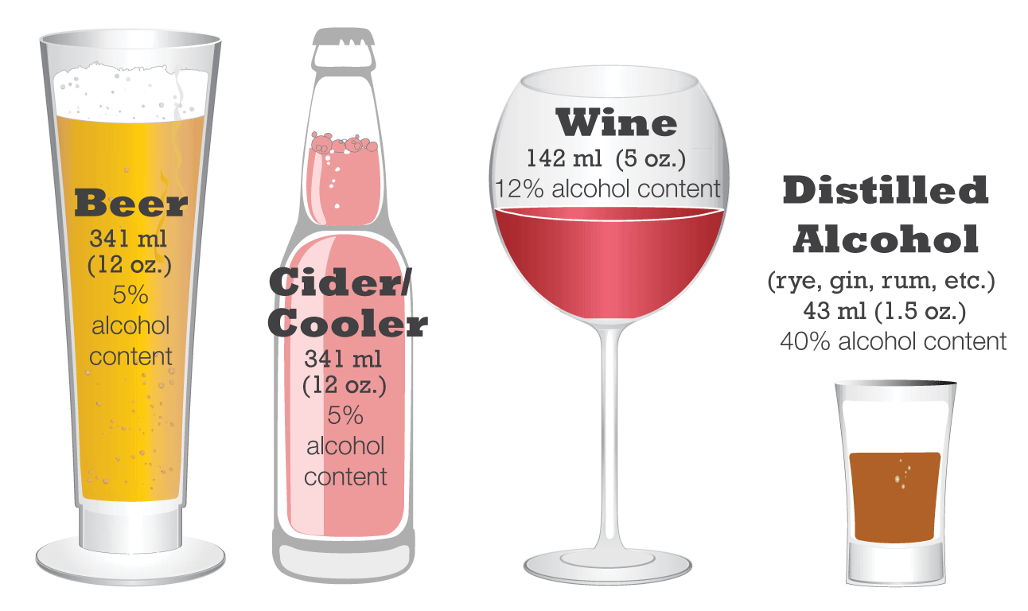
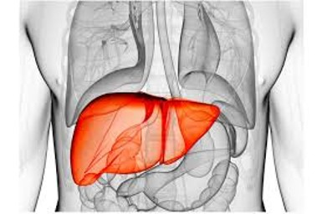

What is Binge Drinking?
What is a STANDARD drink?
The consumption of an excessive amount of alcohol in a short period of time.
!
Binge drinking can
lead to difficulty concentrating, problems with memory, mood changes, and alcohol poisoning.
How long until it leaves my body?
Alcohol Poisoning
affects the body’s involuntary reflexes – including breathing and the gag reflex, as well as the bloodstream. If the gag reflex isn’t working right, a person can choke to death on his or her own vomit.
Biology
Weight
Body Fat percentage
Notes:
About five percent of the alcohol consumed leaves the body through urine, sweat glands, and breathing.
Most of the alcohol must be broken down (metabolized) by the liver to remove it from the system.
The liver metabolizes alcohol at a very constant rate, depending on a few different factors:
Biology
Weight
Body fat percentage
The only way to remove alcohol from the body is to give the liver enough time to metabolize it.
A cold shower, fresh air, exercise, or black coffee will not help sober a person up.
Time is the only thing that will remove alcohol from the system

Slide 10

SAFETY PLAN: IF YOU DECIDE TO DRINK
1
2
3
4
MAKE A PLAN
Set a LIMIT of what you will drink
Pace yourself
Have a full stomach
Mix it up!
WHO will YOU CALL?
Safe drivers
Tell someone you trust
where you will be.
Plan how you will get home in
advance or plan a safe place to
stay.
Have taxi numbers saved on your cell phone, or a designated driver’s name on your cell phone.
Know who you can call if you
or someone is in trouble.
Notes:
The most effective way to be safe from the harming effect of alcohol is to not use it at all.
However, this isn’t always a choice that people can or want to make, so we need to think about ways to reduce harm when using alcohol.

Slide 11
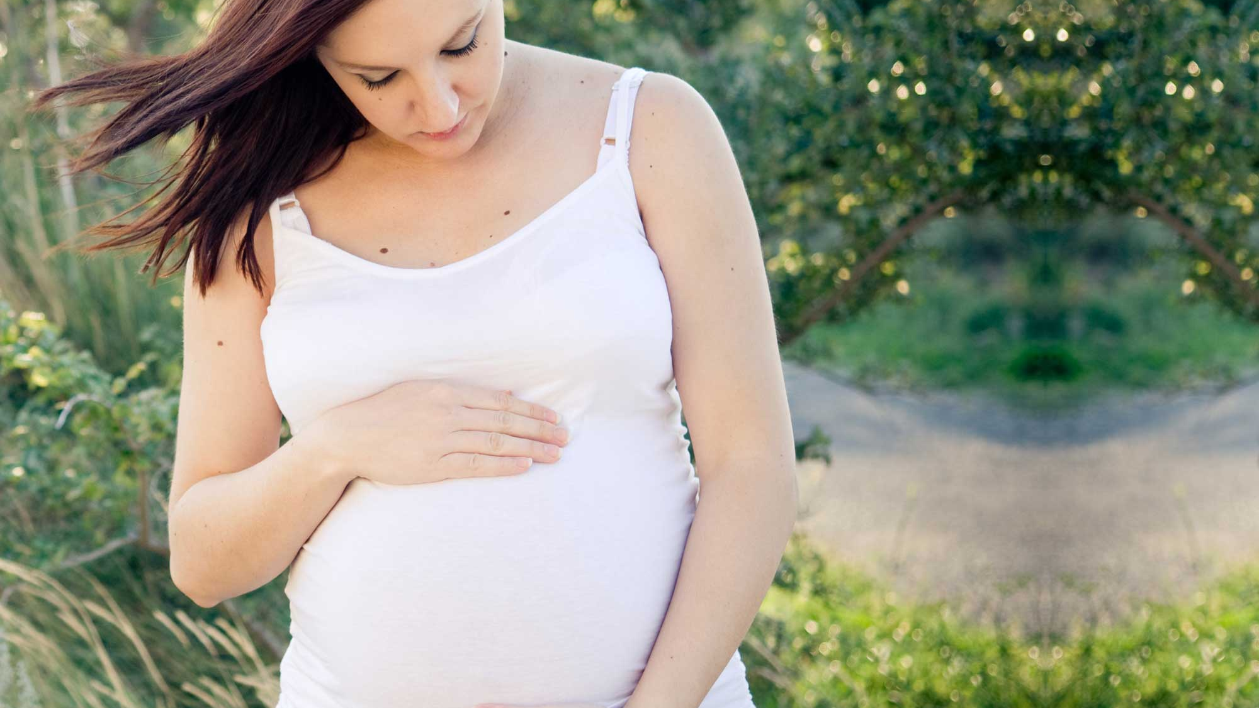
_{Prevention}
_{Conversation}
LET’S GET REAL ABOUT
Drinking alcohol & Pregnancy

Slide 12



ANYONE including:
Who drinks
During pregnancy?
Light/moderate/heavy drinkers
Higher income, higher education, over 30 yrs old, successful
People exposed to poverty and isolation
Those who use substances
Victims of violence (childhood, domestic)
Notes:
This slide reinforces that anyone can be at risk for many different reason of drinking during pregnancy.
It also shows this is not targeted at any group as some participants may have been exposed to bias towards culture or demographic.

Slide 13

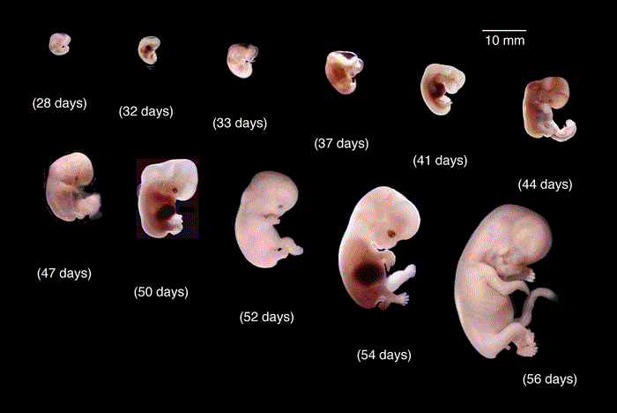
13
What can happen to the developing baby if it is
Exposed to alcohol?
When a woman drinks alcohol during pregnancy, it affects the normal growth and development of the baby.
Alcohol is a teratogen, affecting the size of the brain, the forming of brain structures, and how the brain and body functions after the baby is born.
IYM Health
Notes:
Ask the group if they know how alcohol may affect a developing child.
The only cause of FASD is maternal alcohol use in pregnancy
- mothers share a blood connection with the fetus throughout gestation and therefore have the most significant impact on development through nutrition and lifestyle.

Slide 14
Drinking and Pregnancy
What can happen when they mix?
Fetal Alcohol Spectrum Disorder (FASD)
PREGNANCY
4% of babies in
Alberta are born with FASD
Canada FASD Research Network, (2017)
ALCOHOL
WHO KNOWS WHAT FASD IS?
Notes:
FASD:
A diagnostic term used to describe the impacts on the brain and body of individuals PRE- Natally exposed to alcohol.
There can be a correlation from the effects of alcohol with the permanent damage done to a fetus in utero.
This is a short-term effect while someone is intoxicated however, it can be chronic when the frontal cortex is impacted during fetal development.
For example:
Alcohol changes how the frontal cortex functions reducing inhibitions with a lower degree of impulse control.
Just like the cerebellum is impacted while intoxicated and you will have challenges with coordination, if there is drinking during pregnancy, the cerebellum will have permanent damage.
The same as:
Cognitive function, that problem solving/planning/decision making/language and communication ability, attention/memory….
ALL Short term effect while intoxicated..
Permanent damage in FASD brain.

Slide 15
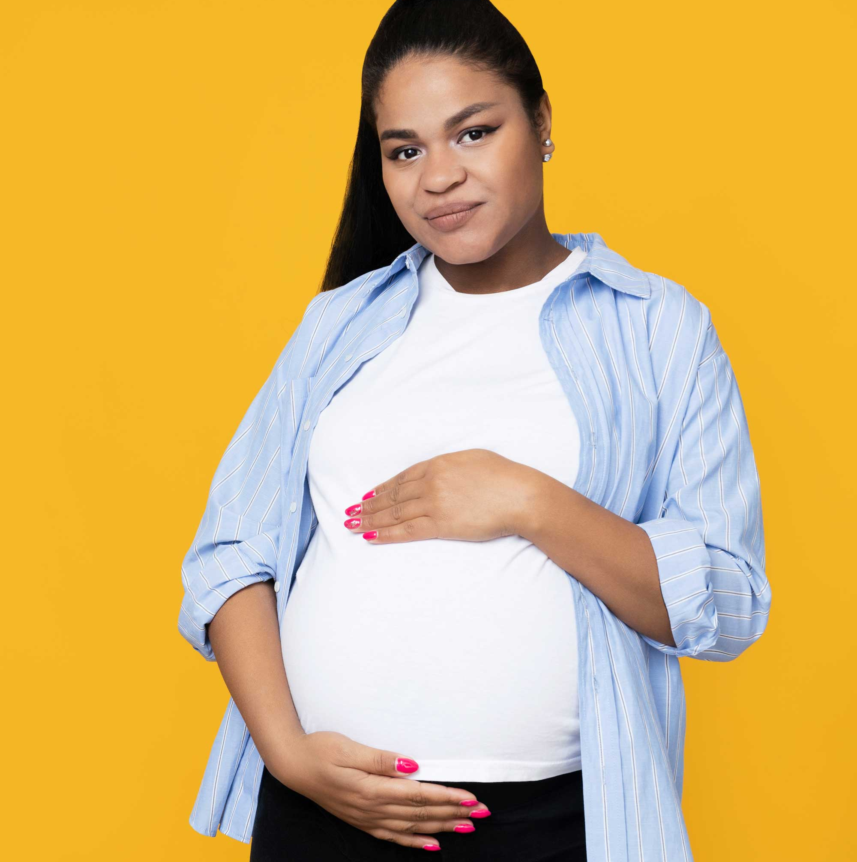
What is FASD?
15
Fetal Alcohol Spectrum Disorder (FASD) is a diagnostic term used to describe impacts on the brain and body of individuals prenatally exposed to alcohol.
FASD is a lifelong disability.
Individuals with FASD will experience some degree of challenges in their daily living, and need support with motor skills, physical health, learning, memory, attention, communication, emotional regulation, and social skills to reach their full potential.

Slide 16

PRIMARY DISABILITIES
16
Typical brain-based, primary disabilities of
FASD includes:
Inconsistent MEMORY and RECALL
Decreased MENTAL STAMINA
Difficulty interpreting, and applying
ABSTRACT CONCEPTS
IMPULSIVITY and poor JUDGEMENT
RESISTANT to change
Inability to PREDICT OUTCOMES
Inability to see ANOTHER PERSON’S perspective
Inability to recognize indirect SOCIAL CLUES
Centre for Addiction and Mental Health (CAMH)
Notes:
MEMORY and RECALL: Learning difficulties/ Forgetfulness
MENTAL STAMINA: Mental/Physical ability to continue with a task
ABSTRACT CONCEPTS: Math/Money/Time
IMPULSIVITY and poor JUDGEMENT: Act without thinking
RESISTANT to change: Like Consistency
PREDICT OUTCOMES: Actions vs. Consequences /Don’t always learn from mistakes
ANOTHER PERSON’S perspective:
SOCIAL CLUES: Facial expressions/Body language/Tone of voice
Also: SENSORY DIFFICULTIES: How they experience the world around them.
See taste
Touch smell
Hear

Slide 17

17
ADVERSE OUTCOMES
Adverse outcomes are those not present at birth but occur later in life because of the primary disabilities associated
with FASD.
They include:
MENTAL HEALTH problems
Poor ACADEMIC achievement
Inability to live INDEPENDENTLY
ALCOHOL and/or DRUG problems
Problems with EMPLOYMENT
Trouble with the LAW
Disrupted SCHOOL experience
Centre for Addiction and Mental Health (CAMH)

Slide 18
18
FASD FACTS
It is a spectrum
FASD can be prevented
Each individual with FASD is unique and has areas of both strengths and challenges
Safest not to drink alcohol during pregnancy. FASD is not curable.
Centre for Addiction and Mental Health (CAMH)
Notes:
FASD is not a diagnosis; it is a term to describe a range of disabilities which may include cognitive impairments, physical birth defects and health problems. To understand the acronym FASD a bit better, let’s consider each of the words that make it up:
•Fetal refers to the fetus in the womb of the mother.
•Alcohol is the cause of the disorder. When alcohol is consumed by the mother it interrupts the normal development of the fetus. There is some research developing that says alcohol may be THE most powerful toxic chemical to an unborn baby or fetus. Alcohol interferes with how cells in the body develop, including cells in the brain.
•Spectrum is a term to describe a range of effects an individual with FASD might have – from mild to severe effects that are lifelong and not curable.
•Disorder indicates that this is an abnormal condition. FASD affects the whole body including physical, mental, behavioral, and/or learning challenges.
We also need to know that FASD impacts the lives of individuals, their families, and caregivers.
FASD is assessed and diagnosed by a multi-disciplinary team including at minimum a physician, psychologist and speech-language pathologist.
And, FASD is theoretically preventable.
Finally, we need to know that FASD has no cure but there is hope. With effective resources and supports and understanding, people with FASD can lead meaningful and engaged lives.
Fetal Alcohol Spectrum Disorder (FASD) Prevention: Canadian Perspectives. (2008). Government of Canada Web site. Retrieved from https://www.canada.ca/en/public-health/services/health-promotion/childhood-adolescence/programs-initiatives/fetal-alcohol-spectrum-disorder-fasd/publications/canadian-perspectives.html

Slide 19

CONSIDER THIS…
To help guide your decisions
But what
CAN I DO?
Hold yourself accountable to your own values and beliefs around alcohol and drug consumption.
HAVING QUESTIONS OR CONCERNS IS NORMAL!
Seek help from role models or adults you trust when you feel it is necessary.
Based on what you now know, make your best informed decision.
Notes:
Ask the group:
After viewing this presentation, what have you learned/taken away?

Slide 20
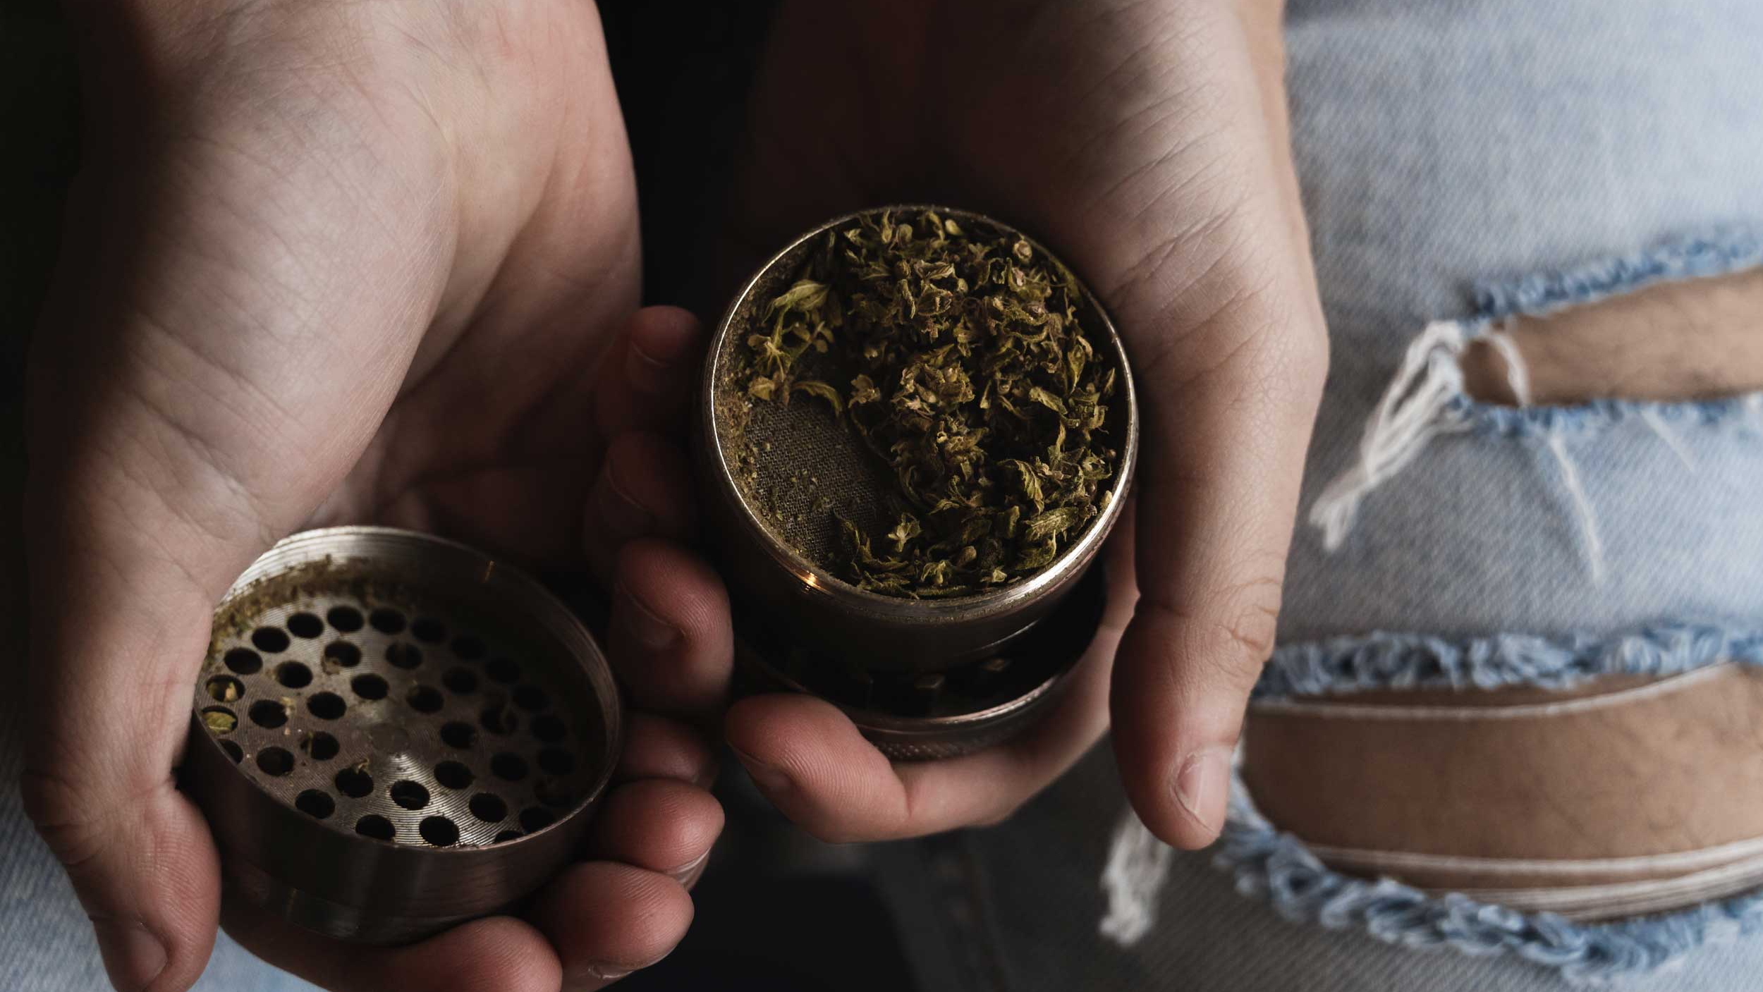
_{Prevention}
_{Conversation}
LET’S GET REAL ABOUT
Cannabis
Notes:
Introduce the topic of sex.
Ask the group:
Who has talked about this topic openly before?
What are some things they’ve talked about before?

Slide 21
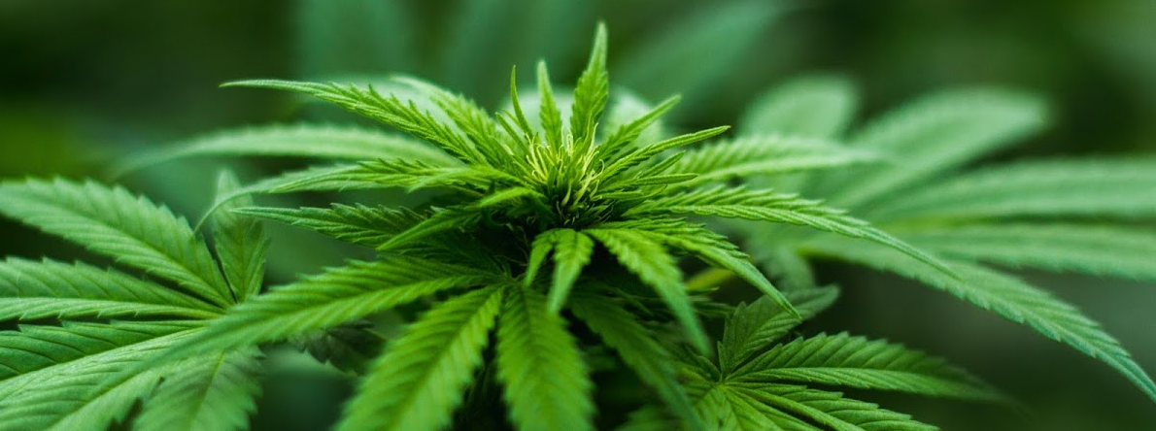
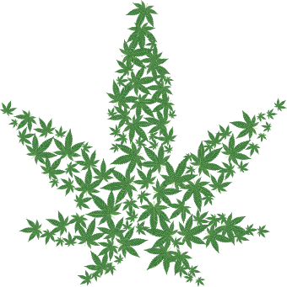
The Alberta
Cannabis Scene
After alcohol, cannabis is the most widely used psychoactive substance in Canada.
The cannabis plant contains more than 400 chemicals. Tetrahydrocannabinol (THC) is the main active chemical in the cannabis plant that gives people who use it a ‘high’. THC affects areas of the brain that control memory, concentration, and coordination. Cannabidiol (CBD) is an active chemical in the cannabis plant that’s used for medicinal purposes.
30 grams
Personal Limit
18+
Legal Age Limit
Alberta Gaming, Liquor and Cannabis Commission (2020)
Notes:
As or March 31, 2020, AGLC has issued 436 cannabis retail store licenses.
30 Grams of dried flower or equivalent is the most you can buy or carry at one time and each household is permitted to grow a maximum of 4 plants.
Legal- must be 18+, youth cannot enter cannabis stores, even with an adult, can only purchase from licensed retail stores
Drug-impaired driving is still impaired driving
Adults over 18 can possess up to 30 grams (or equivalent of extract, edible or topical) of cannabis in a public place, in line with the federal possession limit.
When cannabis is in a car, it must be secured in closed packaging and not within reach of any occupants.

Slide 22
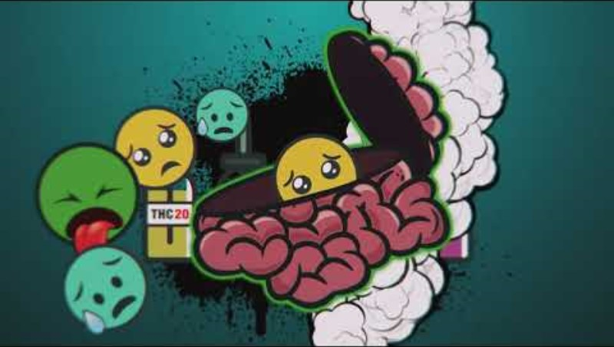
RISKS TO VAPING CANNABIS

Slide 23
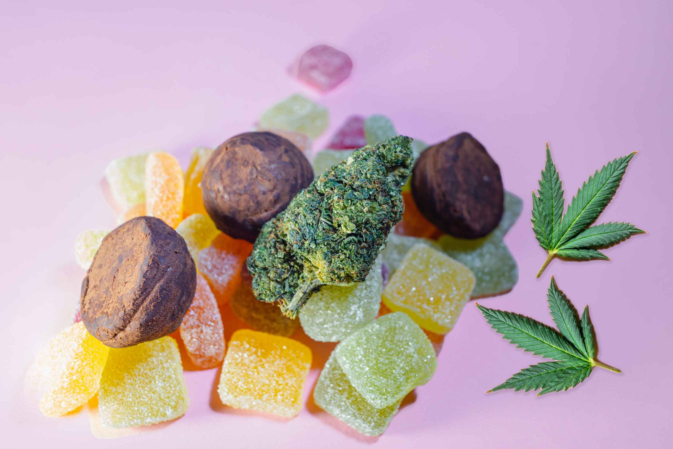
Cannabis Quick Facts
Cannabis can affect everyone differently.
Female bodies are more sensitive to cannabis (and other substance use) than male bodies.
Should you mix cannabis and alcohol? NO!!
The two substances can worsen the effects of the other when mixed. Alcohol consumption while using cannabis amplifies the effects of cannabis—making it easier to overconsume and experience negative side effects when combined.
Don’t use and drive
Reaction time, coordination and concentration can
increase your chances of being in a motor vehicle collision
Inhaling cannabis is the most harmful route of administration
Ingesting cannabis (edibles) takes longer to take affect
The earlier in life you start using cannabis, the higher the risk for addiction and health-related harms.
Attention, judgment, decision-making and your ability to learn can be affected by how early, how much and how often you
use cannabis.
Although cannabis is legal for adults 18+, your brain continues to develop until your mid-20s. Cannabis can affect brain development.
AGLC, aglc.ca/Cannabis AB, 2020
https://cannabissense.ca/health-effects/cannabis-use-guidelines
Notes:
Like Cigarettes, smoking cannabis harms your lungs.
Avoid combining cannabis with alcohol, tobacco or other drugs (prescription) .
Using alcohol and cannabis together results in greater impairment and an increased likelihood of undesirable effects
Don’t use and drive.
Combining alcohol and cannabis impairs a driver more than consuming cannabis or alcohol on their own. When combined, even at low levels, a greater level of intoxication occurs and your ability to drive decreases and the risk of collision increases.
Don't use if you are pregnant, think you might be pregnant, or are planning to become pregnant.
Consider waiting and using cannabis later in life.
High THC products are associated with higher risks for mental health and behavioural problems, higher health and social problems.
Cannabis can affect brain development in early adolescence and increase your risk of long-term cognitive impairments.

Slide 24


WHERE TO GO IF I HAVE
QUESTIONS
OR WANT HELP:
www.getrealab.ca

Slide 25

Paradigm Shift
Can you tell if someone has FASD by just looking at them?
Copyright 2005 Fellowship Bible Church little Rock. AR
Notes:
After watching this video participants can discuss any changes in beliefs or perceptions.
If a list of preconceived ideas has been discussed during the presentation such as perceptions of FASD a comparison can be made to see if there is any shifts.
Questions for the group:
Can you know if someone has FASD by just looking at them?
https://www.youtube.com/watch?v=JlRK1vqcuvg

Slide 26

Thank you
for sharing in the conversation

