Slide 1

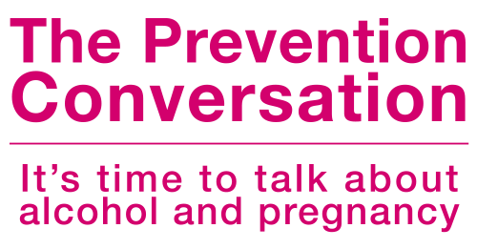



VERSION 3 | August 2025
Notes:
VERSION 3 | AUGUST 2025 – Language updates
VERSION 2 | JANUARY 2023 - Outdated

Slide 2

Contents
Introduction and Objectives
Foundations in FASD
Alcohol Use and Women’s Health
FASD Prevention and Healthy Beginnings
Raising Awareness and Stigma Reduction
Cultural Safety and Identity
Doorways to Conversation
Trauma-Informed Approaches to FASD Prevention
Contraception
Polysubstance Use
Prenatal and Postnatal Support
The Prevention Conversation with Girls
Engaging Partners, and Social Networks
Notes:
According to research published in Prevention of Fetal Alcohol Spectrum Disorder FASD – Who is Responsible? (Institute of Health Economics, 2011), alcohol-related warning messages, alcohol bans, social marketing strategies implemented on a massive scale and similar approaches have little impact on behavior change. How, then, do we carry the message to those who need to hear it? The answer, according to IHE’s findings, lies in interactive approaches.
*Note*: the language throughout will predominately focus on women, but these discussions are inclusive to women, girls, mothers, and individuals with uteruses, their partners and their support networks.
*Note regarding Support Networks*:We also recognize that support networks may have a broader inclusion recognizing that a) women or pregnant people may not have partners but instead rely on a larger support network and b) in Indigenous communities, every person has a role in supporting a pregnancy journey.
Current Canadian Efforts and Analysis of Gaps revealed the following:
We based our study on the four-part framework developed to organize and clarify the complex continuum of interventions involved in FASD prevention. Level 1 prevention is focused on broad awareness building and health promotion and includes prevention campaigns, pamphlets, warning signs and labels, and other forms of public education.
Such public awareness of FASD is foundational to the other levels of FASD prevention. Studies examining the effect of educational campaigns generally report increased knowledge about the effects of alcohol during pregnancy after the intervention. However, this awareness does not always translate into changes in attitude or behavior. Similarly, studies of alcohol warning labels report having moderate to high support, but these labels have little effect on the beliefs of risks associated with alcohol use or changes in alcohol use.
Published online 2016 May 5
https://www.ncbi.nlm.nih.gov/pmc/articles/PMC4861006/

Slide 3



1
SECTION
Introduction
and Objectives
Notes:
Current Canadian Efforts and Analysis of Gaps revealed the following:
We based our study on the four-part framework developed to organize and clarify the complex continuum of interventions involved in FASD prevention. Level 1 prevention is focused on broad awareness building and health promotion and includes prevention campaigns, pamphlets, warning signs and labels, and other forms of public education.
Such public awareness of FASD is foundational to the other levels of FASD prevention. Studies examining the effect of educational campaigns generally report increased knowledge about the effects of alcohol during pregnancy after the intervention. However, this awareness does not always translate into changes in attitude or behaviour. Similarly, studies of alcohol warning labels report having moderate to high support, but these labels have little effect on the beliefs of risks associated with alcohol use or changes in alcohol use.
Published online 2016 May 5
https://www.ncbi.nlm.nih.gov/pmc/articles/PMC4861006/

Slide 4

Why We’re Here
The Prevention Conversation online course will provide an overview of Fetal Alcohol Spectrum Disorder (FASD) prevention and how to engage in meaningful conversations with women and girls who may become pregnant, and their support networks.
OBJECTIVES
To understand the complex reasons why an individual may drink during pregnancy and have the tools to support conversations with pregnant women, individuals, and their support networks
To feel confident in engaging in meaningful conversations to prevent alcohol-exposed pregnancies
To understand and be comfortable discussing harm reduction strategies
To know how to connect with local resources

Slide 5

Acknowledgement of the Land and Peoples
The Prevention Conversation and Canada Fetal Alcohol Spectrum Disorder Research Network acknowledge the First Nations, Inuit, and Métis peoples as the first inhabitants and traditional custodians of the lands in which we live, learn, and work. Throughout the presentation, we have included art pieces from Indigenous artists across Turtle Island that honour Indigenous knowledge systems and capture spiritual, relational, and emotional connections to the modules.

Slide 6

Language Matters
TALKING ABOUT FETAL ALCOHOL SPECTRUM DISORDER (FASD)
FASD is a developmental disability. Like other people with disabilities, people with FASD have many strengths and skills and can lead happy and productive lives. The language we use can challenge stereotypes and people with FASD, promote compassion for women who drank during their pregnancy (for whatever reason), and help others to see people with FASD as more than a disability.
Notes:
For more information on the language we use, see Language Matters: Talking about Fetal Alcohol Spectrum Disorder

Slide 7


It’s time for a different approach
IT’S TIME FOR REAL CONVERSATIONS ABOUT FASD AND HOW TO PREVENT IT
Broad-based awareness campaigns, i.e., social media campaigns or alcohol-related warning messages, are more effective when they are linked to other levels of FASD prevention that encourage and support behaviour change.
The Prevention Conversation is the catalyst for meaningful conversations!

Slide 8

Let’s Talk
DELIVERYING THE PREVENTION CONVERSATION
The Prevention Conversation is about the risks of drinking during pregnancy or before a woman even knows she’s pregnant.
THIS IS BEST DONE BY:
Raising public awareness about the negative effects of drinking alcohol during pregnancy and connecting women and their partners to information and services related to prenatal alcohol use.
Training and supporting health care providers to use tools and techniques designed to engage women in non-judgmental, empathetic conversations about alcohol use during pregnancy.

Slide 9

What We
Deeply Believe
1
FASD can be prevented
FASD is a uniquely complex disability but with the right supports, it can be prevented.
2
No Alcohol during pregnancy
There has been no established safe level of alcohol to be consumed during pregnancy. Experts agree that no alcohol during pregnancy is safest.
3
FASD affects everyone
FASD occurs in all segments of society including all cultures, any social standing and economic status.
Notes:
FASD affects everyone
- FASD occurs in all segments of society including all cultures, any social standing and economic status. Alcohol use in pregnancy does not discriminate. FASD is a highly complex disability intertwined with the social determinates of health and other factors which can affect people from all economic, ethnic, religious, racial or social backgrounds. All populations where alcohol is used are at risk of FASD.

Slide 10

4
Creating safety is crucial
To effectively engage women and their support networks in The Prevention Conversation, we must first create a climate in which they feel safe and free from judgement. Managing the fear, confusion and social stigma that surround the issue of drinking alcohol during pregnancy is crucial to our success. Everyone deserves access to support without judgement or blame.
5
Relationships are important
Most of the work of FASD prevention is relationship-based. The Prevention Conversation cannot unfold effectively outside the framework of a relationship that's trust-based, sincerely caring and openly supportive.
6
FASD Prevention is Complex
On the surface, the prevention of FASD seems strikingly simple: avoiding alcohol during pregnancy completely eliminates the risk. However, the influences on drinking during pregnancy such as addiction and mental health issues, effects of childhood trauma and abuse, poverty and cultural identity, and so on - make the work of FASD prevention highly complex.

Slide 11
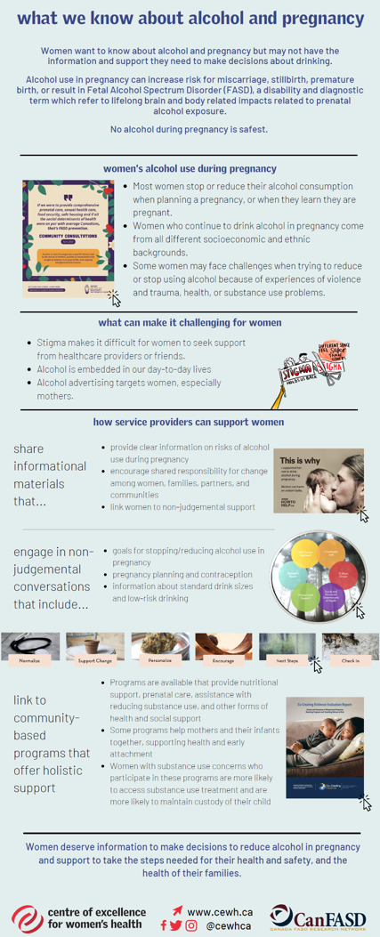
Consistency is Crucial
The effectiveness of a campaign or communications initiative that aims to raise awareness and prompt behaviour change is tied directly to three factors: frequency, impact and consistency.
Frequency
A message can become top of mind only if it repeatedly reaches its target audience with relevant and memorable messages.
Frequency
Impact
To make a lasting impression, a message must be far more than ‘clever’ or ‘catchy’. It must be clear, compelling, and memorable. It must be authentic. And above all, it must matter.
Impact
Consistency
Rigorous adherence to a consistent message through all communication activities is crucial to making an impression and effecting a change of thinking, attitude, belief, or behavior.
This is true for any communications initiative, but it’s especially true for one that must stand up against a glut of mixed, often contradictory messages in the public realm.
The core messages of The Prevention Conversation must compete with countless mixed messages perpetuated on social media and websites, by physicians, researchers, authors, in the news, and so on. To stand any chance of being heard above the noise, consistency is absolutely crucial.
Consistency
https://canfasd.ca/wp-content/uploads/publications/What-we-know-about-alcohol-and-pregnancy.pdf
Notes:
Please click the link for an infographic, developed by the CanFASD Research Network, through its Prevention Network Action Team (pNAT) that describes what we know about alcohol use and pregnancy and preventing FASD.
https://canfasd.ca/wp-content/uploads/publications/What-we-know-about-alcohol-and-pregnancy.pdf

Slide 12

Statement on Respect
Respect, dignity and inherent human worth should be promoted among individuals with FASD, people who use alcohol during pregnancy, and their families.
Respect and acknowledgement is implied to all cultural and gender diverse groups throughout the presentation regardless of how it may be referred to in the content.

Slide 13

2
SECTION
Foundations
in FASD
Definition
Impact of Prenatal Alcohol on Fetus
Strengths and Challenges
Assessment and Diagnostics
FASD Interventions
FASD Prevention

Slide 14

What is FASD?
"Fetal Alcohol Spectrum Disorder (FASD) is a diagnostic term used to describe impacts on the brain and body of individuals prenatally exposed to alcohol.
FASD is a lifelong disability. Individuals with FASD will experience some degree of challenges in their daily living, and need support with motor skills, physical health, learning, memory, attention, communication, emotional regulation, and social skills to reach their full potential.
Each individual with FASD is unique and has areas of both strengths and challenges."
Notes:
FASD is one of the most common neurodevelopmental disabilities in North America. FASD impacts more people in Canada than Autism Spectrum Disorder, Cerebral Palsy, and Down Syndrome combined.
FASD directly impacts at least 4% of people and families in Canada and occurs in all segments of society. This translates to 1.5 million people in Canada, or 1 in 25 people. This means it is possible that one student in every classroom may have FASD. The true rate of prevalence is difficult to know and is thought to be even higher because diagnosis is challenging.
FASD is a lifelong disability but individuals with FASD can achieve positive outcomes if their needs and challenges are addressed early in life and they have access to supports that carry into adulthood.
Sources
CanFASD. FASD Facts. Available from: https://canfasd.ca/fasd-facts/.
Katherine Flannigan, K.U., Kelly Harding, The Prevalence of Fetal Alcohol Spectrum Disorder. 2018.
McFarlane, H., Fetal Alcohol Spectrum Disorder: A Quick Guide for Schools. 2007, Cold Lake, Alberta: Lakeland Centre for Fetal Alcohol Syndrome.

Slide 15

The Leading Disability
FASD is one of the most common neurodevelopmental disabilities in North America. FASD impacts more people in Canada than Autism Spectrum Disorder, Cerebral Palsy, and Down Syndrome combined.
2.5 times more than
19 times more than
Autism
Cerebral Palsy
28 times more than
40 times more than
Down Syndrome
Tourette’s Syndrome

Slide 16
The Canadian Picture of FASD
This translates to more than
1.6 million
people in Canada, or
1 in 25 people
4%
This means it is possible that one student in every classroom may have FASD.
The true rate of prevalence is difficult to know and is thought to be even higher because diagnosis is challenging.
Current studies suggest that conservatively, 4% of individuals in Canada have FASD
61%
of all pregnancies are unplanned
$9.7 BILLION
Total estimated annual investment in Canada = $9.7B
Many pregnancies are undetected in the early weeks
www.canFASD.com
Notes:
FASD is one of the most common neurodevelopmental disabilities in North America. FASD impacts more people in Canada than Autism Spectrum Disorder, Cerebral Palsy, and Down Syndrome combined.
FASD directly impacts at least 4% of people and families in Canada and occurs in all segments of society. This translates to 1.5 million people in Canada, or 1 in 25 people. This means it is possible that one student in every classroom may have FASD. The true rate of prevalence is difficult to know and is thought to be even higher because diagnosis is challenging.
FASD is a lifelong disability but individuals with FASD can achieve positive outcomes if their needs and challenges are addressed early in life and they have access to supports that carry into adulthood.
Sources
CanFASD. FASD Facts. Available from: https://canfasd.ca/fasd-facts/.
Katherine Flannigan, K.U., Kelly Harding, The Prevalence of Fetal Alcohol Spectrum Disorder. 2018.
McFarlane, H., Fetal Alcohol Spectrum Disorder: A Quick Guide for Schools. 2007, Cold Lake, Alberta: Lakeland Centre for Fetal Alcohol Syndrome.
The Burden and Economic Impact of FASD In Canada
Svetlana Popova, February 2015, CAMH, Public Health Agency of Canada
http://www.camh.ca/en/research/news_and_publications/reports_and_books/Documents/Burden%20and%20Eco%20Costs%20FASD%20Feb%202015.pdf
The cost associated with FASD in Canada in 2013 (based on the cost drivers included in this study) totalled approximately $1.8 billion (from about $1.3 billion as the lower estimate to $2.3 billion as the upper estimate). The highest contributor to the overall FASD-attributable cost was the cost of productivity losses due to disability and premature mortality, which accounted for 42% (between $532 million and $1.2 billion) of the overall cost. The second highest contributor was the cost of corrections, accounting for 30% ($378.3 million). The third highest contributor was the cost of health care at 10% (between $128.5 and $226.3 million). Information has since been updated from the Common Messages –Guidelines for Talking and Writing about Fetal Alcohol Spectrum Disorder 2025 (CANFASD).
- www.canfasd.ca
- www.canfasd.ca

Slide 17
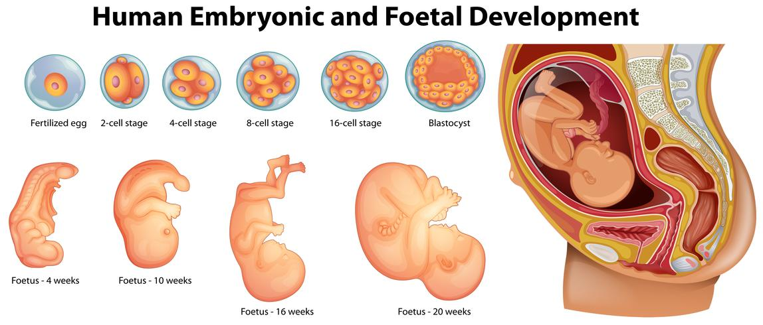
Much of embryogenesis occurs prior to the time that pregnancy is typically recognized.
Impact of Prenatal Alcohol on a Fetus
Alcohol is a teratogen (a substance that disturbs the development of an embryo or fetus)
The development of the brain and central nervous system is constant throughout the entire pregnancy. The consumption of alcohol can affect development at any moment of this critical time.
No one can predict exactly how alcohol will affect a developing baby, but the timing and amount of alcohol consumed, genetic makeup, and maternal nutrition are factors that influence the impact on the developing fetus.
Image courtesy SOGC.
There is no safe time, type, or amount of alcohol to drink during pregnancy.
Notes:
Refer to page 26 of the offspring (Alati et al., 2006. In utero alcohol exposure and prediction of alcohol disorders in early adulthood: A birth cohort study. Arch Gen Psychiatry, 2006, 63(9), 1009-16.for more information on the above bullets

Slide 18

Can FASD occur
only during the
first trimester of
the pregnancy?
The brain and nervous system develop throughout the entire pregnancy, so injury to neurological functions can occur over the entire nine months. The baby’s brain is especially vulnerable to the teratogenic effects of alcohol in early pregnancy.
It is safest not to use alcohol during pregnancy!
Notes:
What does alcohol do to a developing baby?
EVERYTHING a pregnant woman eats, drinks, inhales, sniffs or injects passes to the fetus through the placenta via the umbilical cord.
A baby cannot break down alcohol as quickly as the mother making the alcohol level in the baby much higher and last longer.
Alcohol is a teratogen – a poison that interferes with the normal growth and development of fetal cells.
This effects the normal development of the brain cells, changing their structure and ability to function.

Slide 19


Strengths and Challenges
Each individual with FASD is unique and will have their own strengths and challenges. Being in an environment where strengths are celebrated can transform the learning experience.
In this video, Myles Himmelrich, an adult with FASD, describes his unique experiences of FASD:
Description
FASD = Faith, Ability, Strength, Determination
https://youtu.be/5fm3Ptp9ZMA
Notes:
https://youtu.be/5fm3Ptp9ZMA

Slide 20
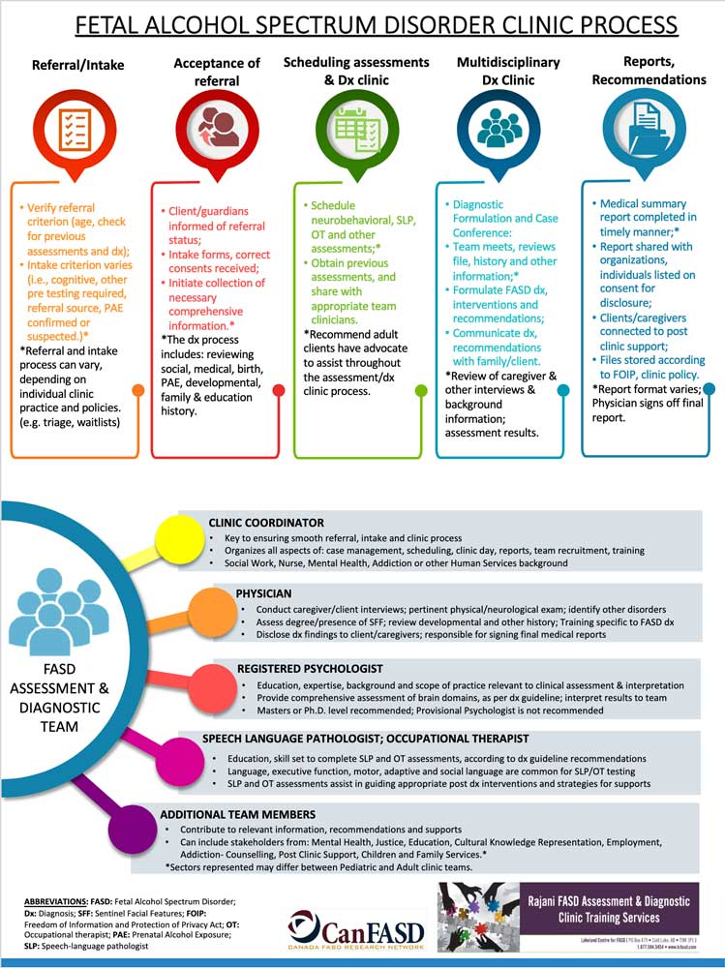
Assessment and Diagnosis
In Canada, we use FASD as the general term to cover anyone who meets criteria for diagnosis
According to the 2015 Canadian FASD Diagnostic Guidelines, FASD diagnosis is organized into 3 separate terms:
FASD with sentinel facial features (a thing that acts as an indicator of the presence of disease)
FASD without sentinel facial features
At risk for neurodevelopmental disorder and FASD, associated with prenatal alcohol exposure (PAE)
https://canfasd.ca/wp-content/uploads/publications/FASD-Clinic-Process.pdf
Sources: CanFASD. FASD Diagnostic Clinic Cards. Available from: https://canfasd.ca/topics/diagnosis/fasd-faq-cards/.
Notes:
The first two terms are diagnostic labels, while the third is a non-diagnostic category indicating that the assessed individual does not currently meet diagnostic criteria for FASD but requires follow-up and support.
Prior to 2015, individuals could be diagnosed with Fetal Alcohol Syndrome (FAS), partial FAS (pFAS), or Alcohol-Related Neurodevelopmental Disorder (ARND). FASD with or without sentinel facial features replaced FAS, pFAS, and ARND, which are no longer used as diagnostic terms.
Although the Common Messages (Guidelines – CANFASD 2025) prefers that FASD is not referred to as an ‘invisible disease’ and would rather we use messaging such as a disability/FASD with no physical signs and considering that sentinel facial features are in fewer than 10% of all FASD cases, since the Canadian FASD Diagnostic Guidelines still uses sentinel features as diagnostic criteria, we have left it in this manual.

Slide 21
Signs and Symptoms
Individuals with FASD are at increased risk for:
mental health issues
school difficulty, addictions
trouble with the law
difficulties maintaining employment
FASD often goes undiagnosed or misdiagnosed.
Communication
Signs and symptoms are hard to recognize in babies and young children, so individuals with FASD often aren’t diagnosed until they are school-aged or teenagers.
Challenges with communication – can be highly verbal, but lack comprehension skills both written and verbal
Decisions
Movement
Challenges with executive functioning
Challenges with neuromotor defects – impaired balance and coordination
Notes:
Sources
Pei, J., et al., Best Practices for FASD Service Delivery: Guide and Evaluation Toolkit. 2015, Alberta Clinical and Community-Based Evaluation and Research Team, Alberta.

Slide 22

FASD Interventions
There are four overarching principles of practice, which many of the best practices already incorporate, that are important to FASD.
Consistency
Collaboration
Responsiveness
Proactivity
Notes:
Consistency
Common understanding of FASD throughout all staff
Common message and approach to providing services
Minimizing staff turnover and building relationships
Service structure and stability within systems
Collaboration
Integrated response systems at all organizational levels
Organizational support for complex case management
Coordination of referrals
Intentional planning between types of services and levels of service delivery
Responsiveness
Balance between dependency and complete independence
Expectations are unique to individual strengths and needs
Competency development in a supportive and adaptive environment
Proactivity
Anticipate rather than respond
Early intervention to develop positive behaviours
Planning for transition periods
These were adapted from Pei et al. 2015 and Pei et al. 2018:

Slide 23

FASD Prevention
Recent data show that risky drinking, or drinking above the recommended limit, among women of childbearing age (10 to 49 years) is rising. According to the Public Health Agency of Canada (2016), 56% of childbearing aged women reported binge drinking at least once vs. 44% in 2004.
Experts recommend that women go alcohol-free if:
They’re pregnant
Planning to get pregnant, or
Having unprotected sex (i.e., when there is potential for an unplanned pregnancy).
It is safest not to drink alcohol during pregnancy. Stopping or reducing your alcohol consumption at any time during pregnancy can improve the health and wellbeing of you and your child.
Research shows that partners’ drinking habits influence the drinking pattern of mothers.

Slide 24

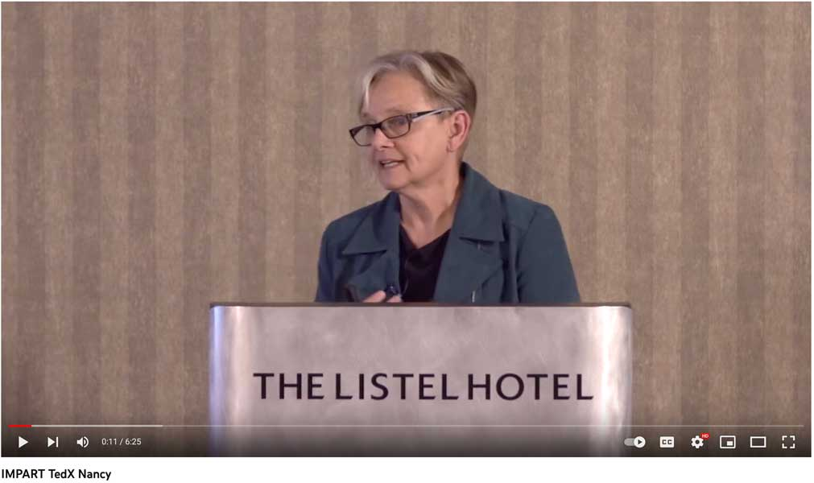
Women’s Health
and Prevention
FASD prevention is not only important for the child but is essential for women’s health. Researchers, community members, professionals, and experts have identified 10 fundamental components for
FASD prevention should support women’s health and social concerns.
Description
In this video, researcher Nancy Poole discusses how preventing FASD is about gender, trauma, addiction, and harm reduction:
https://youtu.be/ZVm3XgcLTg0
https://canfasd.ca/wp-content/uploads/2016/09/PREVENTION-of-Fetal-Alcohol-Spectrum-Disorder-FASD-A-multi-level-model.pdf
Notes:
https://youtu.be/ZVm3XgcLTg0
https://canfasd.ca/wp-content/uploads/2016/09/PREVENTION-of-Fetal-Alcohol-Spectrum-Disorder-FASD-A-multi-level-model.pdf

Slide 25



3
SECTION
Alcohol Use and Women’s Health
Quick facts on alcohol use in Canada
Explore sex and gender factors related to alcohol use
Problematic alcohol use
Canada’s Guidance on Alcohol and Health
The Beauty of Life Givers by Jessica Somers

Slide 26

Alcohol Consumption in Canada
As of January 2021
of Canadians aged 15 years and older reported using alcohol at least once in the past 30 days.
66%
PREVALENCE OF ALCOHOL USE
The prevalence of alcohol use remains higher among boys and men but are increasing among women and girls.
The number of people reporting
per occasion increased from 11% before the COVID-19 pandemic to 18% during the COVID-19 pandemic.
5+ drinks
Among girls and women, the highest increase in past-year heavy drinking was seen among women 25 years and older (86%).
During the COVID-19 pandemic,
In 2018, rates of heavy drinking were 24% for Canadian men and 15% for Canadian women among all age groups; however, rates of heavy drinking were much higher for young Canadian women ages 18-34 (24% of young women compared with 34% of young men).
37%
of women reported both moderate-to-severe anxiety and increased alcohol use. Women reported the most mental health concerns, particularly in households with children under 13.
Notes:
Alcohol use increased during the COVID-19 pandemic out of stress, boredom, loneliness, and as a means to cope with not having a regular routine and with mental health concerns

Slide 27
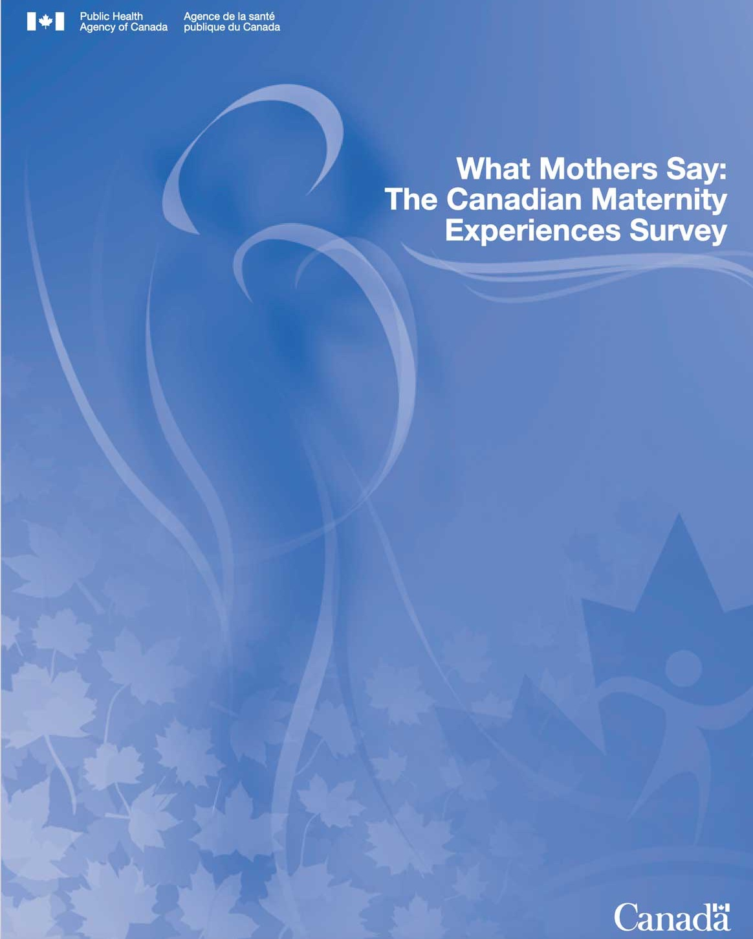
Findings from the Maternity Experiences Survey
4%
of women consumed alcohol in the three months prior to pregnancy.
2015
5%
of women reported alcohol use during pregnancy.
The Maternity Experiences Survey was a 2006-2007 survey of Canadian women that sought to understand women's experiences, perceptions, knowledge and practices before, during and following pregnancy.
A higher percentage of women above the low-income line reported drinking alcohol during pregnancy compared to women below the low-income line.
The proportion of alcohol use during pregnancy increased with maternal age.
https://www.canada.ca/content/dam/phac-aspc/migration/phac-aspc/rhs-ssg/pdf/survey-eng.pdf
Notes:
Sources
Government of Canada. (2021). Alcohol use among Canadians. Available from: https://health-infobase.canada.ca/alcohol/ctads/
Mental Health Commission of Canada. (2021). Mental health and substance use during COVID-19: Summary report 2- Spotlight on gender and household size. Available from: https://www.mentalhealthcommission.ca/sites/default/files/2021-05/mhcc_ccsa_covid_leger_poll_2_eng.pdf
Statistics Canada. (2019). Heavy drinking, 2018. Ministry of Industry: Ottawa, ON.
Statistics Canada. (March 4, 2021). Alcohol and cannabis use during the pandemic: Canadian Perspectives Survey, Series 6. Statistics Canada: Ottawa, ON.

Slide 28
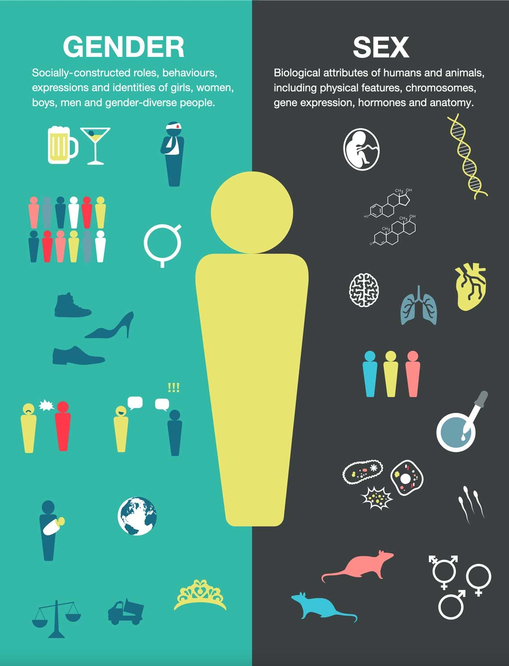
Sex vs Gender
Sex and gender factors impact the patterns of effects of alcohol use among women.
Sex refers to a set of biological attributes in humans and animals. Female and male bodies have different genetic and physiological characteristics that affect the processes of how substances are metabolized, effects on the brain, tolerance and dependence.
Gender refers to socially constructed roles, behaviors, expressions, and identities of girls, women, boys, men, and trans and gender diverse individuals. Gender-related factors affect individuals' risks for use, exposure to marketing or exploitation, access to care and services, and the societal response.
https://cihr-irsc.gc.ca/e/documents/igh_s17_infographic_gender_sex-en.pdf
Notes:
https://cihr-irsc.gc.ca/e/documents/igh_s17_infographic_gender_sex-en.pdf

Slide 29

Key Sex-Related Factors
Females transition from alcohol initiation to regular use faster than males.
Females develop, and have more progressive liver injuries, even when consuming lower quantities of alcohol.
Females have less of an enzyme which breaks down alcohol in the stomach and therefore require smaller amounts of alcohol to become intoxicated/reach higher blood alcohol concentration.
Girls who binge drink demonstrate poorer sustained attention and working memory than boys who binge drink.
Increased rates of alcohol use during pregnancy can lead to miscarriage, stillbirth, premature birth, or FASD.

Slide 30

Key Gender-Related Factors
Co-occurring depression and substance use is more common among women and girls, who may be more likely to use alcohol and other substances as a coping mechanism or to respond to peer pressure.
Transgender individuals may use substances to socially validate or affirm their gender identity. Transgender men’s alcohol use may be influenced by the societal belief that excessive drinking is associated with masculinity.
Intergenerational trauma is closely linked with substance use, including alcohol use, among Indigenous women.
Notes:
Sources
Greaves, L., Poole, N., Brabete, A. C., Hemsing, N., Stinson, J. & Wolfson, L. (2020). Sex, gender, and alcohol. Centre of Excellence for Women’s Health: Vancouver, BC.
Lyall, V., Wolfson, L. et al. (2021). “The Problem is that we hear a bit of everything… ”: A qualitative systematic review of factors associated with alcohol use, reduction, and abstinence in pregnancy. International Journal of Environmental Research and Public Health, 18(7), 3445. https://doi.org/10.3390/ijerph18073445

Slide 31

Women’s alcohol use in pregnancy may be influenced by:
poverty
history of trauma and violence
physical and mental health concerns
child welfare involvement
not knowing they are pregnant
advice from family and friends about ‘safe’ alcohol consumption.

Slide 32

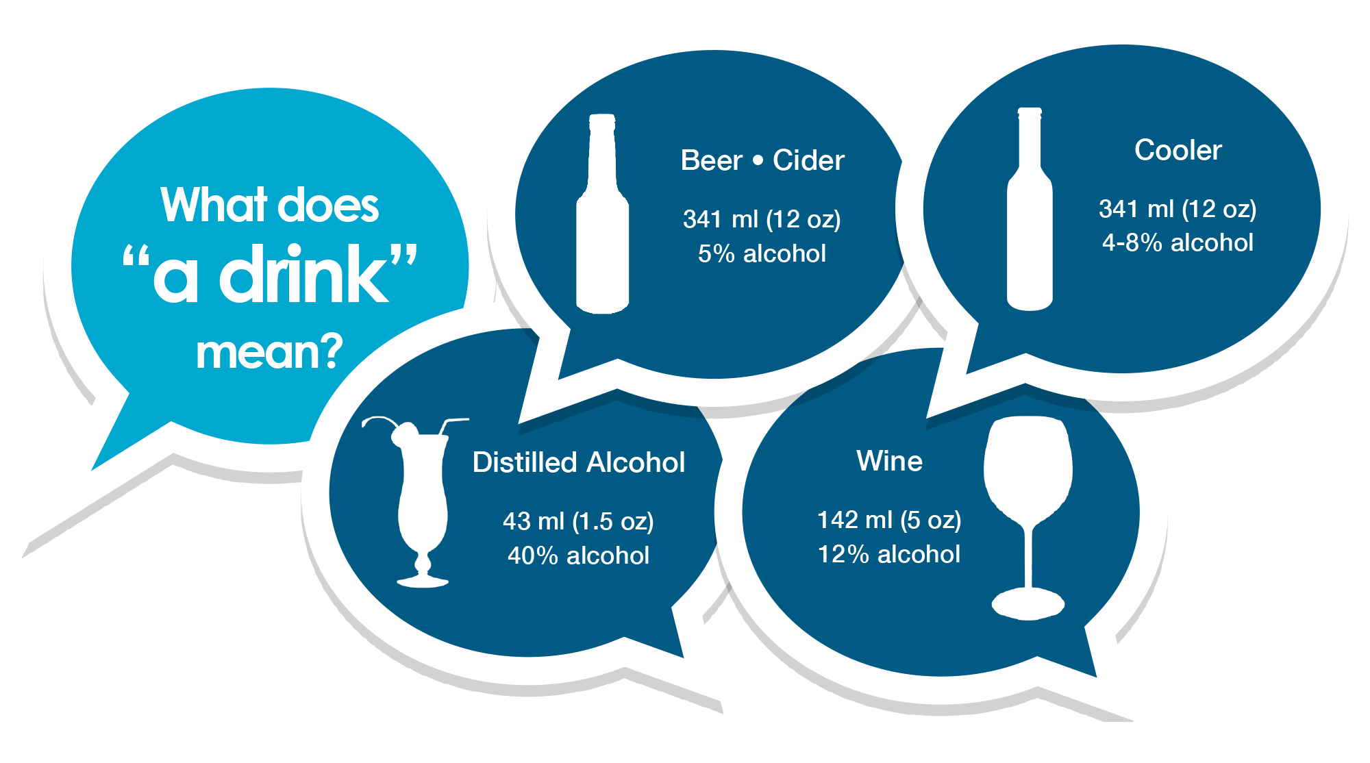
Understanding Alcohol Use Disorder
Alcohol Use Disorder (AUD) is a medical condition characterized by an inability to stop or control alcohol use despite harms to an individuals’ health, interpersonal relationships, ability to work, etc. Symptoms may include:
Drinking more alcohol or drinking for longer than intended
Inability to stop or cut down alcohol use
Spending a lot of time drinking or recovering from the effects of alcohol
Difficulty thinking about things other than alcohol
Failure to fulfill major responsibilities at work, school or home
Drinking in dangerous situations, such as drinking while driving or operating machinery
Spending less time on things that bring joy in order to drink
Continuing to drink despite it leading to feelings of anxiety, depression, or memory loss
Physical illness when drinking stops
Binge Drinking can increase the risk for an AUD. Binge drinking brings blood alcohol concentration to 0.08% or above (equivalent to an average female consuming more than three drinks on one occasion).

Slide 33

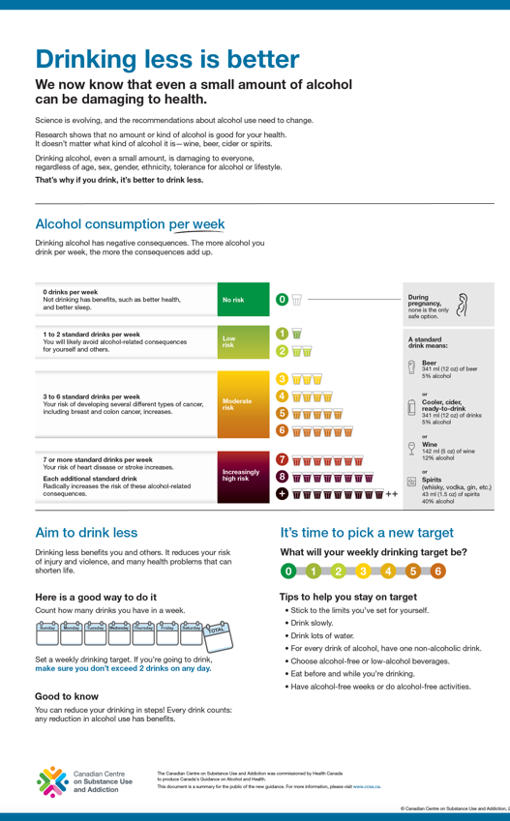
Canada’s Guidance on Alcohol and Health
We now know that even a small amount of alcohol can be damaging to health.
Science is evolving, and the recommendations about alcohol use need to change.
Research shows that no amount or kind of alcohol is good for your health. It doesn’t matter what kind of alcohol it is—wine, beer, cider or spirits.
Drinking alcohol, even a small amount, is damaging to everyone, regardless of age, sex, gender, ethnicity, tolerance for alcohol or lifestyle.
That’s why if you drink, it’s better to drink less.
Description
https://ccsa.ca/sites/default/files/2023-01/CGAH-Drinking-Less-is-Better-en%20%28ID%2050809%29.pdf
Notes:
https://ccsa.ca/sites/default/files/2023-01/CGAH-Drinking-Less-is-Better-en%20%28ID%2050809%29.pdf

Slide 34
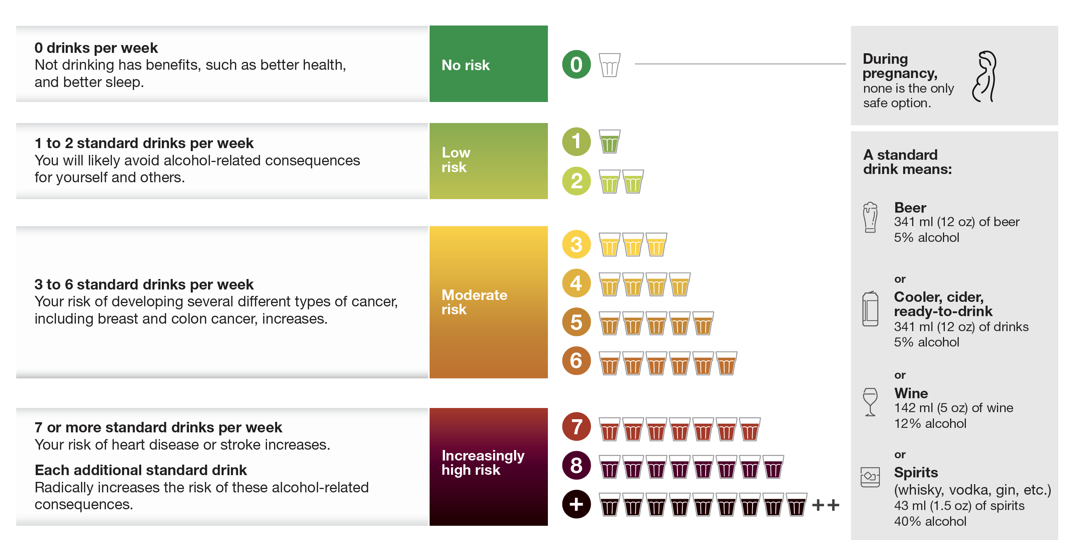
Alcohol consumption per week
Drinking alcohol has negative consequences. The more alcohol you drink per week, the more the consequences add up.
Consuming more than 2 standard drinks per week or occasion is associated with a significant increase in risk of harms to self and others.
https://ccsa.ca/canadas-guidance-alcohol-and-health-public-summary-drinking-less-better-infographic
Notes:
https://ccsa.ca/canadas-guidance-alcohol-and-health-public-summary-drinking-less-better-infographic

Slide 35

Key Takeaways
from Canada’s Guidance on Alcohol and Health
Sex and gender are important and both influence alcohol use and the risks associated with alcohol use
The risks associated with alcohol use are greater among youth. Youth should delay alcohol use as long as possible
No alcohol is safest when:
Pregnant, trying to get pregnant, or breastfeeding
Operating a motor vehicle, using machinery, or tools
Taking medicine or other substances that interact with alcohol
Responsible for the safety of others
Making important decisions
Notes:
Sex and gender: Alcohol use and harms are influenced by both sex-based physiological differences, as well as many gender-related factors, including alcohol marketing tactics, and gender roles, attitudes and expectations. Many harms from alcohol use are gender-related, including stigma, sexual assault and intimate partner violence. Men’s use per occasion is more likely to lead to injury, violence, and death. There are more risks to females compared to males when drinking at the high end of the moderate zone of consumption (6+ drinks/week).
Youth: Alcohol use is a leading behavioural risk factor for death and social problems among youth and young adults, and alcohol is the most common psychoactive substance used by this age group. Even for the same number of drinks consumed per drinking occasion, the risk of adverse outcomes from alcohol consumption is greater for youth than for adults. This may be due to several factors, including greater impulsivity and less emotional maturity among youth, lower body mass on average, less experience doing complex tasks that are made more dangerous by alcohol (e.g., operating a motor vehicle) and faster drinking speeds

Slide 36

Aim to drink less
Drinking less benefits you and others. It reduces your risk of injury and violence, and many health problems that can shorten life.
Tips to help you stay on target
Stick to the limits you’ve set for yourself.
Drink slowly.
Drink lots of water.
For every drink of alcohol, have one non-alcoholic drink.
Choose alcohol-free or low-alcohol beverages.
Eat before and while you’re drinking.
Have alcohol-free weeks or do alcohol-free activities.
Notes:
https://ccsa.ca/canadas-guidance-alcohol-and-health-public-summary-drinking-less-better-infographic

Slide 37
Safer Drinking Tips
For every drink of alcohol, have one non-alcoholic drink.
Choose alcohol-free or low-alcohol beverages.
Eat before and while you are drinking.
Drink slowly. Have no more than two drinks in any three hours.
Always consider your age, body weight and health problems that might suggest lower limits.
If you are pregnant, planning to become pregnant, or breastfeeding,
the only safe choice is no alcohol.

Slide 38

Supporting Women During Pregnancy
If a woman is planning a pregnancy, it is safest for her to stop drinking alcohol before she becomes pregnant and avoid alcohol during her pregnancy.
Many pregnancies are unplanned, and a woman may not know she is pregnant for some time. Ceasing alcohol consumption as soon as she finds out she is pregnant will reduce the potential for harm.
From a harm reduction perspective, the best message is, “It’s never too late to quit or cut down.”
A healthy baby isn’t just a mother’s responsibility. Everyone plays a role.

Slide 39

4
SECTION
FASD Prevention and Healthy Beginnings
Facts about the impacts of drinking during pregnancy and factors that increase risk for alcohol use during pregnancy
Various levels of FASD prevention
Brief alcohol interventions in your practice
The Woman and the Water by Colleen Gray
“She kept her child safe in the waters of her body. She found comfort in the song of the wolf and in the light of Grandfather Moon. The child was the center of it all, cradled lovingly in the womb of water and earth.”

Slide 40
Understanding alcohol
and pregnancy
Experts agree that there is no safe amount of alcohol to drink during pregnancy. It is well established that drinking at any stage of pregnancy can cause FASD, but the exact amount required to cause damage is unknown.
Many factors can influence the impact of prenatal alcohol exposure (PAE) on a developing baby:
!
dose of alcohol
!
general health and nutrition of the mother
!
pattern and timing of exposure
mother’s level of stress and/or trauma
!
!
whether the mother also smoked and/or used other drugs
!
parents’ genetics and epigenetic changes
!
mother’s age
Despite Canada’s Guidance on Alcohol and Health, women of childbearing age (15 to 49 years) are drinking in a risky manner more than ever, which makes preventing alcohol-exposed pregnancies crucial.
Notes:
Sources
Guerri, C., A. Bazinet, and E.P. Riley, Foetal Alcohol Spectrum Disorders and alterations in brain and behaviour. Alcohol Alcohol, 2009. 44(2): p. 108 - 114.
Statistics Canada. Canadian Community Health Survey – Annual Component 2009-2010. 2011; Available from: http://www23.statcan.gc.ca/imdb-bmdi/pub/document/3226_D71_T9_V1-eng.pdf

Slide 41
… And The False Information!
I read about a new study on the internet yesterday which said…
It’s not good to deprive yourself. 1-2 drinks at a time is nothing to worry about.
?!
!?
A little alcohol can’t hurt, especially later in your pregnancy.
Back in the 1960s and 1970s, everyone drank. It wasn’t a problem then…
!?
?!
Advice is always changing. Everything in moderation is the best thing.
?!
!?
I drank while I was pregnant, and my kids are fine.
Notes:
Sources
Astley, S.J., et al., Fetal alcohol syndrome (FAS) primary prevention through FAS diagnosis: II. A comprehensive profile of 80 birth mothers of children with FAS. Alcohol Alcohol, 2000. 35(5): p. 509 - 519.
Grant, T.M., et al., Preventing Alcohol and Drug Exposed Births in Washington State: Intervention Findings from Three Parent-Child Assistance Program Sites. The American Journal of Drug and Alcohol Abuse, 2005. 31(3): p. 471-490.
Lyall, V., Wolfson, L. et al. (2021). “The Problem is that we hear a bit of everything… ”: A qualitative systematic review of factors associated with alcohol use, reduction, and abstinence in pregnancy. International Journal of Environmental Research and Public Health, 18(7), 3445. https://doi.org/10.3390/ijerph18073445
Nathoo, T., et al., Doorways to conversation: Brief intervention on substance use with girls and women. 2018, Centre of Excellence for Women’s Health: Vancouver, BC.
Schmidt, R., et al., Mothering and opioids: Addressing stigma and acting collaboratively. 2019, Centre of Excellence for Women’s Health: Vancouver, BC.

Slide 42

Why is FASD Prevention Important?
Preventing alcohol use during pregnancy can positively impact the life of the mother, the child, the family, and the community.
Prevention of alcohol use within a broad range of health and social service providers are well positioned to work with women and girls to reduce their alcohol use and support them with other issues that affect their substance use behaviors using a range of approaches to support women and children’s health.
Respectful
Self-Determining
Trauma and Violence Informed
Harm Reduction Oriented
Relational
Women+ Centered
Uses a FASD-Informed and Disability Lens
Health Promoting
Culturally Safe
Supportive of Mothering

Slide 43


A Letter from Jane
This video, ‘A Letter from Jane’ captures the voices of women who have participated in HerWay Home, a FASD prevention program in Victoria, BC, describing their experience.
Description
A Letter from Jane
https://youtu.be/wXC6LmNXrDE

Slide 44
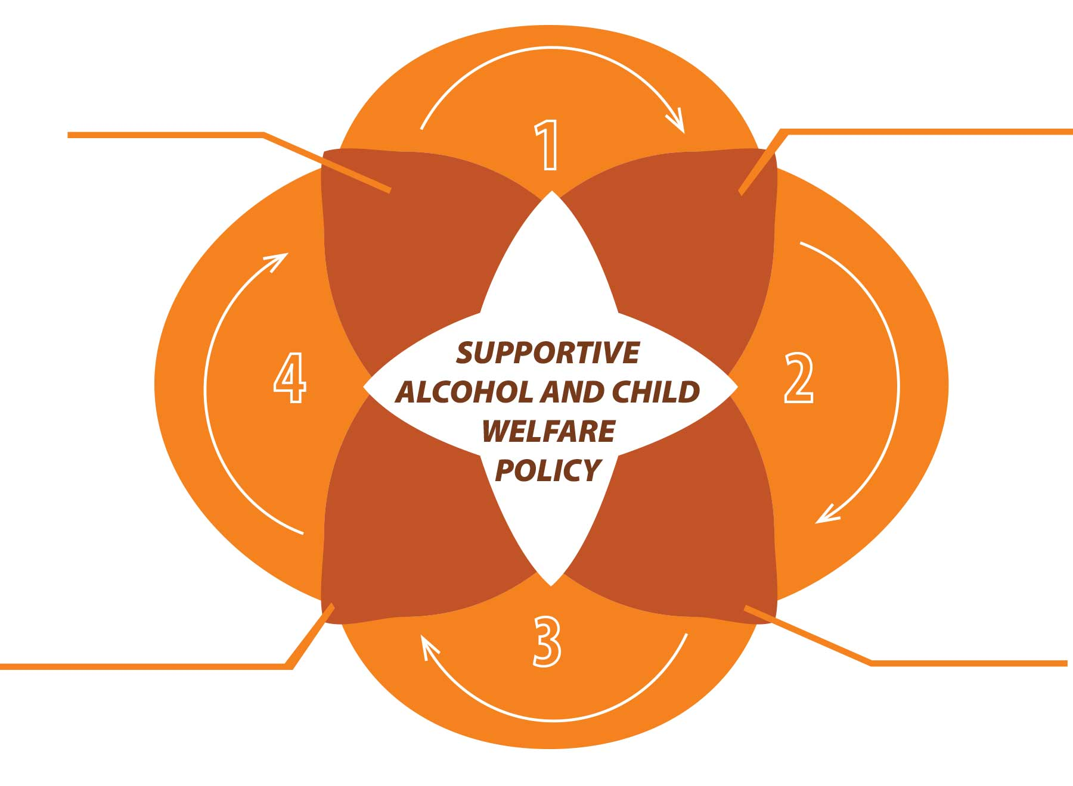
Levels of FASD Prevention
FASD prevention is incredibly complex and should use a holistic approach that addresses the numerous risk factors for drinking that are intertwined with the social determinants of health.
Level 4
Level 1
Postpartum support for new mothers and support for children assessment and development
Broad awareness building and health promotion efforts
Level 3
Level 2
Specialized, holistic support of pregnant women with alcohol and other health/social problems
Discussion of alcohol use and related risks with all women of childbearing years and their support networks
Notes:
Sources
Astley, S.J., et al.. (200). Fetal alcohol syndrome (FAS) primary prevention through FAS diagnosis: II. A comprehensive profile of 80 birth mothers of children with FAS. Alcohol Alcohol, 35(5), 509 - 519.
Mikkonen, J. and D. Raphael. (2010). Social Determinants of Health: the Canadian Facts. Available from: http://thecanadianfacts.org.
Nathoo, T., et al., (2018). Doorways to conversation: Brief intervention on substance use with girls and women. Centre of Excellence for Women’s Health: Vancouver, BC.
Poole, N., (2008). Fetal Alcohol Spectrum Disorder (FASD) Prevention: Canadian Perspectives. PHAC: Ottawa, ON.
Popova, S., et al. (2016). The Economic Burden of Fetal Alcohol Spectrum Disorder in Canada in 2013. Alcohol Alcohol, 51(3), 367 - 375.

Slide 45

What are healthy beginnings?
Some people and communities may prefer to use the language of ‘healthy beginnings’ rather than FASD prevention. This may be due to stigma surrounding FASD or out of a desire to holistically support the emotional, spiritual, physical, and mental wellbeing of the mother, the child, the family, and the community.
Use non-stigmatizing language
Identify existing programs and their strengths
Connect with those who have walked before us
In this video from First Nations Health Authority, Lucy Barney talks about the role of life givers, and how those teachings have facilitated healthy beginnings.
https://youtu.be/X3wiwYlW7jw
Notes:
1. Use non-stigmatizing language
Our language can help women feel safe to ask questions and encourage women to seek help if they’re having difficulties stopping or reducing their substance use. Using non-judgmental language and understandings may require us to reframe prevention programming to use terminology and approaches that are more supportive of individuals and their cultural worldviews.
2. Identify existing programs and their strengths
Identifying community strengths, what communities need, and how linkages may be made, can help support the collaboration across community resources and improve health. In some communities, the linkage of programs and services, rather than creating a dedicated FASD prevention program, will be key to supporting healthy families.
3. Connect with those who have walked before us
Existing FASD prevention programs and knowledge can help us learn from their successes and challenges. Revitalizing Culture and Healing: Indigenous Approaches to FASD Prevention includes examples of how traditional teachings and guidance from an Indigenous wholistic perspective are making a difference for women, their families, and their communities. These examples can help us expand and decolonize our thinking around what FASD prevention can look like and move us towards Indigenous wellness models.
https://youtu.be/X3wiwYlW7jw

Slide 46



5
SECTION
Raising Awareness and Stigma Reduction
Raising awareness and health promotion for FASD prevention
What is stigma and strategies to reduce stigma
Surrounded by Love by Cody Houle
"When I think of wellness, I think of self care and self love. For me my culture and my art provides me self care. I am able to express myself and release my thoughts and emotions into my work."

Slide 47
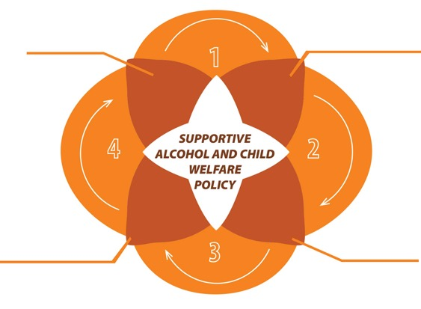

Level 1
Broad awareness building and health promotion efforts
Level 1 FASD Prevention
Awareness/health education
(e.g., pamphlets, posters, and awareness campaigns about girls’ and women’s health, FASD, and FASD prevention)
Health promotion
(e.g., facilitators materials for girls’ and women’s empowerment groups and community-wide strategies)
Alcohol policy
(e.g., low-risk drinking guidelines and warning labels on alcohol containers)
Notes:
This level of prevention is foundational because of its capacity to build general awareness. While this level of prevention can result in alcohol reduction, the campaigns must be stigma reducing, use evidence-informed messaging, and, in some cases, include tailored messaging to population subgroups.

Slide 48

Understanding
Stigma
Women who drink alcohol during pregnancy and those with FASD, their families, and their support networks are often stigmatized.
Women who use substances during pregnancy or parenting experience stigma as they are not perceived as a ‘good’ mother and that they don’t care.
Stigma
is a set of damaging attitudes, stereotypes, and discriminatory behaviors.
Improving awareness campaigns will help to reduce stigma and discrimination towards women who use alcohol in pregnancy and individuals with FASD.
Stigmatization
is the product of these attitudes, stereotypes, and behaviors.
Misinformation and campaigns that portray women as irresponsible, or villainous do not consider the many reasons why a women may use alcohol during pregnancy.
Notes:
Sources
Kendall-Taylor, N. and M. Fond, (2017). Reframing Fetal Alcohol Spectrum Disorder: Studying Culture to Identify Communication Challenges and Opportunities. Studies in Media and Communication, 5(2): p. 105 - 117.
Johnston, S. and J.S. Boyle (2013). Northern British Columbia Aboriginal mothers: Raising adolescents with Fetal Alcohol Spectrum Disorder. Journal of Transcultural Nursing, 24(1), 60 - 67.
Salmon, A., (2011). Aboriginal mothering, FASD prevention and the contestations of neoliberal citizenship. Critical Public Health, 21(2), 165 - 178.
Werner, S. and C. Shulman (2015) Does type of disability make a difference in affiliate stigma among family caregivers of individuals with autism, intellectual disability or physical disability? Journal of Intellectual Disability Research, 59(3), 272-283.

Slide 49

More Ways to Reduce Stigma
Stigma is considered one of the biggest barriers to women accessing and receiving care. If pregnant women that use substance feel discriminated against or judged, they may not seek the help they need for themselves or their children.
Women may avoid accessing preconception and prenatal care out of fear of child apprehension or criminalization.
Women need to feel comfortable seeking support and treatment. The messaging must not be stigmatizing, and instead should be compassionate, strengths-based, trauma-informed, and harm reduction oriented.
Notes:
Pg. 36 in Let’s Talk Manual for more information

Slide 50
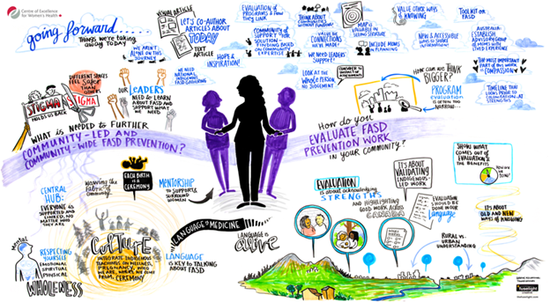
6
SECTION
Cultural Safety and Identity
Cultural safety and its importance to The Prevention Conversation
Truth and Reconciliation Commission of Canada
Advancing Collaborative Action on Fetal Alcohol Spectrum Disorder by Tanya Gatsby
Notes:
This graphic recording, captured by Tanya Gastby at Fuselight Creative, reflects the second half of a workshop that brought together Indigenous program providers involved in offering community-led and culture-driven FASD prevention programs. The recording captures the importance of culture, language, land, and lineage in furthering FASD prevention and healthy beginnings.

Slide 51
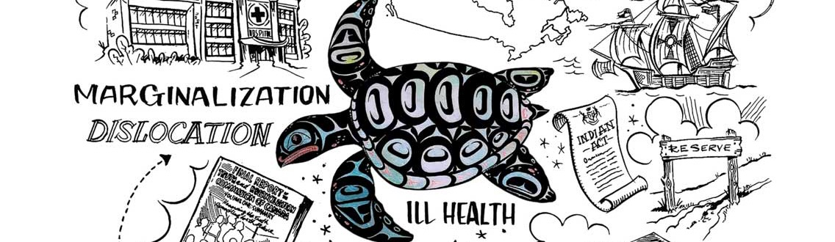
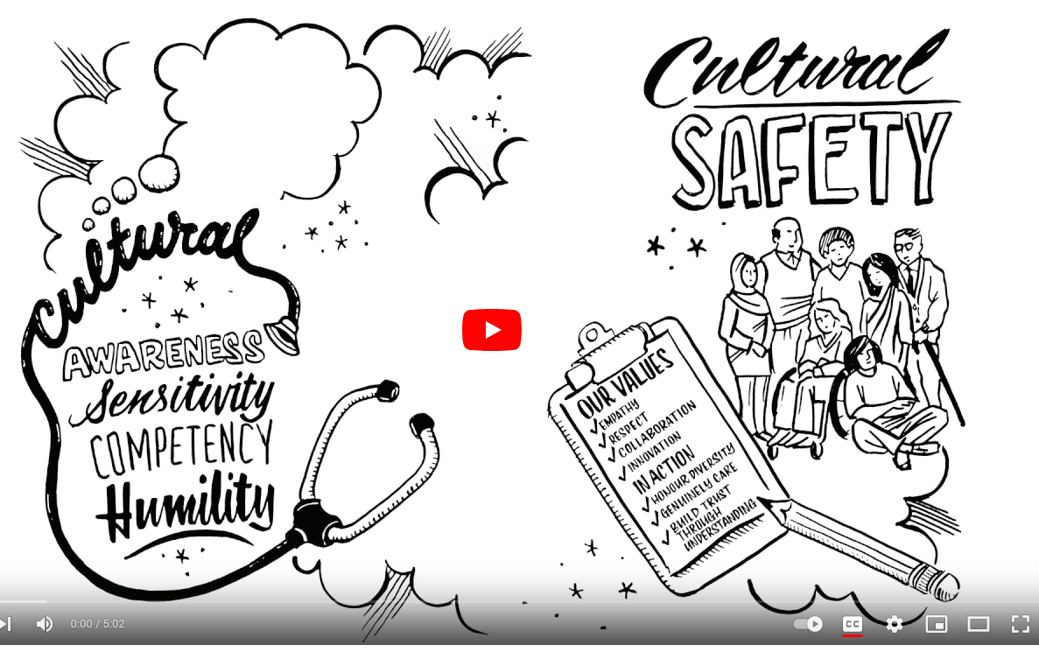
Cultural Safety
The goal of cultural safety is for people of all backgrounds to feel safe and respected when they interact with programs and services.
This video was developed by Northern Health in BC and provides an animated introduction to the importance of cultural safety when working with Indigenous peoples.
Description
https://youtu.be/MkxcuhdgIwY
Notes:
https://youtu.be/MkxcuhdgIwY

Slide 52

Prenatal alcohol exposure is a risk in all populations where alcohol is used.
Description

Slide 53
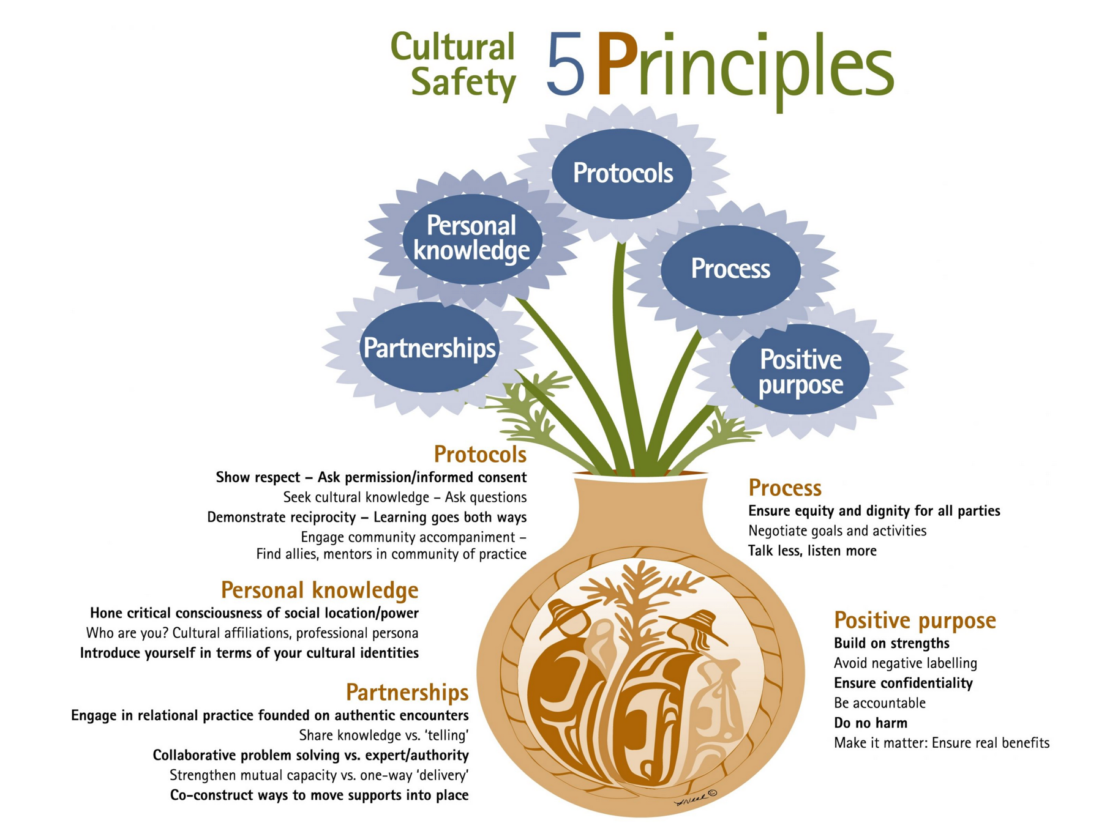
Principles to Promote Cultural Safety
Protocols: Find out about cultural forms of engagement and respect these.
Personal knowledge: Become mindful of one's own cultural identity and socio-historical location.
Partnerships: Promote collaborative practice.
Process: Engage in mutual learning, frequent checking in.
Positive purpose: Ensure positive steps to achieve a service recipient's goals. Make it matter.
https://ecdip.org/cultural-safety/
Notes:
The image below summarizes research by Jessica Ball and other researchers at the University of Victoria on what helps to create culturally safe programs, services, and systems. Practicing these principles can increase the likelihood that a person will feel respected, included, and protected in terms of their cultural identity and their own goals and values.
Five principles to engender cultural safety
1. Protocols
Find out about cultural forms of engagement and respect these.
2. Personal knowledge
Become mindful of one's own cultural identity, socio-historical location in relation to service recipients, commitments to certain beliefs and ways of conceptualizing things like health, wellness, and optimal child development. Be prepared to share information about oneself if this will help to create equity and trust.
3. Partnerships
Promote collaborative practice in which those seeking help are also welcomed into a joint problem-solving approach as carriers of important information and know-how.
4. Process
Engage in mutual learning, frequent checking in to ensure that proposed action plans 'fit' with service recipient's values, preferences, and lifestyles.
5. Positive purpose
Ensure that there is a good probability that positive steps to achieve a service recipient's goals (or resolve problems) can be taken and that these are likely to be beneficial. Make it matter.

Slide 54
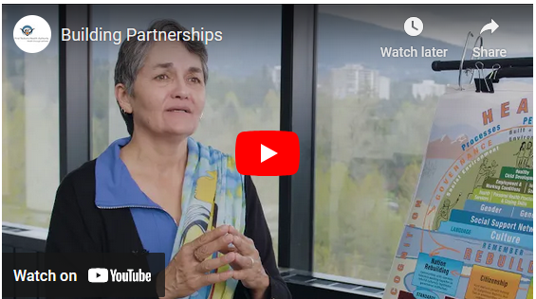
Ask yourself:
Situating Yourself and Building Relationships
What are the protocols, social structures and social nuances of the communities and people in your area?
How may your upbringing impact what you believe is ‘culturally safe’?
What services in your community provide care and support to Indigenous or other multi-cultural people or provide culture-specific programming?
What are the traditional territories of the Indigenous groups in your area? (Resources like native-land.ca may be helpful to you).
People are unique, so it is important to create and deliver services that are respectful of unique culture(s) and influences.
https://youtu.be/_yklWpOV9Vc
Notes:
What are the protocols, social structures and social nuances of the communities and people in your area? Is there anything that might affect your conversations when working with Indigenous people? (For example, in some cultures, direct questions and eye contact might not be considered acceptable).
How may your upbringing impact what you believe is ‘culturally safe’?
What services in your community provide care and support to Indigenous people or provide Indigenous-specific programming?
Building relationships are fundamental to working with Indigenous peoples and communities. These should be based on trust, respect, self-determination, and commitment.
In this video from First Nations Health Authority, Gwen Phillips describes the primary role of relationships and trust in creating partnerships that support community-driven, nations-based approaches.

Slide 55


Diversity and
Multi-culturalism
Canada is a beautiful, diverse and multi-cultural country. It is important to recognize the cultural differences, beliefs, and nuances of each culture to achieve trust and respect.
Notes:
Cultural groups in Canada have many differences and similarities. For instance, many cultural groups have those they refer to as elders, who may be the first point of contact in the group.
Make sure you have completed your research, you have learned about the cultural expectations as a presenter, and that you have made the appropriate connection to be invited into the group.
This might be an introduction from another in the group that now trusts you.
While FASD can affect people from all racial, ethnic and sociological backgrounds, the data from 69 previously published studies of people in 17 countries — including Canada, the United States, South America, Europe, Asia and Australia. — shows prevalence rates are particularly devastating for certain subpopulation groups.

Slide 56

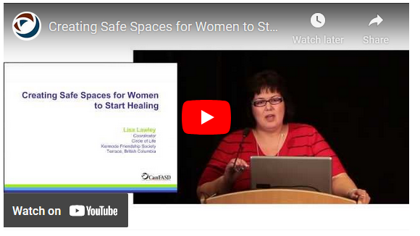
Safe Spaces for Conversations
Description
In this video, Lisa Lawley talks about creating safe spaces for Indigenous women to talk about alcohol and pregnancy. Lisa is Tahltan Tlingit, English, and Japanese and the mother of six children (three who have been diagnosed with FASD).
https://youtu.be/R00UAIWMfG8
Notes:
Ideally, Indigenous peoples who take part in the Prevention Conversation training in person will see their involvement as a safe space to share their experiences, receive support for their choices, and to learn about new ways to take care of themselves and connect with resources in the community.
In this video, Lisa Lawley talks about creating safe spaces for Indigenous women to talk about alcohol and pregnancy. Lisa is Tahltan Tlingit, English, and Japanese and the mother of six children (three who have been diagnosed with FASD). Lisa gave this presentation at the International FASD Conference in Vancouver, BC in 2013 about her work with women with addiction issues in the Circle of Life program in Terrace, BC. (The program is based on the Parent-Child Assistance Program model).
https://youtu.be/R00UAIWMfG8

Slide 57

‘Indigenous peoples’ describe the peoples of North America who were present before colonization. In Canada, this term encompasses three distinct groups of people: First Nations, Métis, and Inuit. These three populations are distinct and diverse groups with unique histories, languages, cultural practices, and spiritual beliefs.
Notes:
First Nations, Métis, and Inuit are the first inhabitants and traditional custodians of the land that we currently call Canada. All Indigenous peoples in Canada have been affected by the Residential School System, historical and contemporary child welfare practices including the 60s and millennial scoops, and systemic violence against women. These colonial policies, practices, and systemic responses have impacted Indigenous peoples and communities in different ways, including the disruption of families and communities; loss of land, culture, language, and identity; and the perpetuation of shame and loss. The effects are felt across generations through the intergenerational transmission of trauma. The losses have manifested in communities in many ways, including through the need to self-medicate as a means of coping with the historic and persistent trauma, contributing to substance use and addiction, including in pregnancy.
Wolfson, L.; Poole, N.; Morton Ninomiya, M.; Rutman, D.,; Letendre, L.; Winterhoff, T…. & Rowan, T. Collaborative action on Fetal Alcohol Spectrum Disorder prevention: Principles for enacting the Truth and Reconciliation Commission Call to Action #33. J. Environ. Res. Public Health 2019, 16, 1589; doi: 10.3390/ijerph16091589

Slide 58

Alcohol and Pregnancy in Indigenous Communities
Preventing and supporting individuals living with FASD is recently become a health priority within Indigenous communities.
Misconceptions including the idea that FASD is “an Indigenous issue” has led to negative stereotypes about Indigenous peoples and inappropriate practices and policies.
Colonial policies, including the Residential School System, and the disruption of families and communities; loss of land, culture, language, and identity; and the perpetuation of shame and loss.
Intergenerational transmission of trauma.
The need to self-medicate as a means of coping contributing to substance use and addiction, including in pregnancy.
Notes:
Sources
Muir, N.; Bohr, Y. Contemporary practice of traditional Aboriginal child rearing: A review. First Peoples Child Fam. Rev. 2014, 9, 66–79.
Pacey, M. Fetal Alcohol Syndrome & Fetal Alcohol Spectrum Disorder among Aboriginal Canadians: Knowledge Gaps; National Collaborating Centre for Aboriginal Health: Prince George, BC, Canada, 2010.
Popova, S.; Lange, S.; Probst, C.; Parunashvili, N.; Rehm, J. Prevalence of alcohol consumption during pregnancy and Fetal Alcohol Spectrum Disorders among the general and Aboriginal populations in Canada and the United States. J. Med Genet. 2017, 60, 32–48.
Preventing and supporting individuals living with FASD has emerged as a health priority within Indigenous communities over the past few decades.
While several early studies suggested that FASD prevalence was higher in Indigenous communities, these studies were limited by significant methodological concerns. However, it has resulted in misconceptions including the idea that FASD is “an Indigenous issue” even though all communities where women drink alcohol in pregnancy are equally affected by FASD. This has led to the perpetuation of negative stereotypes about Indigenous peoples and inappropriate practices and policies.

Slide 59

Truth and Reconciliation Commission of Canada
The Truth and Reconciliation Commission of Canada (TRC) began in 2008. It was part of the Indian Residential Schools Settlement Agreement, meaning it grew out of a class action lawsuit against the Canadian government.
1
The first goal of the TRC was to document the experiences of all survivors, families and communities personally affected by the Indian Residential School System, including former students, their families and communities, the churches, former school employees, government officials, and other Canadians.
The second goal of the TRC was to teach all Canadians about what happened in residential schools.
2
Notes:
The TRC recognized the intergenerational impact of residential schools on alcohol and other concerns about substance use for many Indigenous peoples.

Slide 60

In 2015, the Commission released 94 Calls to Action, including two Calls on FASD and FASD Prevention.
Call to Action #33 focuses on Fetal Alcohol Spectrum Disorder prevention and the need for collaborative and culturally relevant FASD prevention programs:
“We call upon the federal, provincial, and territorial governments to recognize as a high priority the need to address and prevent Fetal Alcohol Spectrum Disorder (FASD), and to develop, in collaboration with Aboriginal people, FASD preventive programs that can be delivered in a culturally appropriate manner.” (www.trc.ca)
Call to Action #34 states:
“We call upon the governments of Canada, the provinces, and territories to undertake reforms to the criminal justice system to better address the needs of offenders with Fetal Alcohol Spectrum Disorder (FASD), including:
i. Providing increased community resources and powers for courts to ensure that FASD is properly diagnosed, and that appropriate community supports are in place for those with FASD.
ii. Enacting statutory exemptions from mandatory minimum sentences of imprisonment for offenders affected by FASD.
iii. Providing community, correctional, and parole resources to maximize the ability of people with FASD to live in the community.
iv. Adoption of appropriate evaluation mechanisms to measure the effectiveness of such programs and ensure community safety.” (www.trc.ca)
Notes:
The TRC recognized the intergenerational impact of residential schools on alcohol and other concerns about substance use for many Indigenous peoples.

Slide 61


National Inquiry into Missing and Murdered Indigenous Women and Girls
In 2016, the National Inquiry into Missing and Murdered Indigenous Women and Girls began. The National Inquiry examined the social, economic, cultural, institutional, and historical causes that contribute to violence against Indigenous women and girls in Canada.
Description
In 2019 the final report, Reclaiming Power and Place, was released with 231 Calls to Justice.
https://www.mmiwg-ffada.ca/final-report/
Notes:
https://www.mmiwg-ffada.ca/final-report/

Slide 62


Delve Deeper
Indigenous Canada is a free 12 module course from the University of Alberta that explores, from an Indigenous perspective, key issues facing Indigenous peoples today.
https://www.ualberta.ca/admissions-programs/online-courses/indigenous-canada
Description
Watch the trailer
https://youtu.be/VAcPNxvw0_A
Notes:
Watch the trailer:
https://youtu.be/VAcPNxvw0_A
Register for course:
https://www.ualberta.ca/admissions-programs/online-courses/indigenous-canada

Slide 63
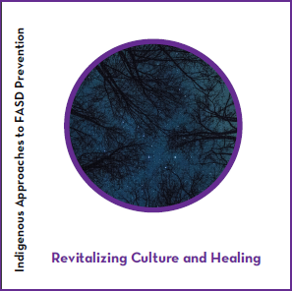
Cultural Knowledge and Practices
Indigenous-led initiatives to develop collaborative and culturally relevant approaches to addressing alcohol use during pregnancy
Programs that focus on strengthening cultural identity and promoting wellness through balancing traditional and mainstream worldviews and roles.
Revitalizing Culture and Healing demonstrates some of the ways in which community-based, community-driven FASD prevention and healthy beginning programs have been developed.
Globally, there has been a revitalization of traditional Indigenous language, culture, medicine, healing, and knowledge systems including:
https://canfasd.ca/wp-content/uploads/2019/11/Indigenous-FASD-Booklet-Revitalizing-Culture-and-Healing.pdf
Notes:
https://canfasd.ca/wp-content/uploads/2019/11/Indigenous-FASD-Booklet-Revitalizing-Culture-and-Healing.pdf
Conversations about FASD are incorporated into programs and initiatives that support learning life skills and making healthy decision-making related to contraception, sexual health, relationships, and substance use in general.

Slide 64



7
SECTION
Doorways to Conversation
Screening for alcohol use in pregnancy
Techniques and benefits of Brief Interventions with girls and women
Radiant by Mekayla Dionne
“Radiant is a brightly coloured painting made from oil paint on a wood panel. It has a yellow to orange gradient as a background, and a series of rolling hills, bouncing lines, and rounded shapes layer on top. Through the composition and colours, I aim to embody the feeling of hopefulness and new beginnings that arise through a journey to wellness and healthfulness. The energetic nature of the bouncing shapes, and the wiggle of lines are intended to display movement around the image, in an upward motion bringing the eye to the horizon. The top third of the painting is more monochromatic, fading into the bright yellow sky, demonstrating the room to grow and shift through stages of life.”
Notes:
“Radiant is a brightly coloured painting made from oil paint on a wood panel. It has a yellow to orange gradient as a background, and a series of rolling hills, bouncing lines, and rounded shapes layer on top. Through the composition and colours, I aim to embody the feeling of hopefulness and new beginnings that arise through a journey to wellness and healthfulness. The energetic nature of the bouncing shapes, and the wiggle of lines are intended to display movement around the image, in an upward motion bringing the eye to the horizon. The top third of the painting is more monochromatic, fading into the bright yellow sky, demonstrating the room to grow and shift through stages of life.”

Slide 65

Discussion of alcohol use and related risks with all women of childbearing years and their support networks
Level 2 FASD Prevention
Level 2
Discussions of alcohol use can be done informally as part of a conversation, or in a brief intervention that might also include the use of a formal screening tool.
Screening
As there is no known safe level of alcohol consumption during pregnancy, screening allows for appropriate interventions to be applied at the earliest possible point.
Screening can:
give the client permission to talk about drinking;
help to identify and/or clarify co-occurring issues;
minimize surprises in the treatment process; and
lead to more effective treatment or referral to related concerns.
It is important to recognize that screening will not be useful if:
women do not feel safe to discuss their alcohol use.
women do not know what a standard drink is (these are available in the Canada’s Guidance on Alcohol and Health).
Notes:
It is important for women to know they will not be judged for their alcohol use, that asking about alcohol is an approach to assist her to have a healthy pregnancy, and that the information will not be shared without her consent and involvement.
Screening can be conducted through practice-based approaches, such as single questions or brief dialogue and discussion using evidence-based approaches, or through formal structured questionnaires described later in this chapter (i.e., AUDIT-C, T-ACE, TWEAK, TLFB).

Slide 66


Supportive Dialogue
A non-judgmental, women-centered approach is important to engaging women in the decision to reduce or stop alcohol use in pregnancy. It's especially helpful for women who drink above low-risk levels and who may have other problematic substance use issues.
Research shows that 5–10-minute counselling sessions can reduce alcohol consumption during pregnancy by up to 30%.
Screening and brief interventions need to be embraced as standards of care.

Slide 67
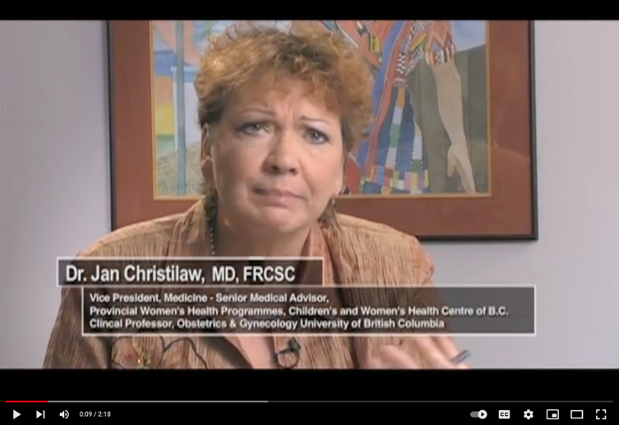
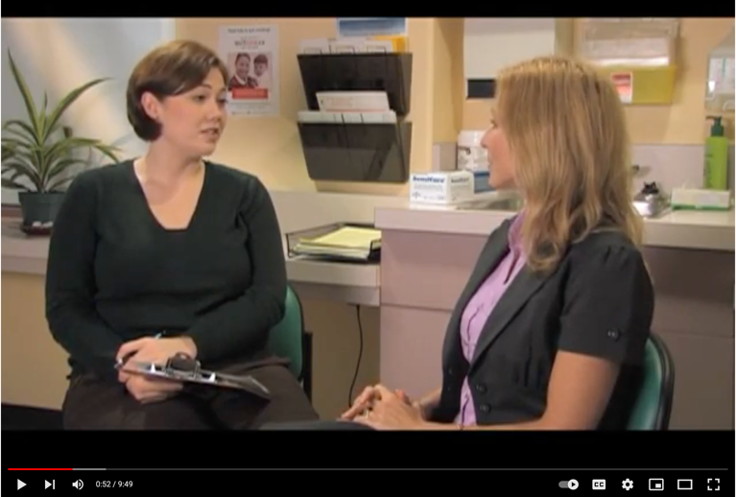

A video on how to ask questions about substance use to women of childbearing years
A video on how to begin a conversation in a non-threatening way
Brief Interventions
Brief interventions are collaborative conversations between an individual and a health or social service provider to discuss issues such as substance use, mental wellness, contraception, diabetes, etc.
https://youtu.be/ZDuG8e4bhOA
https://youtu.be/BQNSE9ZPivg
Doorways to Conversation: Brief Intervention on Substance Use with Girls and Women provides an extensive resource on discussing alcohol with girls and women, including 50 ideas for engaging in dialogue, skill-building, and development.
http://bccewh.bc.ca/wp-content/uploads/2018/06/Doorways_ENGLISH_July-18-2018_online-version.pdf
Notes:
Their overall purpose is to:
Support people in learning more about health issues affecting them, and to reflect on their health promotion strategies
Support people in making any needed changes in health and substance use
Support people in making connections between substance use sexual health, mental wellness, and other determinants of health that might support their plans for change in substance use
Support people to identify and strategize as to how to address underlying concerns that may be directly or indirectly affecting substance use (e.g., depression, gender-based violence, lack of resources)
These conversations can be an important step in engagement for people in all levels of substance use, and a link to building trust and other levels of support.
Most successful brief alcohol interventions include:
Awareness raising through discussion of risks and assessment of readiness for change;
Advice including provision of written or web materials and discussion of strategies for reducing or eliminating problematic alcohol use; and,
Assistance in the form of eliciting ideas about change strategies, supporting/enhancing readiness, goal setting to reduce or eliminate alcohol use, positive reinforcement, and/or referrals to supportive services.
However, brief interventions are very effective where relationships and trust have been built to ‘meet women where they are at.’ This creates a space to respond using a social determinants of health perspective, which recognizes the many reasons for which individuals may use substances.
Guidelines for brief interventions with pregnant women often suggest using the FRAMES model, which uses motivational interviewing and is consistent with a trauma-informed approach:
https://youtu.be/ZDuG8e4bhOA
https://youtu.be/BQNSE9ZPivg
http://bccewh.bc.ca/wp-content/uploads/2018/06/Doorways_ENGLISH_July-18-2018_online-version.pdf

Slide 68

Motivational Interviewing (MI)
Motivational interviewing is a counselling approach that prepares people to change their behaviours by helping them explore and resolve their reluctance to change.
MI involves accurately understanding the other person’s views, avoiding or de-escalating resistance, and helping them see the discrepancy between their ideal behaviour and their actual behaviour.
Many brief interventions are based on the use of Motivational Interviewing skills and these skills can be learned and applied by a wide range of helping professionals. Elements of successful MI encompasses the following elements:
Express Empathy
Develop Discrepancy
Avoid Argumentation
Support Self-efficacy

Slide 69

Motivational Interviewing
The following four steps (OARS) can be used to build motivation to change
Ask open ended questions
These are questions that invite more than a yes/no response
”I would like to understand how you see things. Tell me how you think alcohol is impacting your health.”
O
Affirm
This step helps build rapport and supports clients
“Thank you for coming in today. I have enjoyed talking with you and getting to know you a little bit.”
A
Reflective listening
These statements show that you understand what the client is saying. It may involve making a guess as to what your client means. It should not be a question, as to not evoke resistance.
“You feel like no one supports you.”
R
Summarize
This statement shows that you have been listening. It links to what has been discussed and may involve asking if anything has been missed.
“What I am hearing you say is that things have been hard for you over the last while. Although you know that alcohol is bad for your health, it is the only way to cope with your stress. What I am also hearing is that you are open to receiving more information, which is a big step in caring for yourself.”
S

Slide 70

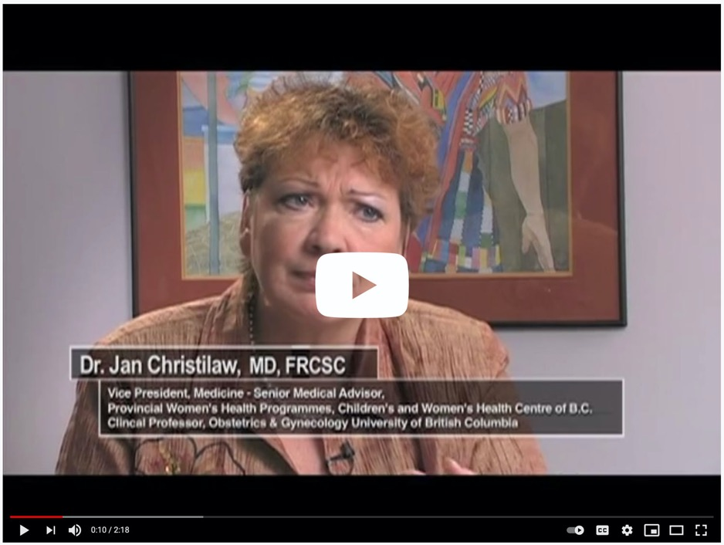
Common Clinical Questions
How do I assess readiness
to change?
Centre of Excellence for Women’s Health
YouTube Channel : www.youtube.com/user/BCCEWH
https://youtu.be/UbohrBPvV2A
Notes:
https://youtu.be/UbohrBPvV2A
Centre of Excellence for Women’s Health
YouTube Channel : www.youtube.com/user/BCCEWH

Slide 71

Case Scenario
Janice
Janice is 26 years old. She found out yesterday that she is 8 weeks pregnant with her first child. A few weeks ago, she was at an anniversary celebration and had three glasses of wine. The day before she discovered she was pregnant, she went to a bar after work and had two drinks. She has consulted several sources on the internet and is worried about the health of the baby.
If you connected with Janice or she walked into your office while pregnant, how would you help her?
What other supports and services may you link Janice to?

Slide 72
Tailoring Practice
Culturally Relevant Considerations
For instance, ‘brief’ interventions that are between a provider and individual may not be culturally appropriate for new Canadians or First Nations, Métis, or Inuit. Some considerations to make brief interventions more culturally appropriate may include:
Widening brief interventions so they are conducted in a group and or over a longer period
Engaging families, peers, significant others, etc.
Using culturally-appropriate/adapted resources
Conducting brief interventions using appropriate language(s) or imagery
Using culturally-appropriate exercises, such as walks and blanket exercises, to conduct brief interventions

Slide 73

Brief Interventions with Indigenous Peoples
Local Connections
Support Cultural Identity
Motivational Interviewing
In this short video, Richard San Cartier, an Indigenous nurse-practitioner discusses why motivational interviewing can be adapted to working with Indigenous people. (Note: In this video, Richard San Cartier is discussing quitting smoking, but the overall idea is relevant to FASD prevention).
https://youtu.be/yN2B6823uXg
Notes:
Local Connections
In your Prevention Conversations, you can include resources developed by local community members and share information about Indigenous-specific programs and supports for people who might be interested. If you are leading a workshop, you can consider inviting an Elder or having an Indigenous colleague from the community you are working with to co-facilitate with you or to provide feedback on your presentation.
Support Cultural Identity
In your conversations with women, you can focus on their strengths by asking questions about their interests, skills, what they are already doing to take care of themselves, and the role of Indigenous culture in their lives. Support women to draw from their identity, culture and community (if they are interested).
While there is enormous diversity globally in Indigenous worldviews, traditions, and cultural practices, most Indigenous peoples view wellness from a holistic point of view that promotes balance between the mental, physical, emotional and spiritual aspects of life. For example, a more holistic approach for some Indigenous women might mean exploring alcohol use and discussing Indigenous practices that support mothering, healing and wellness.
Motivational Interviewing
There are many similarities between motivational interviewing and Indigenous worldviews and motivational interviewing techniques can support the concerns and priorities of Indigenous women.
In this short video, Richard San Cartier, an Indigenous nurse-practitioner discusses why motivational interviewing can be adapted to working with Indigenous people. (Note: In this video, Richard San Cartier is discussing quitting smoking, but the overall idea is relevant to FASD prevention).
Is Motivational Interviewing a culturally safe counselling approach to use with Indigenous Peoples? (2:33)

Slide 74

Supporting Individuals with FASD
Individuals with FASD are more likely to experience substance use problems and other life adversity, which can result in FASD becoming an inter-generational phenomenon. You may work with individuals with FASD who are at risk of having a baby with FASD. Therefore, identifying a woman at-risk of harmful prenatal alcohol consumption is critical.
There are many ways we can tailor our discussions of alcohol to support people with cognitive and other learning disabilities. We must move away from viewing the individual as failing if they do not do well in standard programs and/or respond to typical interventions, toward viewing the program as not providing what the individual needs to succeed.

Slide 75

Supporting Trans, Two-Spirit,
and Gender Diverse Clients
Individuals who are trans, Two-Spirit, and gender diverse are more likely to experience substance use problems because of stigma, discrimination, violence, and trauma.
However, there are many ways in which we can tailor our discussions about alcohol use :
Ask your clients their pronouns and preferred name
Encourage their involvement in the design of new interventions
Help address co-occurring issues, such as substance use and gender dysphoria, mental health, violence, or HIV prevention.

Slide 76
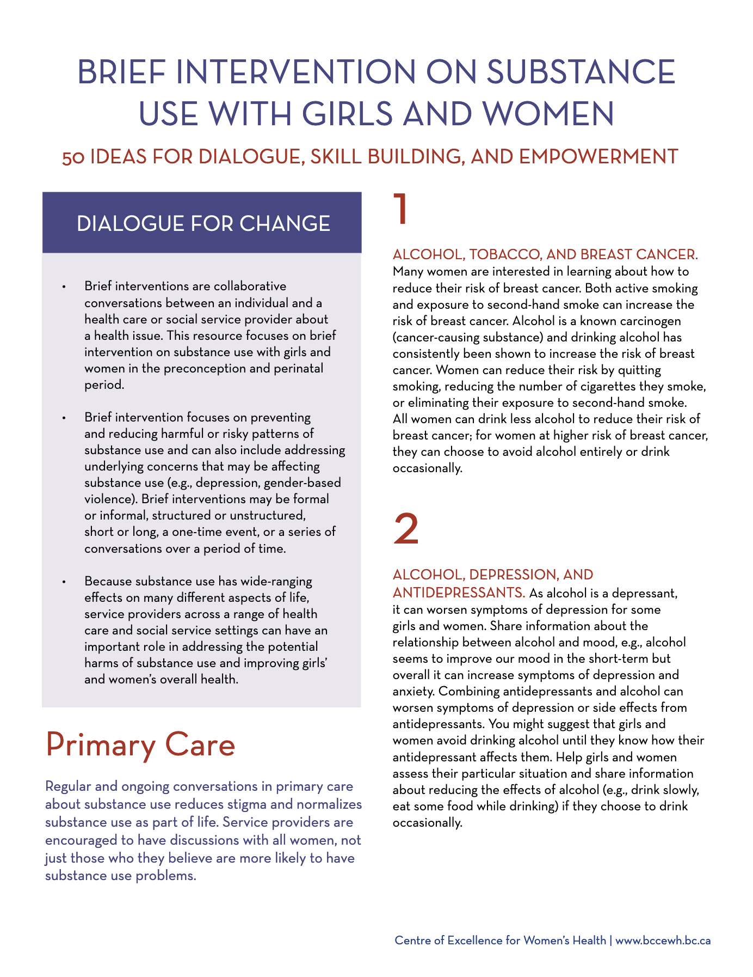

Self-Reflection Tools
ADDITIONAL STRATEGIES FOR HAVING CONVERSATIONS ABOUT ALCOHOL
Brief Interventions on Substance Use with Girls and Women: 50 Ideas for Dialogue, Skill Building, and Empowerment can be a useful resource for a range of health and social service providers.
https://cewh.ca/wp-content/uploads/2018/06/50-Brief-Intervention-Ideas_June-4-2018.pdf
Notes:
Sources
George, M.A., et al. (2007). Bridging the research gap: Aboriginal and academic collaboration in FASD prevention. The Healthy Communities, Mothers and Children Project. Alaska Medicine, 49, 139 - 141.
Health Canada (2006). Best Practices: Early Intervention, Outreach and Community Linkages for Women with Substance Use Problems. 2006, Health Canada: Ottawa, ON.
Latuskie, K.A., et al. (2019). Reasons for Substance Use Continuation and Discontinuation During Pregnancy: A Qualitative Study. Women & Birth, 32(1), e57 - e64.
Miller, W. R., & Rollnick, S. (2002). Motivational Interviewing: Preparing People for Change (2nd ed.). New York, NY: The Guilford Press.
Nathoo, T., et al., Doorways to conversation: Brief intervention on substance use with girls and women. 2018, Centre of Excellence for Women’s Health: Vancouver, BC.
Poole, N., T. Nathoo, & Hache, A. (2013). Community-driven alcohol policy and Fetal Alcohol Spectrum Disorder prevention: Implications for Canada's North. International Journal of Circumpolar Health, 72, 250 - 251.

Slide 77



8
SECTION
Doorways to Conversation
Violence and trauma can influence alcohol use during pregnancy
Introduction to trauma-informed practice
Examples of how to support women who have past or current experiences of trauma and/or violence
A True Place of Belonging by Aly McKnight
“My body is the safest place for me to be. Not a poisonous chamber. But a beautiful shelter and a true place of belonging. After years of working through so much heartbreak and pain, I’ve grown better at relying on my body instead of neglecting or abusing it. And with each new day I learn to better understand my body and the ever-changing landscapes hosted within me. I do this work and challenge you to do the same because it’s vital that we learn to be home to ourselves and believe that we always deserve to exist.”
Notes:
“My body is the safest place for me to be. Not a poisonous chamber. But a beautiful shelter and a true place of belonging. After years of working through so much heartbreak and pain, I’ve grown better at relying on my body instead of neglecting or abusing it. And with each new day I learn to better understand my body and the ever-changing landscapes hosted within me. I do this work and challenge you to do the same because it’s vital that we learn to be home to ourselves and believe that we always deserve to exist.”

Slide 78

What is Trauma?
Trauma can be defined as experiences that overwhelm an individual’s capacity to cope.
This can include trauma early in life, including childhood physical, emotional or sexual abuse, neglect, and witnessing violence
It can also include traumatic experiences later in life, including intimate partner violence, sexual violence, accidents, natural disasters, war, or sudden unexpected loss
Trauma can also result from poverty, having a chronic or life-threatening illness, intergenerational events, grief and loss, and other life events that are experienced as overwhelming and out of one’s control
Trauma affects everyone differently, but it’s important to remember that people can and do heal from trauma.

Slide 79

Intergenerational Trauma
In Canada, colonization and subsequent policies, such as the creation of the Indian Reservation System and Indian Residential School System, were developed to oppress and forcibly assimilate Indigenous peoples. The Indian Residential School System in Canada was designed to forcibly remove Indigenous children from their families, communities, languages, and cultures, and placing them in government and church-run schools. Residential schools impacted all aspects of Indigenous peoples’ lives through the disruption of families, communities, culture, language, and identity. The effects have been felt across generations and, for some people and communities, has impacted their relationship to alcohol and alcohol use in pregnancy.
Notes:
Sources
Augiar, W. & Halseth, R. (2015). Aboriginal peoples and historical trauma: The process of intergenerational trauma. National Collaborating Centre on Aboriginal Peoples Health: Prince George, BC.
Wolfson et al. (2019). Collaborative action on Fetal Alcohol Spectrum Disorder prevention: Principles for enacting the Truth and Reconciliation Commission Call to Action #33. International Journal of Environmental Research and Public Health, 16(9), doi: 10.3390/ijerph16091589

Slide 80
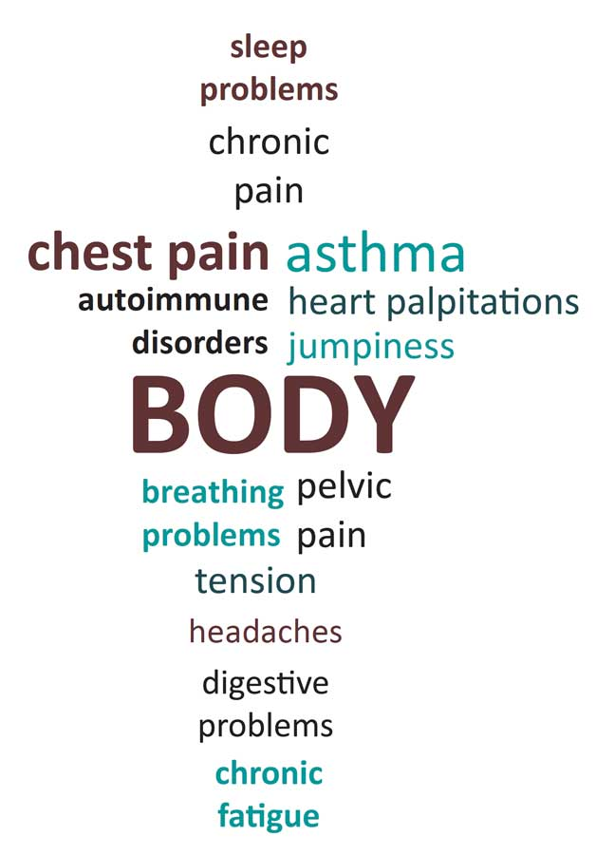
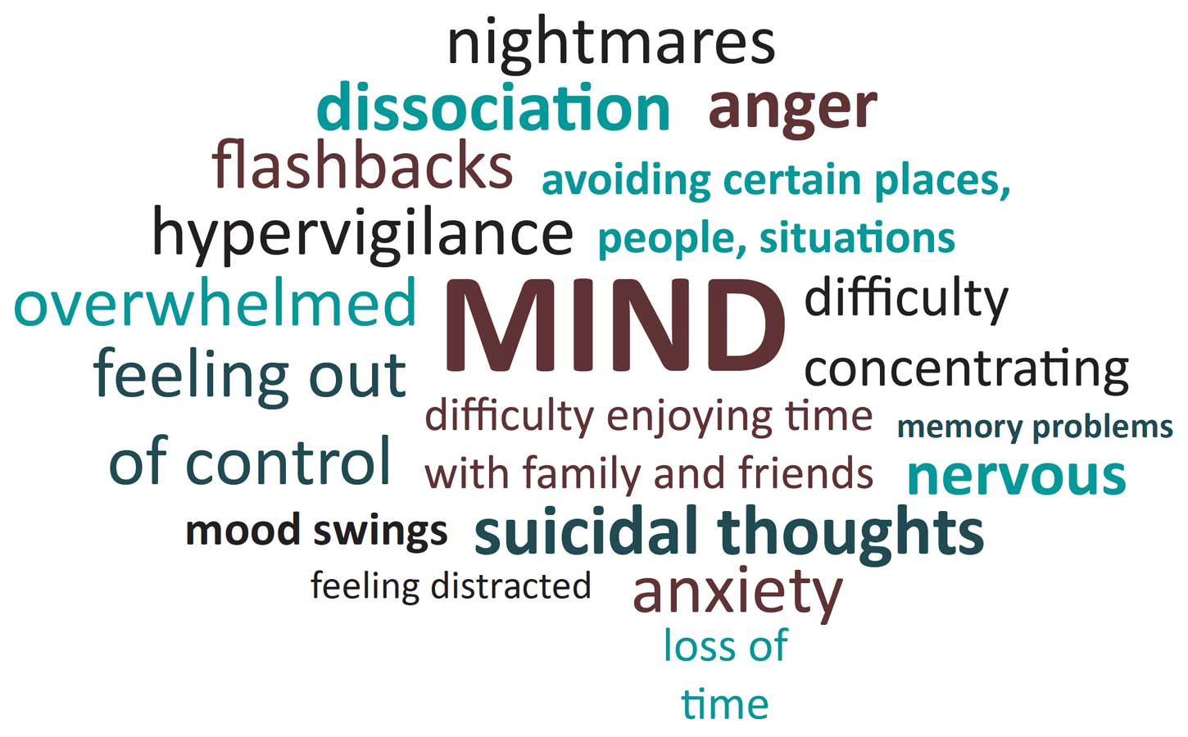
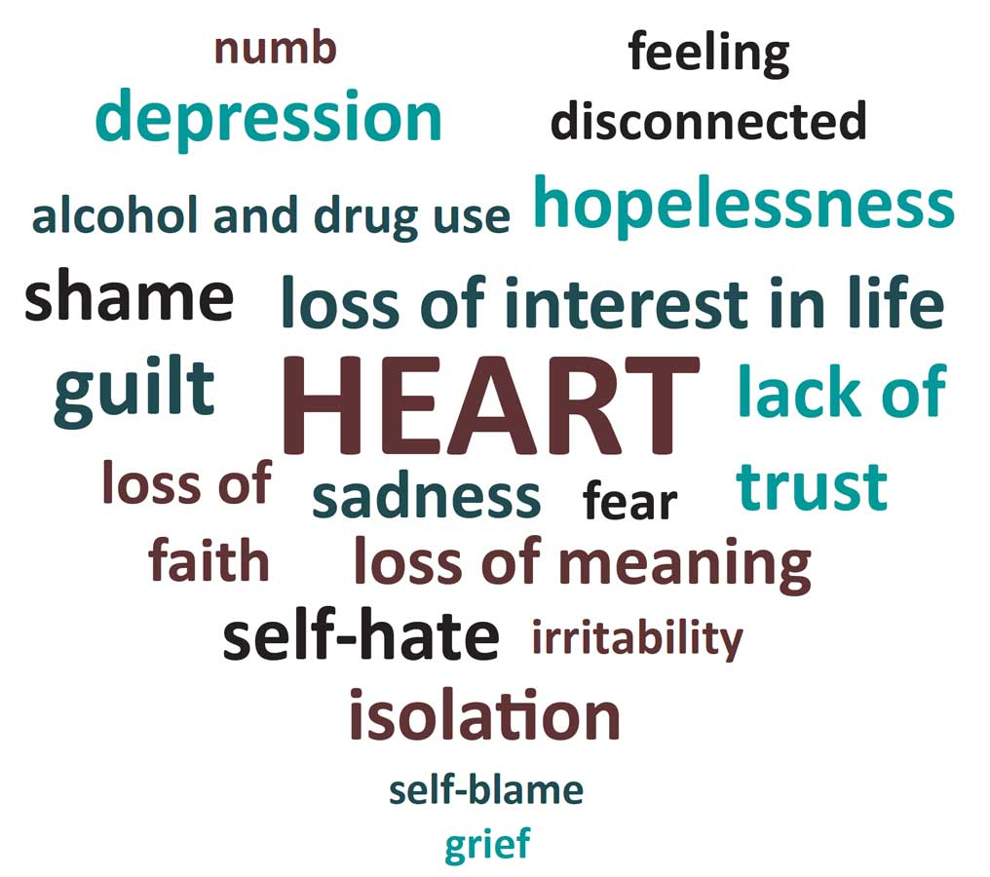
How Do People Respond to Trauma?
!
Long term effects
There are a wide range of responses that people can have to traumatic events. It is important to be aware of how these effects of trauma may affect engagement in prevention conversations.
Notes:
1. Centre of Excellence for Women’s Health, Coalescing on Women and Substance Use
Conclude by referencing the wide variety of reasons that women drink when pregnant, and the importance of working at multiple levels, across sectors to address this
This slide can be provided as a handout, “talking about substance use in pregnancy’ where there are some of these statements, but also responses that service providers can use:
https://bccewh.bc.ca/wp-content/uploads/2018/10/Collaborative-Conversation-Ideas_Sept-19-2018.pdf

Slide 81
In-the-moment
Trauma Responses
HOW TO RETURN TO A CALM WINDOW OF TOLERANCE
Fight/Flight
Our brains and bodies often respond with a ‘Fight or Flight’ or ‘Freeze’ response when we feel threatened. This can include feeling stuck or trapped, being harmed (physically, emotionally, psychologically, spiritually), being ignored or not taken seriously, being treated unfairly, or reminded of previous harm.
Move body to let out excess energy
Take deep breath, focusing one long exhale
Name fears, concerns and frustrations
Remove ourselves from the situation
FLIGHT
OR FLIGHT
RESPONSE
(hyper-arousal)
WINDOW OF TOLERANCE
“Calm and comfortable”
FREEZE
RESPONSE
(hypo-arousal)
Freeze
Press hands on to our arm or legs
Count to up 20 and back down
Describe things around you: What colours do you see?
Drink a cool glass of water
Take deep breaths, focusing on exhale
Colour/paint a picture
Notes:
b) In the moment trauma responses
For those having conversations about alcohol and other substance use, it is also important to understand in-the-moment trauma responses. Often stressful situations may cause a trauma survivor to revert to a survival response, in which our bodies respond with an automatic reaction to feeling overwhelmed. When we feel threatened, the brain sends a signal to the body to be “on alert” which results in physiological changes including:
Increased heart rate
Increased blood pressure and muscle tension
Dilation of the eyes
Shallow breathing
Flushed skin
Release of adrenaline, cortisol and other chemicals into the body
This is an automatic (involuntary) physiological reaction that we share with other animals.
These reactions are often called “fight/flight/freeze” responses or “hyper-arousal” (too much or over arousal) and “hypo-arousal” (too little or under arousal).
It is important to stop the conversation when these in-the-moment responses are noticed and support the person with getting back into a calmer and centered space. A service provider may offer the option of resuming the conversation later, taking a break and/or practicing self calming skills.

Slide 82
Trauma and Substance Use
Trauma is common for people in Canada overall.
76%
Alcohol and other substance use is one way that many people cope with the effects of trauma.
Many women who have a difficult time stopping their alcohol use during pregnancy have past or current experiences of trauma.
One study estimates that 76% of adults will experience at least one traumatic event in their lifetime.
For many Indigenous peoples, the intergenerational transmission of trauma related to colonial practices (past and present), residential school experiences, the ‘60s Scoop, and ongoing racism have had an important role in influencing alcohol use during pregnancy.

Slide 83

Four Principles for Trauma Informed Practice
We need to adapt the way we work to better engage and support people who have experienced trauma.
1
2
3
4
Choice, Collaboration and Connection
Trauma Awareness
Safety and Trustworthy
Strengths-Based and Skill Building
Notes:
Sources
BC Mental Health and Substance Use Services and Centre of Excellence for Women’s Health. (2013). Trauma-Informed Practice Guidelines.

Slide 84
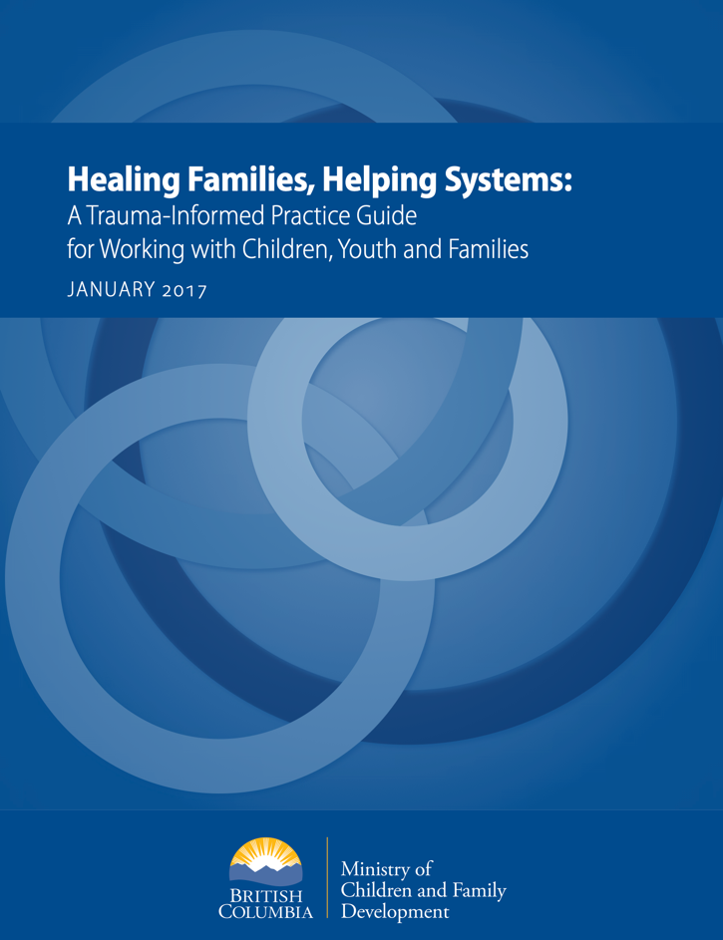
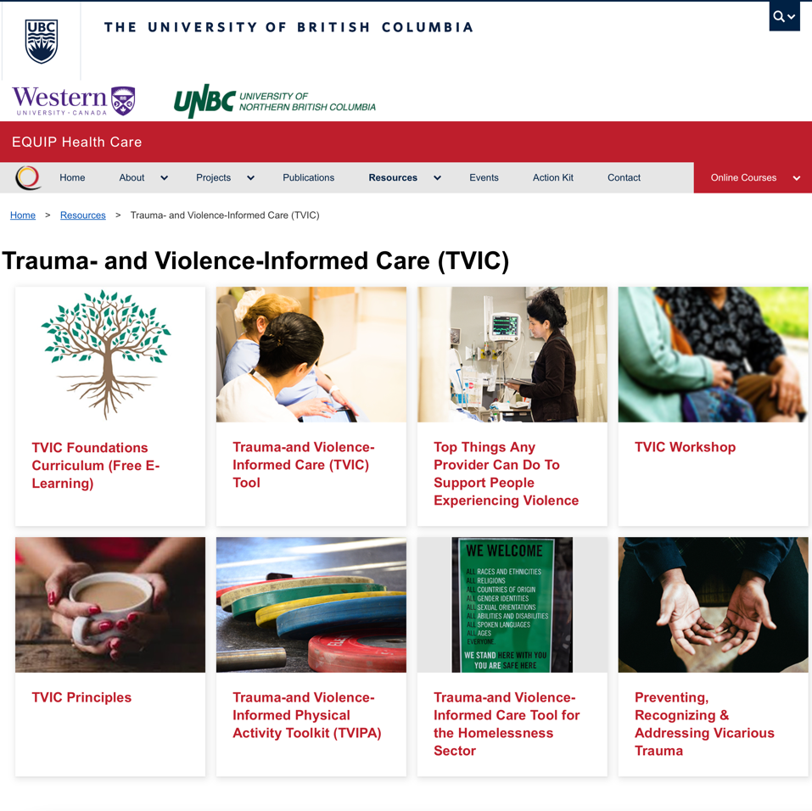
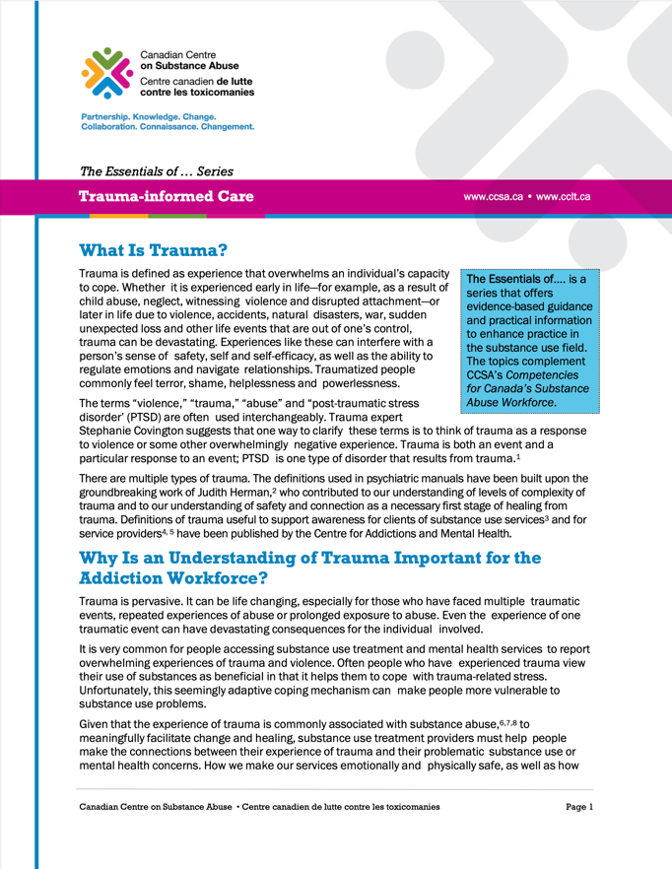
Delve Deeper
FOR SCREENING AND CHANGING THE CONVERSATION
Trauma Informed + Substance Use
This booklet from the Canadian Centre on Substance Use and Addiction outlines the importance of understanding trauma when working with people with substance use problems and the implications for treatment and support
Trauma Informed + Child Welfare Here is an example of how trauma informed approaches can be brought into child welfare contexts.
Trauma Informed + Primary Care
Here is an example of how trauma informed approaches can be brought into primary care settings and related contexts.
Notes:
https://www.ccsa.ca/sites/default/files/2019-04/CCSA-Trauma-informed-Care-Toolkit-2014-en.pdf
https://www2.gov.bc.ca/assets/gov/health/child-teen-mental-health/trauma-informed_practice_guide.pdf
https://equiphealthcare.ca/resources/trauma-and-violence-informed-care/

Slide 85

Alcohol Use, Pregnancy, and Partner Violence
Women’s substance use is influenced by their partners in important ways. Women may use alcohol due to coercion, fear of violence, or to cope with social stressors. Pregnant women experience higher rates of intimate partner violence (IPV) compared to non-pregnant women.
It is safest not to use alcohol during pregnancy!
Notes:
Sources
Astley, S. J., Bailey, D., Talbot, C., & Clarren, S. K. (2000). Fetal Alcohol Syndrome (FAS) Primary Prevention through FASD Diagnosis II: A comprehensive profile of 80 birth mothers of children with FAS. Alcohol and Alcoholism, 35(5), 509-519.
Bakhireva, L.N., et al., Paternal drinking, intimate relationship quality, and alcohol consumption in pregnant Ukrainian women. Journal of Studies on Alcohol and Drugs, 2011. 2011: p. 536-544.
Daoud, N., Urquia, M.L., O’Campo, P., Heaman, M., Janssen, P.A., Smylie, J., and Thiessen, K. (2012). Prevalence of abuse and violence before, during, and after pregnancy in a national sample of Canadian women. American Journal of Public Health, 102(10): 1893-901.
Deutsch, A.R., The importance of intimate partner violence in within-relationship and between-person risk for alcohol-exposed pregnancy. Alcoholism: Clinical and Experimental Research, 2019. 43(4): p. 679 - 689.
Eaton, L.A., et al., Pregnancy, alcohol intake, and intimate partner violence among men and women attending drinking establishments in a Cape Town, South Africa Township. Journal of Community Health, 2011. 37: p. 208 - 216. 16.

Slide 86

Safe Relationships
1 in 6 women who experienced IPV (intimate partner violence) stated that abuse worsened over the course of their pregnancy.
In relationships where women experience violence, partners may use alcohol or other substances as a form of control.
As a result, women may have difficulties reducing alcohol use, obtaining birth control, or use contraception.
Notes:
IPV – intimate partner violence
Sources
Astley, S. J., Bailey, D., Talbot, C., & Clarren, S. K. (2000). Fetal Alcohol Syndrome (FAS) Primary Prevention through FASD Diagnosis II: A comprehensive profile of 80 birth mothers of children with FAS. Alcohol and Alcoholism, 35(5), 509-519.
Bakhireva, L.N., et al., Paternal drinking, intimate relationship quality, and alcohol consumption in pregnant Ukrainian women. Journal of Studies on Alcohol and Drugs, 2011. 2011: p. 536-544.
Daoud, N., Urquia, M.L., O’Campo, P., Heaman, M., Janssen, P.A., Smylie, J., and Thiessen, K. (2012). Prevalence of abuse and violence before, during, and after pregnancy in a national sample of Canadian women. American Journal of Public Health, 102(10): 1893-901.
Deutsch, A.R., The importance of intimate partner violence in within-relationship and between-person risk for alcohol-exposed pregnancy. Alcoholism: Clinical and Experimental Research, 2019. 43(4): p. 679 - 689.
Eaton, L.A., et al., Pregnancy, alcohol intake, and intimate partner violence among men and women attending drinking establishments in a Cape Town, South Africa Township. Journal of Community Health, 2011. 37: p. 208 - 216. 16.

Slide 87

A study in Washington state interviewed 80 birth mothers who were accessing support services for their children diagnosed with FASD.
The study found that mothers had very difficult lives and were isolated from social supports:
100%
100% of the women had a history of being seriously sexually, physically or emotionally abused,
Despite the finding it is important to note that not all women who drink in pregnancy and have children affected by FASD have experienced abuse.
80%
80% had major unaddressed mental illnesses, and
80%
80% lived with men who did not want them to quit drinking.
Notes:
Sources
Astley, S. J., Bailey, D., Talbot, C., & Clarren, S. K. (2000). Fetal Alcohol Syndrome (FAS) Primary Prevention through FASD Diagnosis II: A comprehensive profile of 80 birth mothers of children with FAS. Alcohol and Alcoholism, 35(5), 509-519.
Bakhireva, L.N., et al., Paternal drinking, intimate relationship quality, and alcohol consumption in pregnant Ukrainian women. Journal of Studies on Alcohol and Drugs, 2011. 2011: p. 536-544.
Daoud, N., Urquia, M.L., O’Campo, P., Heaman, M., Janssen, P.A., Smylie, J., and Thiessen, K. (2012). Prevalence of abuse and violence before, during, and after pregnancy in a national sample of Canadian women. American Journal of Public Health, 102(10): 1893-901.
Deutsch, A.R., The importance of intimate partner violence in within-relationship and between-person risk for alcohol-exposed pregnancy. Alcoholism: Clinical and Experimental Research, 2019. 43(4): p. 679 - 689.
Eaton, L.A., et al., Pregnancy, alcohol intake, and intimate partner violence among men and women attending drinking establishments in a Cape Town, South Africa Township. Journal of Community Health, 2011. 37: p. 208 - 216. 16.

Slide 88

Trauma-informed
Brief Interventions
If a relationship has been established or a woman discloses current or past experiences of violence or abuse, you have opportunities to provide support and assistance.
It’s important to respect each woman’s wishes on what she wants to see happen with her relationship.
Working from a trauma-informed perspective means changing how we think and talk about alcohol use during pregnancy. It requires us to question our assumptions and be compassionate toward women who may have a difficult time stopping their alcohol use.

Slide 89

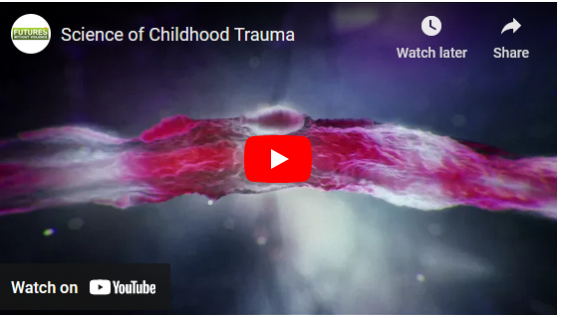
Promoting Resilience
Resilience is the process of adapting well in the face of adversity, trauma, tragedy, and chronic stress. It means "bouncing back" from difficult experiences.
Many studies show that the primary factor in resilience is having caring and supportive relationships within and outside the family.
Description
Five Everyday Gestures
The U.S. Department of Justice and Futures Without Violence highlight five everyday “gestures” that caring adults can use to help promote resilience in the face of trauma.
https://youtu.be/WZIf_4Eg7_Y

Slide 90

9
SECTION
Contraception
Role of contraception in preventing alcohol-exposed pregnancies
How to include contraception into the Prevention Conversation
Culture and Safer Sexes Memes, Native Youth Sexual Health Network
Notes:
In 2013, the Native Youth Sexual Health Network launched internet memes as part of National Sexual and Reproductive Health Awareness Week. These memes were intended to be a fun way to share information about sexual and reproductive health and culture through memes created by Indigenous youth.
The Native Youth Sexual Health Network has found ways to make sexual and reproductive health fun, and a way for Indigenous youth to reclaim their identities and self-determination over their bodies. For more information, visit their website at: https://www.nativeyouthsexualhealth.com/

Slide 91

Alcohol, Contraception, and Preconception
Many women do not realize they are pregnant until well into the first trimester, and many drink alcohol during this time.
There are several ways to reduce the risk of an alcohol exposed pregnancy including:
reducing alcohol use
using effective contraception, otherwise known as birth control
reducing alcohol use and using effective contraception.
Notes:
Hanson, J.D. and S. Pourier. (2015). The Oglala Sioux Tribe CHOICES Program: Modifying an Existing Alcohol-Exposed Pregnancy Intervention for Use in an American Indian Community. International Journal Of Environmental Research And Public Health, 13(1).
Ingersoll, K.S., et al., (2011). Preconception markers of dual risk for alcohol and smoking exposed pregnancy: Tools for primary prevention. Journal of Women’s Health, 20(11), 1627-1633.
Nathoo, T., Poole, N., Wolfson, L., Schmidt, R., Gelb, K. (2018). Doorways to conversation: Brief intervention on substance use with girls and women. Vancouver, BC: Centre of Excellence for Women’s Health.
Sobell, L.C., et al., (2017). Preventing Alcohol-Exposed Pregnancies: A Randomized Controlled Trial of a Self-Administered Version of Project CHOICES With College Students and Nonstudents. Alcoholism, Clinical And Experimental Research.

Slide 92


Contraception Methods
HORMONAL
VS
NON-HORMONAL
This means that the type of birth control releases estrogen and/or progesterone into the body.
EXAMPLES INCLUDE: birth control pills, hormonal IUDs, Nuva Ring, the Patch, the Depo-Provera shot
There are no hormones being released into the body.
EXAMPLES INCLUDE: condoms (female and male), copper IUD
>50%
of youth report using condoms only. This may be because of their lower cost (compared to other contraception methods) and that no prescription or health care visit is required to use/access them.

Slide 93
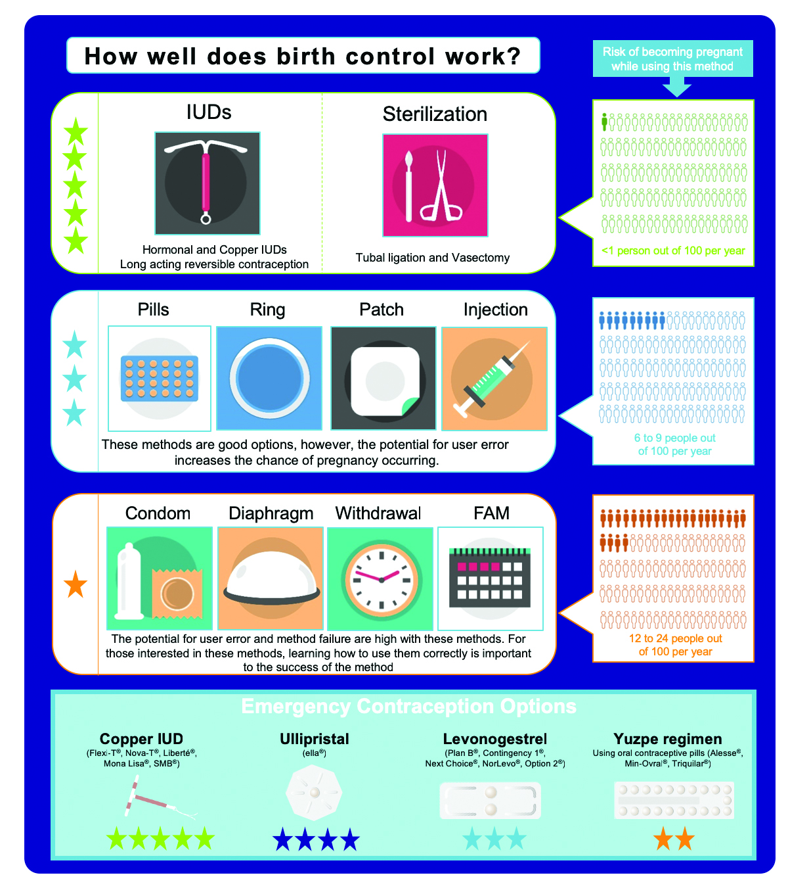
Contraception Methods
Risk of becoming pregnant while using each method
IUDs • Sterilization
  <1 person out of 100/year
Pills • Rings • Patch • Injection
  6 – 9 people out of 100/year
Condom • Diaphragm
Withdrawal • FAM
  12 to 24 people out of 100/year

Slide 94


Identifying the Best Control Options
To find a method that will work for you every time, some things to think about include:
1
How well it works
2
How much effort it takes
3
When you want to have children
4
How much the method costs
5
Whether it protects you from infection
6
If you’ve had a problem with one kind of birth control.
myhealth.alberta.ca
https://www.sexandu.ca/wp-content/uploads/2016/09/Contraception_Methods_Booklet.pdf
Notes:
Supporting Women in Identifying the Best Control Options
The myhealth.alberta.ca website provides information on different forms of birth control, acknowledging that the best form of birth control is the one that protects individuals every time they have sex. Here is some information that service providers may choose to share with their clients (from the myhealth.alberta.ca website).
To find a method that will work for you every time, some things to think about include:
How well it works. Think about how important it is to you to avoid pregnancy. Then look at how well each method works. For example, if you plan to have a child soon anyway, you may not need a very reliable method. If you don't want children but feel it is wrong to end a pregnancy, choose a type of birth control that works very well.
How much effort it takes. For example, birth control pills may not be a good choice if you often forget to take medicine. If you are not sure you will stop and use a barrier method each time you have sex, pick another method.
When you want to have children. For example, if you want to have children in the next year or two, birth control shots may not be a good choice. They can make it hard to get pregnant for several months after you stop them. If you never want to have children, natural family planning is not a good choice because it often fails.
How much the method costs. For example, condoms are cheap or free in some clinics. Some health plans cover the cost of prescription birth control. But cost can sometimes be misleading. An IUD costs a lot up front. But it works for years, making it low-cost over time.
Whether it protects you from infection. Latex condoms can help protect you from sexually transmitted infections (STIs), such as HIV. But they are not the best way to prevent pregnancy. To avoid both STIs and pregnancy, use condoms along with another type of birth control.
If you've had a problem with one kind of birth control. Finding the best method of birth control may involve trying something different. Also, you may need to change a method that once worked well for you.
Sources
Fisher, W. et al. (2004) The 2002 Canadian Contraception Study: Part I. JOGC, https://doi.org/10.1016/S1701-2163(16)30377-2
Hutton, H.E., et al., (2014) A Novel Integration Effort to Reduce the Risk for Alcohol-Exposed Pregnancy Among Women Attending Urban STD Clinics. Public Health Reports, 129, 56-62.
Nethery, E., et al. (2019). Household income and contraceptive methods among youth: A cross-sectional study using the Canadian Community Health Survey (2009 - 2010 and 2013 - 2014). CMAJ Open, 7(43).
Public Health Agency of Canada. (2009) What Mothers Say: The Canadian Maternity Experiences Survey. Ottawa. Available from http://www.phac-aspc.gc.ca/rhs-ssg/pdf/survey-eng.pdf

Slide 95

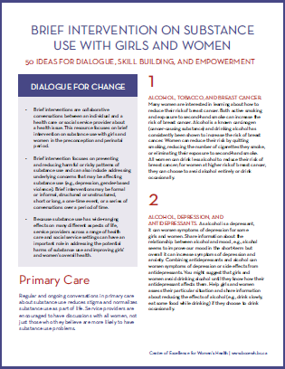
Linking Contraception and Brief Interventions
Here are some ideas for including contraception into the Prevention Conversation.
Preparing for pregnancy
Birth control effectiveness. The website It’s a Plan, may be helpful
Support reflection
This resource from the Centre of Excellence for Women’s Health for more information.
https://bccewh.bc.ca/wp-content/uploads/2018/06/50-Brief-Intervention-Ideas_June-4-2018.pdf
Notes:
Preparing for Pregnancy. Discuss alcohol and/or contraception use when sharing important preconception information with women considering or planning a pregnancy (such as preparing to stop drinking, taking folic acid, etc.). You might want to use the Ready or Not website from Alberta Health Services to guide your discussion.
Birth control effectiveness. When asking questions about whether women are interested in becoming pregnant or in preventing a pregnancy, you can share information about the effectiveness of various methods. If women are unsure about pregnancy or are interested in using a less effective method of birth control, they might find it helpful to reflect on their substance use while deciding. They might be open to not drinking alcohol if they are sexually active and not using effective birth control.
Review contraception options with your client to ensure that she has full contraceptive coverage every time she has sexual intercourse. This might include providing secondary, back-up, or emergency contraception methods. For example, along with oral contraceptives, advise her to use condoms, which have the added benefit of reducing sexually transmitted diseases. The website It’s a Plan, https://www.itsaplan.ca/ may be helpful for you to walk through together.
Support reflection. Support reflection, healthy decision-making, and skill-building related to contraception, substance use, and sexual health. This may include reflection and decision-making around finding personal drinking limits, skill-building such as negotiating condom use. See this resource from the Centre of Excellence for Women’s Health for more information.
https://bccewh.bc.ca/wp-content/uploads/2018/06/50-Brief-Intervention-Ideas_June-4-2018.pdf

Slide 96

For Partners
BRIEF INTERVENTIONS FOR HETEROSEXUAL COUPLES
men often express limited knowledge about preconception health compared to women.
men are more reluctant to engage in health promotion interventions, such as brief interventions, out of fear of ridicule.
including men can help shift attitudes and increase support to reduce substance use and prepare for fatherhood.
some women may want to include their partners in joint interventions at their discretion.
Reach boys and men separately from women.
Notes:
Sources
Bodin, M., et al. (2017). Exploring men’s pregnancy-planning behaviour and fertility knowledge: A survey among fathers in Sweden. Upsala Journal of Medical Sciences, 122(2), 127-135.
Chang, G., et al. (2005). Brief intervention for prenatal alcohol use: a randomized trial. Obstetrics & Gynecology, 105(5 part 1), 991-998.
Frey, K.A., R. Engle, and B. Noble (2012). Preconception healthcare: what do men know and believe? Journal of Men’s Health,. 9(1), 25 - 35.
Frey, K.A. and J.A. (2006). Files, Preconception healthcare: What women know and believe. Maternal Child Health Journal, 10, S73 - S77.

Slide 97

For the woman, her partner/family and
her community:
Friends, partners and family members can support a pregnant woman by asking how they can help her make healthy choices and healthy babies.
Cutting back or abstain from alcohol use during pregnancy and influence women’s health and well-being is a responsibility we can all share.

Slide 98

Culturally Appropriate
Brief Interventions
by including resources developed by local community members and/or in the local language
by using land-based programming
by offering referrals to Indigenous-specific programs
Several Cree and Innu First Nations communities have developed land-based programs including:
leading girls and women in walks
smudges & beadwork
gathering and preparing traditional food on the land
discussing topics like healthy relationships, sexual wellness, safer sex, contraception, pregnancy planning, and mental wellness
Notes:
Sources
Hanson, J.D. and S. Pourier. (2015). The Oglala Sioux Tribe CHOICES Program: Modifying an Existing Alcohol-Exposed Pregnancy Intervention for Use in an American Indian Community. International Journal Of Environmental Research And Public Health, 13(1)

Slide 99

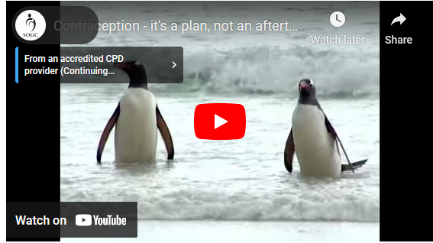
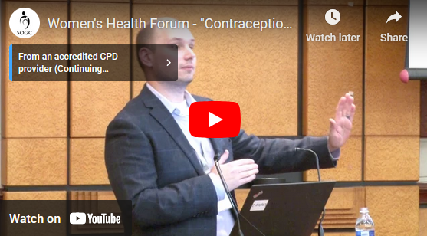
Contraception Resources
Contraception –
It's a plan, not an afterthought
Women's Health Forum - "Contraception"
with Dr. Dustin Costescu
Description
https://youtu.be/CIx488jjKbU
https://youtu.be/z3zr93eDzts
Notes:
Women's Health Forum - "Contraception"
with Dr. Dustin Costescu
https://youtu.be/z3zr93eDzts
Contraception - it's a plan, not an afterthought
https://youtu.be/CIx488jjKbU

Slide 100


10
SECTION
Polysubstance Use
Benefits of discussing other substance use at the same time as alcohol use
Overview of the effects of tobacco, cannabis, and opioids during pregnancy
Key messages to include in conversations about polysubstance use
Fight for Hope by N’we Jinan Artists from Alexis Nakota Sioux Nation
This song was written and recorded with youth from Alexis Nakota Sioux Nation and released on September 9, 2019 during the ANSN FASD Awareness Day. This inspirational song and video’s message shows how youth and culture can help break cycles of substance use and intergenerational trauma.
https://www.youtube.com/watch?v=V8h0qKbipgg
Notes:
This song was written and recorded with youth from Alexis Nakota Sioux Nation and released on September 9, 2019 during the ANSN FASD Awareness Day. This inspirational song and video’s message shows how youth and culture can help break cycles of substance use and intergenerational trauma.
https://www.youtube.com/watch?v=V8h0qKbipgg

Slide 101
Why Discuss Multiple Substances?
Polysubstance use, or using more than one substance at a time, is common in Canada.
It is common for women to use a combination of alcohol, cannabis, and tobacco during pregnancy. Women may also use substances such as heroin, cocaine/crack, or prescription drugs such as methadone.
Talking about multiple substances reflects women’s realities and makes the discussion more relevant to their lives
It normalizes substance use as a part of life for many women
Regular and ongoing conversations about substance use overall helps to reduce stigma
It can support change in many areas, including alcohol use – cutting back or stopping use of other substances can help women make changes to their alcohol use when they are ready.
Notes:
Sources
Ko, J. Y., Tong, V. T., Bombard, J. M., Hayes, D. K., Davy, J., & Perham-Hester, K. A. (2018). Marijuana use during and after pregnancy and association of prenatal use on birth outcomes: A population-based study. Drug and Alcohol Dependence, 187, 72-78. doi:https://doi.org/10.1016/j.drugalcdep.2018.02.017
Parrish, D., et al., Characteristics and Factors Associated with the Risk of a Nicotine Exposed Pregnancy: Expanding the CHOICES Preconception Counseling Model to Tobacco. Maternal & Child Health Journal, 2012. 16(6): p. 1224-1231.
Velasquez, M.M., et al., A dual-focus motivational intervention to reduce the risk of alcohol-exposed pregnancy. Cognitive and Behavioral Practice, 2010. 17(2): p. 203-212.

Slide 102

Tobacco
There are many types of tobacco. Nicotine is the addictive chemical found in tobacco. There are over 4,000 other chemicals in cigarettes and cigarette smoke.
In Canada,
1 in 8
women report smoking cigarettes
1 in 25
report vaping tobacco or nicotine
Women of all ages smoke during pregnancy, but it is especially high in women under 20. Smoking during pregnancy is declining in women ages 25-44.

Slide 103

Tobacco and Pregnancy
Tobacco is one of the leading causes of preventable death.
There is no known safe level of tobacco use for anyone including pregnant women.
When a woman smokes or uses tobacco during pregnancy:
the nicotine, carbon monoxide, and other chemicals that enter her bloodstream pass into the fetus. This keeps the baby from getting the food and oxygen it needs to grow.
can have life-long effects, including learning difficulties, behavior issues, lung diseases, and increased chance of certain birth defects such as cleft lip or cleft palate.
increases the risks of premature birth, stillbirth and having a low-birth- weight baby.
Notes:
http://bccewh.bc.ca/wp-content/uploads/2018/03/InfoSheet-Women-Tobacco0308.pdf

Slide 104

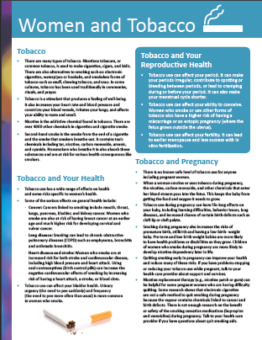
Tobacco and Pregnancy Treatments
Quitting smoking early in pregnancy
Nicotine replacement therapy (e.g., nicotine patch or gum)
Electronic cigarettes and vaping are not safe methods to quit smoking during pregnancy because the vapour contains chemicals linked to cancer and birth defects.
http://bccewh.bc.ca/wp-content/uploads/2018/03/InfoSheet-Women-Tobacco0308.pdf
Notes:
http://bccewh.bc.ca/wp-content/uploads/2018/03/InfoSheet-Women-Tobacco0308.pdf

Slide 105

Cannabis
Women use cannabis for both recreational and medical reasons.
Following the legalization of cannabis in Canada in 2018,
6.2%
women’s cannabis use increased from 12.2% to 18.4%.
There are over
400+
active ingredients in cannabis. The main active chemicals are delta-9-tetrahydrocannabinal (THC) and cannabidiol (CBD).

Slide 106
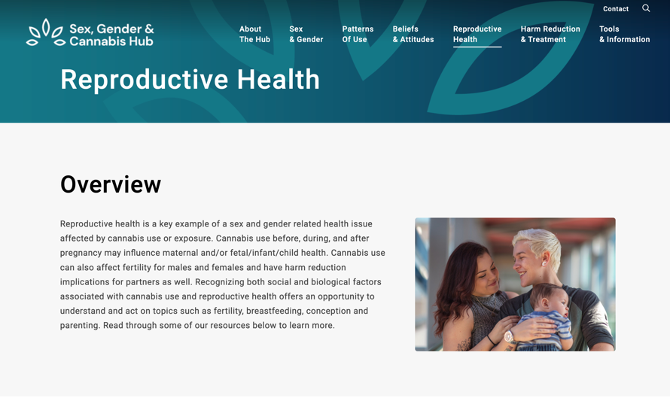
Cannabis and Pregnancy
Both THC and CBD are known to cross the placenta during pregnancy.
Some research suggests that cannabis may affect the baby’s brain development and lead to learning and behavioural issues. Cannabis use during pregnancy may also be associated with increased risk for the following issues:
The risk of low birth weight
Long-term health problems related to cardiovascular and mental health
Short and long-term learning, development, and behavioral issues.
Pre-term labour
Cannabis in all forms may affect the baby’s brain development and may result in learning and behavioral issues that last throughout their life. However, we still do not know the true effects of prenatal cannabis use, and because of that, it is safest not to use cannabis during pregnancy.
Resource Website:
https://sexgendercannabishub.ca/reproductive-health/
Notes:
Tetrahydrocannabinol (THC) is the chemical in cannabis that makes you feel ‘high.’ Research shows that THC passes through to the baby regardless of whether the cannabis is smoked or vaped, eaten, applied as a cream, or taken as a pill.
Resource Website:
https://sexgendercannabishub.ca/reproductive-health/

Slide 107

Opioids
Opioids are a type of medication often prescribed to treat acute and chronic pain.
Some common opioid medications include morphine, codeine, oxycodone (e.g., Oxycontin®, Percodan® or Percocet®), hydrocodone (e.g., Hycodan®, Tussionex®), hydromorphone (e.g., Dilaudid ®), fentanyl, methadone, tramadol and buprenorphine.
Opioids also include illegal drugs like heroin.
1 in 8
say they have a close friend or family member who is dependent on opioids.
nearly 3.5 million
In 2018,
14%
of females reported using prescription opioids.
Notes:
Sources
Angus Reid Institute, Opioids in Canada: One-in-eight have family or close friends who faced addiction. 2018, Angus Reid Institute: Vancouver, BC.
Canadian Centre on Substance Use and Addiction. (2017). Prescription Opioids. Available from www.ccdus.ca.
Statistics Canada (2017). Canadian Community Health Survey, 2018. Available from: https://www150.statcan.gc.ca/n1/daily-quotidien/190625/dq190625b-eng.htm

Slide 108
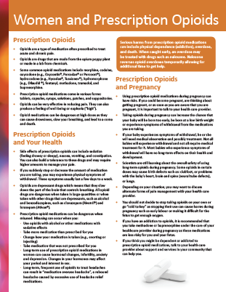
Opioids and Pregnancy
Many women are prescribed opioids before they become pregnant for a variety of reasons and will use opioids during pregnancy.
Taking opioids during pregnancy can increase the chance that your baby will be born too early, be born at a low birth weight or experience symptoms of withdrawal from the medications you are taking.
Some opioids in certain doses may cause birth defects such as clubfoot, or problems with the infant’s heart, brain and spine (neural tube defects) or lungs.
Pregnant women with an opioid addiction should gradually reduce their substance use as acute, severe opioid withdrawal can result in miscarriage and premature labour. Women should seek medical assistance rather than stopping taking opioids on their own or going “cold turkey.”
Prescribed medications such as methadone, buprenorphine and buprenorphine/naloxone (“opioid agonists”) can help pregnant women who are addicted to opioids manage withdrawal and support treatment and recovery.
Resource:
https://cewh.ca/wp-content/uploads/2018/03/InfoSheet-Women-Opioids0308.pdf
Notes:
Sources
Abrahams, R.R., et al. (2007). Rooming-in compared with standard care for newborns of mothers using methadone or heroin. Can Fam Physician, 53(10): 1722-30.
American College of Obstetricians and Gynecologists and American Society of Addiction Medicine. (2017). ACOG Committee Opinion 711: Opioid Use and Opioid Use Disorder in Pregnancy. Available from www.acog.org.
Canadian Centre on Substance Use and Addiction. (2017). Prescription Opioids. Available from www.ccdus.ca
Edwards, L. and L.F. Brown. (2016). Nonpharmacologic Management of Neonatal Abstinence Syndrome: An Integrative Review. Neonatal Netw, 35(5): 305-13.
Resource:
https://cewh.ca/wp-content/uploads/2018/03/InfoSheet-Women-Opioids0308.pdf

Slide 109

Harm Reduction and Polysubstance Use
Many pregnant women can reduce or quit substance use for all or part of their pregnancy. For women who are making changes to their substance use, it may be helpful for them to know about the relative harms of various substances and the potential impact on the fetus.
Alcohol and tobacco are the two substances that can be most harmful for fetal health and in the long-term for infants who are exposed in utero. This information may help women prioritize the changes that they are making in their lives.
If women are using illicit substances (such as heroin or cocaine), some potential harms can be addressed through safer substance use (e.g., clean needles or safe supply), safer sex, and supports such as testing substances before use, and for sexually transmitted and blood-borne infections (STBBIs).
Notes:
Sources
American College of Obstetricians and Gynecologists and American Society of Addiction Medicine, ACOG Committee Opinion 711: Opioid Use and Opioid Use Disorder in Pregnancy. 2017, American College of Obstetricians and Gynecologists: Washington, DC.
Janisse, J.J., et al., Alcohol, tobacco, cocaine, and marijuana use: relative contributions to preterm delivery and fetal growth restriction. Substance Abuse, 2014. 35(1): p. 60-7.

Slide 110

11
SECTION
Prenatal and Postnatal Support
Prenatal and postnatal programs for women and their support networks with substance use concerns
Weeping Willow by Shawn Howe
Artist Description of ‘Weeping Willow’
https://elearning.canfasd.ca/portals/salus/audio/CanFASD/Weeping_Willow_Oral_Story.m4a
Notes:
Artist Description of ‘Weeping Willow’
https://elearning.canfasd.ca/portals/salus/audio/CanFASD/Weeping_Willow_Oral_Story.m4a

Slide 111
Prevention Programs
FOR WOMEN AT HIGHER RISK
Parenting programs for mothers
Ongoing recovery support for new mothers
Continual, holistic, and
non-judgmental care
Support for early attachment
Provision of practical supports, such as nutrition supports and bus tickets
Early interventions for children with prenatal alcohol exposure
Some women need support, care and treatment to help them stop drinking during pregnancy.

Slide 112
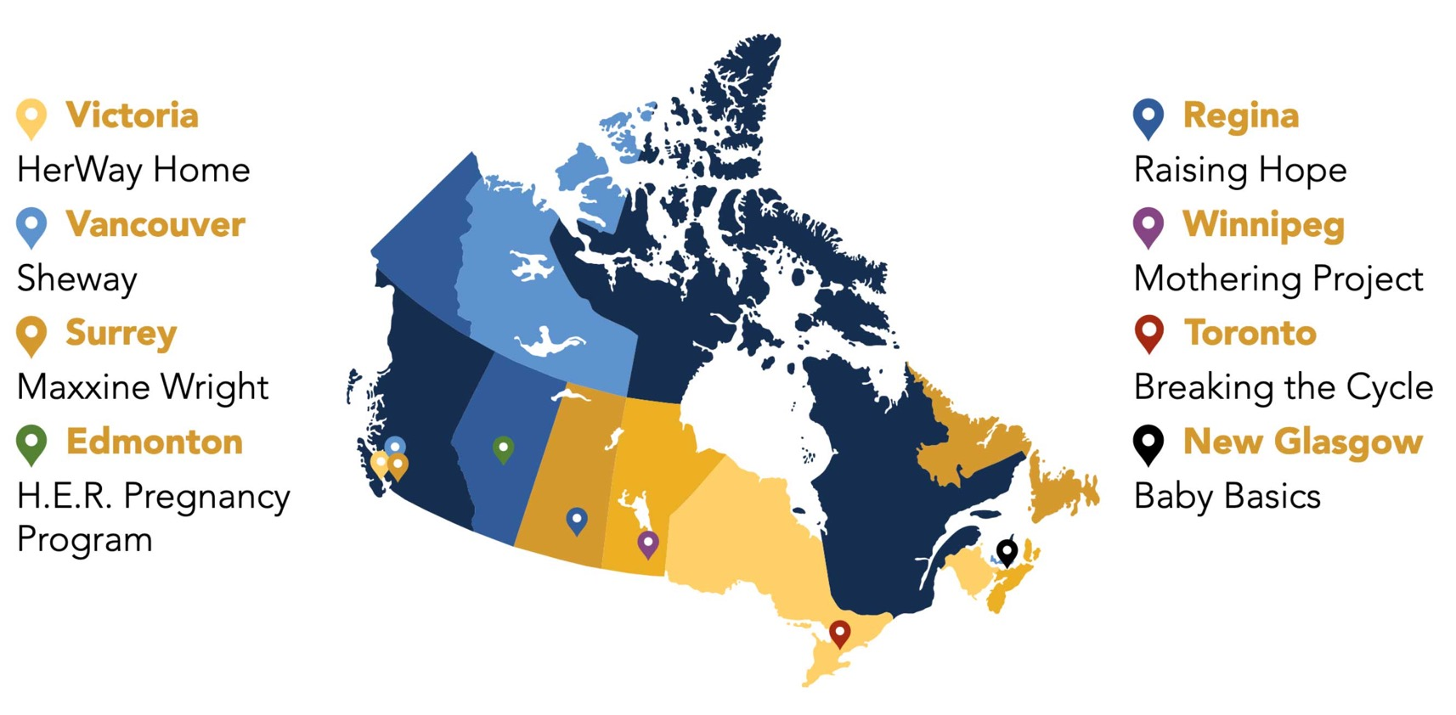
Co-Creating Evidence (CCE) Project
The Co-Creating Evidence (CCE) project was a first-of-its-kind-in-Canada national evaluation involving eight multi-service programs serving women at high risk of having an infant who has been prenatally exposed to alcohol or other substances. The eight programs taking part in the study are all different, and all were developed in response to local influences and issues.
http://www.fasd-evaluation.ca/
Notes:
Holistic, multi-service care for pregnant women with substance use concerns has been identified as effective. Integrated service delivery can support change on multiple health and social issues through providing holistic care for mothers, babies, and the mother-child relationship. Critical components of multidisciplinary integrated programs include a focus on empowerment, enhanced access to and coordination of care for clients, cross-sectoral collaboration, and individually tailored service delivery across the life course. In Canada, the Co-Creating Evidence Project was a national evaluation of eight multidisciplinary integrated programs supporting women at high risk of having an infant prenatally exposed to alcohol or other substances. This map demonstrates the eight programs that took place in the study. Each program is different, were all developed in response to local influences and issues, and reaches 6 jurisdictions across Canada.

Slide 113
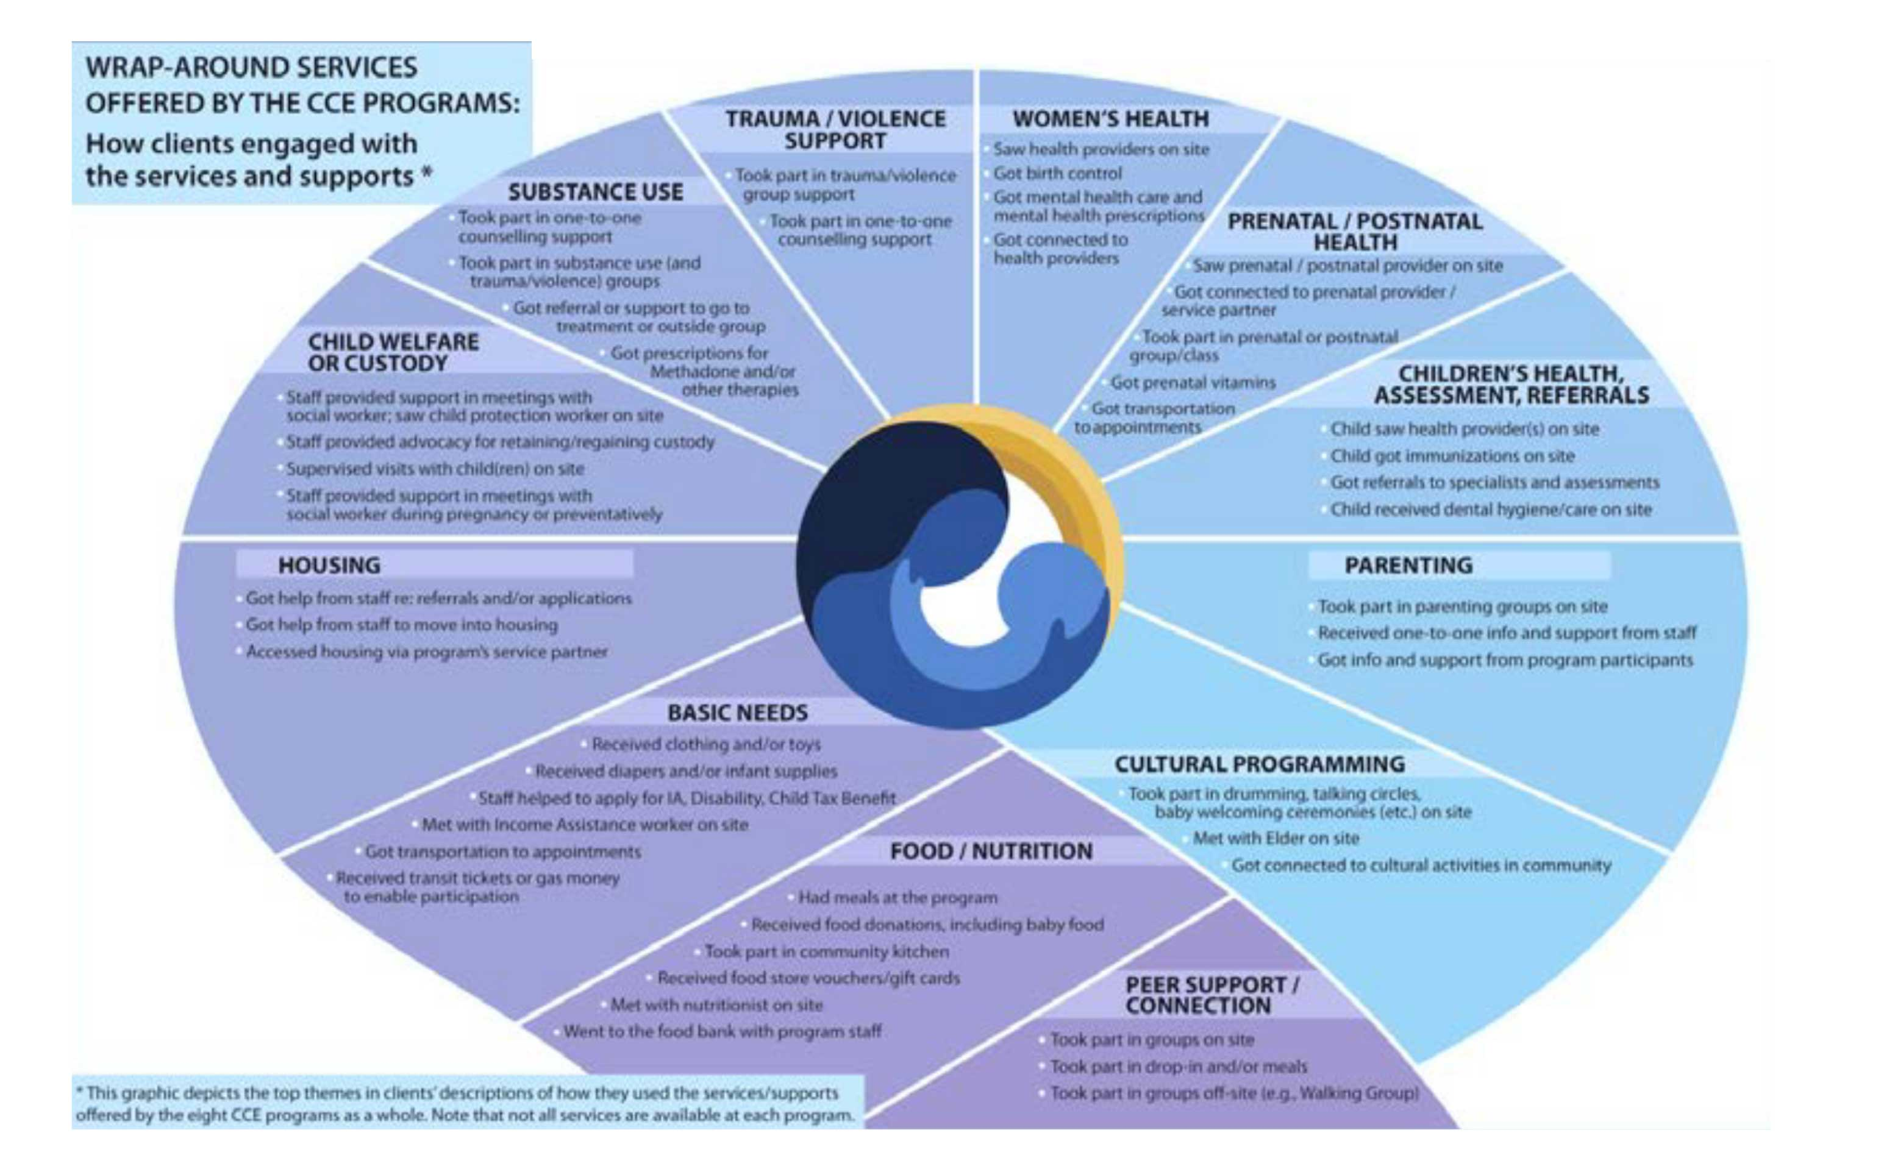
This graphic from the Co-Creating Evidence Project shows how multiple services for women’s various needs can help support clients in many aspects of their lives.
Substance Use
Trauma/Violence Support
Women’s Health
Prenatal/Postnatal Health
Children’s Health, Assessment, Referrals
Parenting
Cultural Programming
Peer Support/Connection
Food/Nutrition
Basic Needs
Housing
Child Welfare or Custody
http://www.fasd-evaluation.ca/communitysystem-outcomes/
Notes:
https://fasd-evaluation.ca/home/
http://www.fasd-evaluation.ca/communitysystem-outcomes/

Slide 114
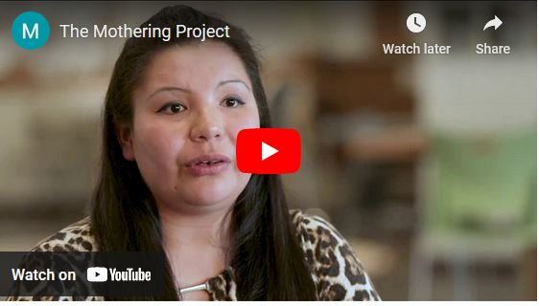
Mothering Project
This video describes how the Mothering Project (Manito Ikwe Kagikwe) in Winnipeg, Manitoba supports women with substance use challenges on their journey of healing and belonging
https://youtu.be/c2YBbOgF7TA
Notes:
https://youtu.be/c2YBbOgF7TA

Slide 115

The Parent-Child Assistance Program (PCAP)
is designed for pregnant women or new mothers (within 6 months postpartum) who have used substances during pregnancy and need support for connecting to local services.
It provides support and linkages to needed services to women for 3 years following enrollment.
The goal is to reduce future alcohol use during pregnancy by increasing abstinence from alcohol and drug use and/or improving regular use of reliable contraception among enrollees.
The model is based on relational theory and harm reduction.

Slide 116
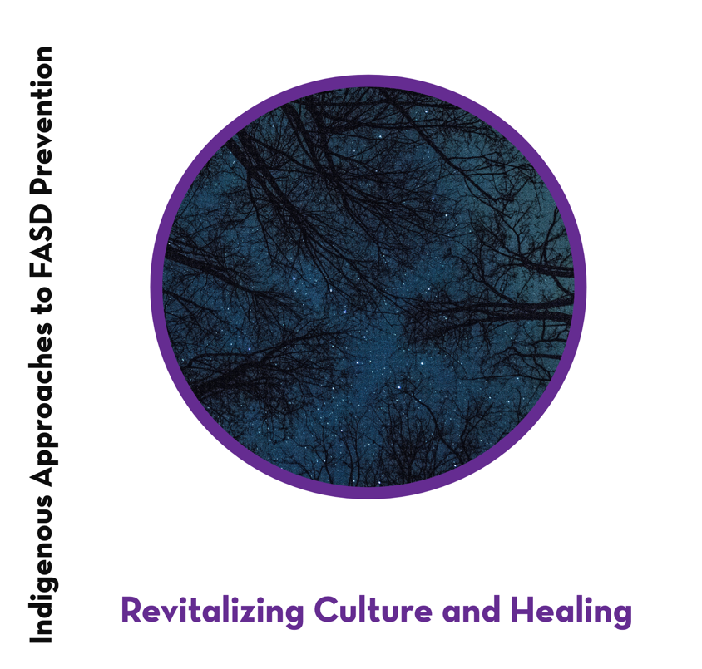
Indigenous Approaches to FASD Prevention
Life Course
Community-based, community-driven approaches respond to the overall well-being of women and families from an Indigenous wellness perspective
Strength Based
Community Led
Wraparound Support
Community Driven
Social and Structural Determinants of Health
https://cewh.ca/wp-content/uploads/2022/01/Indig-FASD-Booklet_November-21-2019-web.pdf
Notes:
where culture and language, coordinating basic needs, and addressing complex challenges become part of community-based strategies for women’s health, goes hand in hand with a non-judgmental supportive approach. Community-based, community-driven programs have been effective in expanding and decolonizing their thinking around what FASD prevention can look like, and how language, ceremony, protocols, traditional knowledge and Elders can be incorporated into wellness programming.
In Revitalizing Culture and Healing, seven community-based, community-driven programs are described by the program providers themselves. Here are the principles embedded in each of the programs.
https://cewh.ca/wp-content/uploads/2022/01/Indig-FASD-Booklet_November-21-2019-web.pdf

Slide 117


12
SECTION
Let’s Talk:
The Prevention Conversation
Connection between alcohol usage and FASD
Empowering approaches
Understand how to engage girls and start conversations
The Four Directions by Theresa Burning
The white heart surrounded by white beads represents the beginning of life - purity and innocence; the baby. Orange represents joy, warmth, enthusiasm, and creativity; the toddler and child. Yellow represents optimism, friendship, energy, and joy; the youth. Red represents life, health, vigour, courage, and life; the young adult. Blue represents serenity, stability, inspiration, and wisdom; the parent. Purple represents peace, independence, and devotion; the final stage.
The barrette surrounded by white beads represents once again returning to innocence at the end of life. The two different shades of colour quills in the star represent the different levels of each stage - different learning of stability, independence, courage, joy, etc.
The white crystal beads with each colour in the star represent the new beginning and purity at each stage.
Notes:
Artist Description of ‘Weeping Willow’
https://elearning.canfasd.ca/portals/salus/audio/CanFASD/Weeping_Willow_Oral_Story.m4a

Slide 118

Girls, Alcohol and Pregnancy
Alcohol use during pregnancy is strongly related to alcohol use before pregnancy. Educating and supporting girls on alcohol and related issues can be an opportunity to share information about FASD prevention and to improve girls’ overall health and well-being.

Slide 119
Alcohol Use By Girls
Alcohol is the leading substance used by Canadian youth, followed by cannabis.
Approximately
Females between
30%
15-24yrs
The average age girls first drink alcohol in Canada is
13.6 years old
are classified as ‘heavy drinkers’ who have consumed 4 or more alcoholic beverages per occasion, monthly
Overall, rates of alcohol use between boys and girls are becoming more similar, and risky drinking among girls aged 10 - 19 have increased, highlighting the importance of gender-informed FASD prevention efforts for girls.
Given that 30% of women ages 15–24 have been classified as ‘heavy drinkers,’ there may be opportunities to increase FASD prevention efforts in order to reduce the risk of alcohol-exposed pregnancies.
1 in 8
In 2018
> 70%
of girls and women ages 15-24 (50% of which are under the legal drinking age) have consumed alcohol in the past year.
live births in Canada were born to mothers ages 15 - 24.

Slide 120



Drinking & Your Health
You can also help girls moderate their drinking by discussing Canada’s Guidance on Alcohol and Health Possible areas for discussion can include:
What is a standard drink?
What is the continuum of risk associated with alcohol use per occasion?
Finding their personal limit
(e.g., based on body size, genetics)
https://ccsa.ca/sites/default/files/2023-01/CGAH-Drinking-Less-is-Better-en%20%28ID%2050809%29.pdf
Notes:
https://ccsa.ca/sites/default/files/2023-01/CGAH-Drinking-Less-is-Better-en%20%28ID%2050809%29.pdf

Slide 121

Empowering Approaches
Alcohol use is connected to many other issues facing girls such as sexuality, mental wellness, eating disorders and weight concerns, and sexual assault. Girls are often learning about their own personal values, limits, and preferences related to alcohol use.
How Can We ALL Start Prevention Conversations To Support Girls?
When working with girls, it is often helpful to take a pragmatic approach and to work with “where girls are at.” If girls are already drinking, you can focus on sharing information and building skills rather than taking a “zero alcohol use” stance. Rather than trying to change their mind about drinking alcohol, you can empower them to make their own decisions about their health and well-being.

Slide 122

Why A Harm Reduction Approach Can Be Helpful
1
You can have open conversations about both the benefits and drawbacks of alcohol use.
Harm reduction approaches do not condone alcohol use – abstinence is an acceptable choice!
But it’s important to have conversations that reflect girls’ realities.
2
More likely to share ideas about changes they would like to make and to get feedback and support in making those changes.
3
You can emphasize options and choices.
4
Harm reduction approaches emphasize contraception use
Notes:
You can have open conversations about both the benefits and drawbacks of alcohol use. While alcohol use can have serious health impacts, it is important to acknowledge the benefits as seen by girls (e.g., enjoyment, a way of coping with stress, a shared activity with friends)
When girls have the opportunity to discuss the pros and cons of alcohol use, they are more likely to share ideas about changes they would like to make and to get feedback and support in making those changes.
You can emphasize options and choices. For many girls, incremental changes or small steps are much more “do-able” than completely stopping drinking. Working with “where she is at” honors the level and type of change that a girl wants to make.
Harm reduction approaches are also inclusive of offering contraception use. Building off of what you learned in Module 8 - Contraception, you can emphasize options such as more effective contraceptive use.

Slide 123

Brief Interventions with Girls
Some ideas for brief conversations with girls about alcohol include:
How to manage stress (alternatives to alcohol and other substance use)
Information on the short- and long-term health effects of alcohol, including unique concerns for girls and women
(e.g., link between breast cancer and alcohol)
Skills for talking to parents about alcohol use
Recognizing warning signs of alcohol poisoning and how to get help
Role-modeling refusal skills
Help with making connections between substance use, sexuality, mental wellness, eating disorders, weight concerns, and sexual assault

Slide 124

Alcohol and Sexual Assault
Let’s Talk About Consent
Ensure girls know that the behaviour of a perpetrator is NEVER their fault.
Discuss ways that girls can keep themselves and their friends safer.
Discuss what consent is, who can give it and when it can and cannot be given.
Help girls develop skills for talking about and discussing consent while in the moment, e.g., “Are you comfortable?”
Remind girls that consent should be clear and enthusiastic on both sides and that they and their partners should be able to consent every step of the way.
If people are under the influence of alcohol or other substances, they are not able to give consent.
https://www.youtube.com/watch?v=rAy5LYJlTII
This short video clip from the Canadian Women’s Health Network raises questions about how to give and get sexual consent (http://getconsent.ca)
Notes:
This short video clip from the Canadian Women’s Health Network raises questions about how to give and get sexual consent (http://getconsent.ca)
https://www.youtube.com/watch?v=rAy5LYJlTII

Slide 125
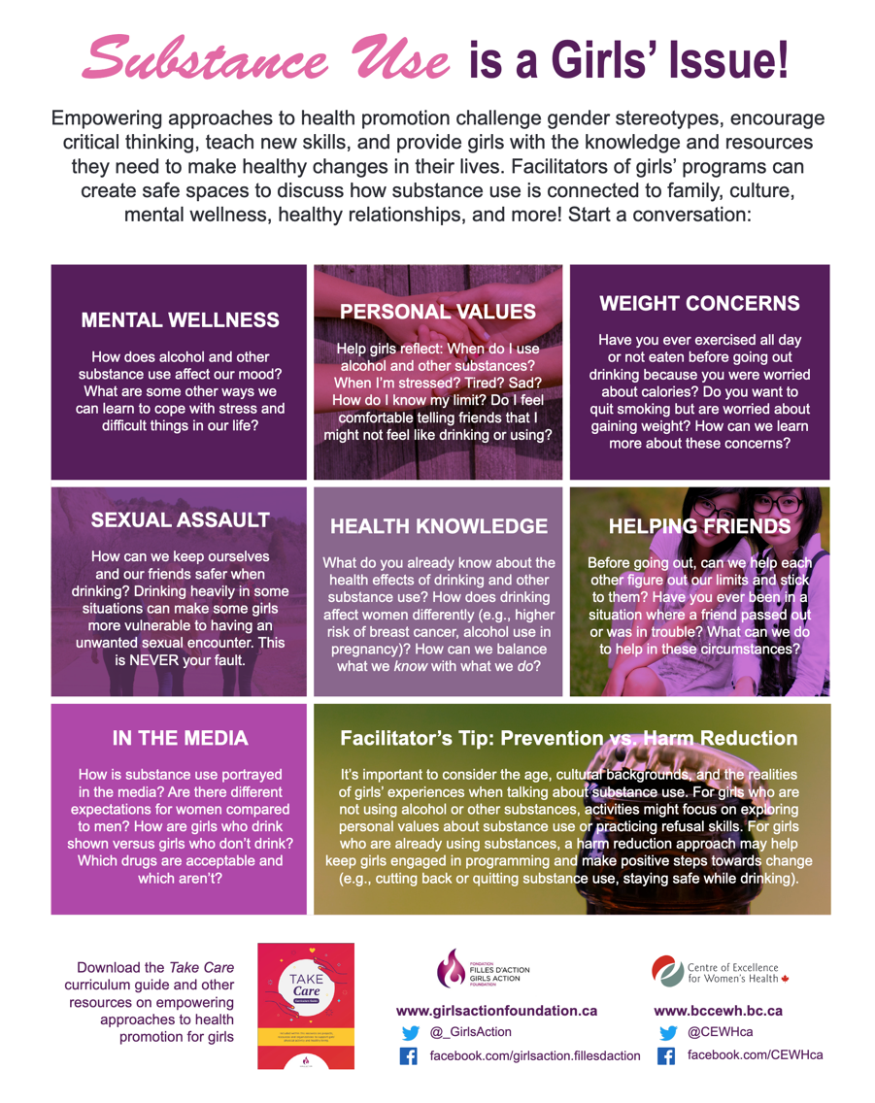
Substance Use is a Girls’ Issue
This resource from the Centre of Excellence for Women’s Health and Girls’ Action Foundation may give you some other ideas for starting conversations about alcohol and other substance use with girls.
https://bccewh.bc.ca/wp-content/uploads/2018/09/Discussion-Questions-for-Girls-Groups-Substance-Use.pdf
Notes:
https://bccewh.bc.ca/wp-content/uploads/2018/09/Discussion-Questions-for-Girls-Groups-Substance-Use.pdf

Slide 126

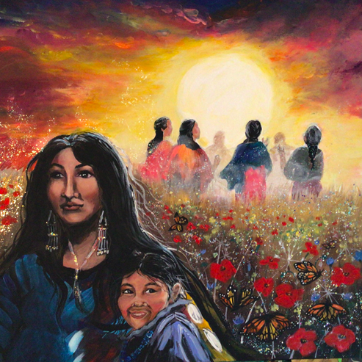

12
SECTION
Engaging Partners and Support Networks
Importance of involving men, partners, and support networks in the Prevention Conversation
Brief interventions that involve women’s partners and support networks
Prayer Warriors by Laura Fauchon
“Behind each child and mother is someone from their community or lineage who has prayed over them or is praying for them during their journey. They are in a circle as we do all things circular. She is protected by the Creator. The poppies represent the families and the butterflies are those in the spirit world.”
Notes:
‘Prayer Warriors’ by Laura Fauchon
“Behind each child and mother is someone from their community or lineage who has prayed over them or is praying for them during their journey. They are in a circle as we do all things circular. She is protected by the Creator. The poppies represent the families and the butterflies are those in the spirit world.”

Slide 127
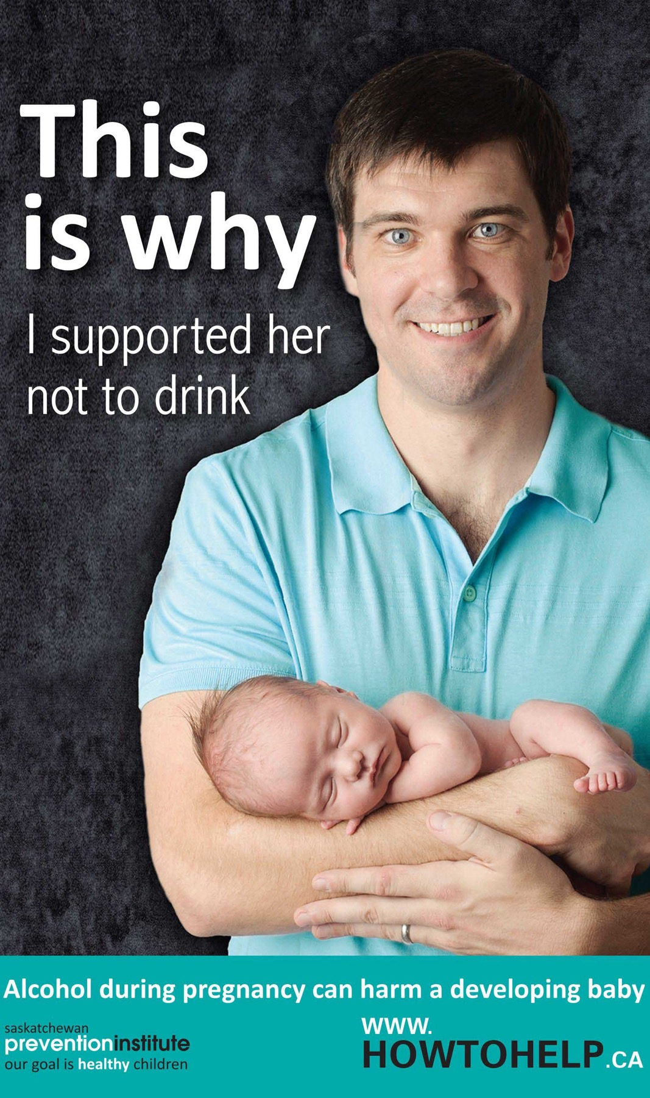
The Role of Partners, Family and Friends
Be Patient and Supportive
Provide Practical Support
A healthy baby isn’t just a mother’s responsibility.
Everyone plays a role.
It is every person’s right to have relationships that nurture and lend support, that are free from harm.
Put Their Needs First
Managing Stress
Notes:
The Role of Partners, Family and Friends
A healthy baby isn’t just a mother’s responsibility. Everyone plays a role. It is every person’s right to have relationships that nurture and lend support, that are free from harm. Partners, friends, and family members can support a pregnant woman in many ways, including how they can help her make healthy choices during her pregnancy.
Be Patient and Supportive
A pregnant woman often feels physically uncomfortable, and pregnancy can affect her moods. Open communication and plenty of empathy (i.e., trying to understand what she’s going through) go a long way.
Provide Practical Support
Help with childcare and housework. Maybe she’d like a massage. Ask her if she needs help in other ways. For example, she may ask people not to drink alcohol around her. She needs people not to smoke around her. She might need help finding professional support (such as counselling).
Put Her Needs First
Other people’s alcohol use can affect a pregnant woman and the baby. It’s okay to tell people not to drink, smoke or use other drugs around her. This is not always easy to do, but the knowledge that others are there to support her will make it easier for her.
Managing Stress
Stress is a part of everybody’s life, but pregnancy can increase stress for both a mother and those close to her. Finding positive ways to deal with stress – and helping the pregnant woman deal with hers in healthy ways – is important. Strategies for managing stress for pregnant women may include talking about one’s worries, getting enough sleep and rest, eating well, exercising, learning relaxation techniques, taking one thing at a time and seeking help if needed. Being helpful rather than being controlling or coercive is important to support women.
http://skprevention.ca/wp-content/uploads/2016/12/3-060_This_Is_Why_I_Supported_Her_Not_To_Drink_Poster.pdf

Slide 128

Partners
PARTNERS CAN HAVE A SIGNIFICANT IMPACT ON WOMEN’S ABILITY TO CHANGE THEIR SUBSTANCE USE
1. Partners and support networks
It is important to remember that partners can be men, women, or gender-diverse.
2. Let women decide
Decisions about whether or how to engage partners will depend on women themselves and whether they find their partners’ involvement supportive or would prefer that their partners access services or make changes on their own.
3. Men’s Health and FASD
Fathers’ drinking does not result in FASD, but it has an important influence on mothers’ consumption and healthy infant and child development. However, there has been increased research on men’s health and FASD. Initial research has found that alcohol impacts males’ reproductive systems, that there are several genes that make a fetus more vulnerable to alcohol exposure.
Notes:
Sources
Astley, S.J., et al., (2000). Fetal alcohol syndrome (FAS) primary prevention through fas diagnosis: II. A comprehensive profile of 80 birth mothers of children with FAS. Alcohol, 35(5), 509-19.
Greaves, L., A. Pederson, and N. Poole, eds. (2014). Making It Better: Gender-Transformative Health Promotion. Canadian Scholars: Toronto, ON.
Lyall, V., Wolfson, L. et al. (2021). “The Problem Is that We Hear a Bit of Everything . . . ”: A Qualitative Systematic Review of Factors Associated with Alcohol Use, Reduction, and Abstinence in Pregnancy. International Journal of Environmental Research & Public Health, 18(3445).
McBride, N. and S. Johnson (2016). Fathers' Role in Alcohol-Exposed Pregnancies: Systematic Review of Human Studies. American Journal of Preventive Medicine, 51(2), 240-248.
van der Wulp, N.Y., C. Hoving, and H. de Vries. (2013). A qualitative investigation of alcohol use advice during pregnancy: experiences of Dutch midwives, pregnant women and their partners. Midwifery, 29(11), e89-e98.
Wulp, N.Y., C. Hoving, and H. Vries. (2016). Correlates of partner support to abstain from prenatal alcohol use: a cross-sectional survey among Dutch partners of pregnant women. Health & Social Care in the Community, 24(5), 614-622.

Slide 129

Brief Interventions with Women and their Partners
Finding common health goals
Ask women and their partners what they know
Share health information
Help plan for fun
Preconception Self-Assessment (for men)
Pregnant Pause
Getting ready for parenthood

Slide 130

Practical Support
Creating Supportive Environments
Offer non-alcoholic drinks at social gatherings, such as juice, water or tea. Or try serving soda water and fruit juice in a fancy glass.
They can take a “pause” from alcohol during the pregnancy or avoid drinking around her. Having someone go alcohol-free for part or all the pregnancy can be helpful and encouraging for some women.
Suggest or choose a coffee shop or restaurant instead of a bar when going out with friends.
Suggest social activities that don’t involve alcohol – watch a movie, go for a walk, or attend a local performance. This helps women to not feel like they are “missing out.”
Circles of Support
While women are often the focus of most mainstream FASD prevention activities, interventions are beginning to expand to include women’s partners, families, and communities.

Slide 131
How to Talk with Women
Sometimes, partners, friends, and family members might be worried about their loved one and feel uncertain about how to help or how to bring up the topic of alcohol use in pregnancy. You can let them know that they can provide positive support by:
Telling her what she is doing well and acknowledging her efforts
Not telling her what to do
Listening
They can start a conversation by saying:
“What could make it easier to stop drinking or reduce drinking?”
“How can I help?”

Slide 132

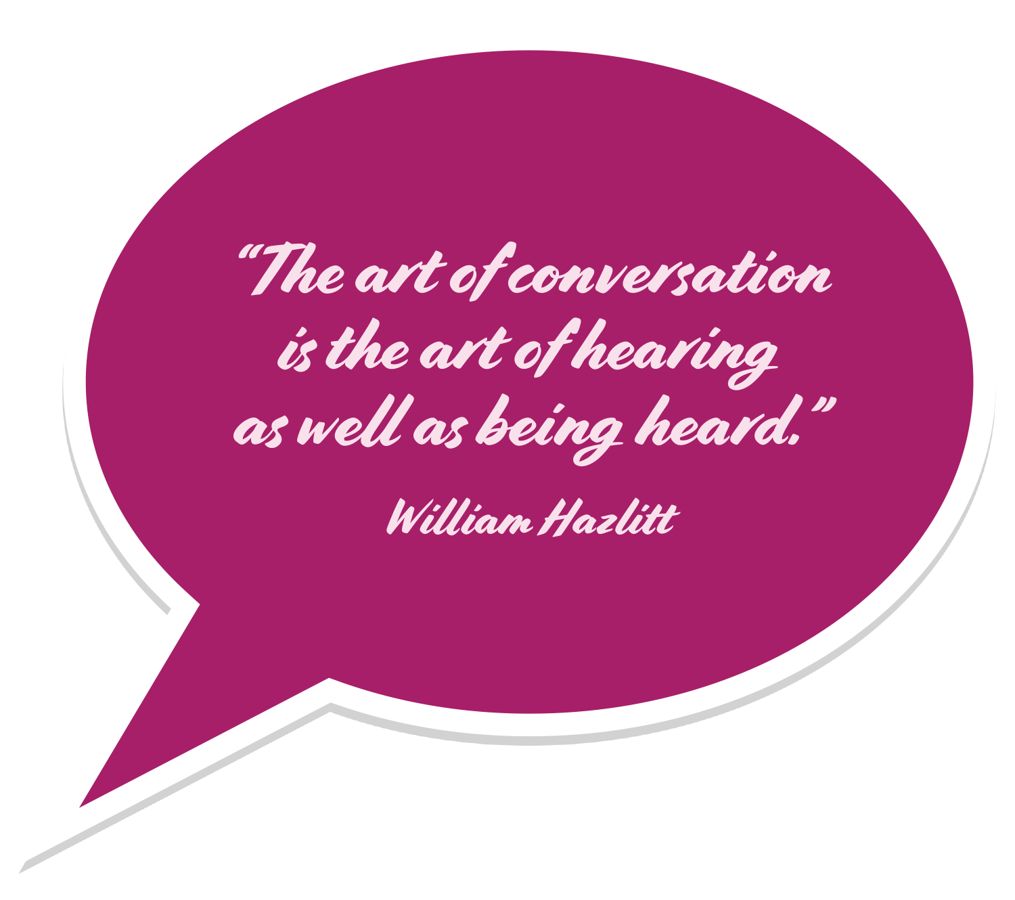
E.A.R. Statements
Empathy
Attention
Respect
“I can see how frustrated you are by this situation, and I want to help. Maybe we can talk about it so I can understand what’s happening. I have a lot of respect for everything you’ve been doing to cut back on your drinking.”

Slide 133

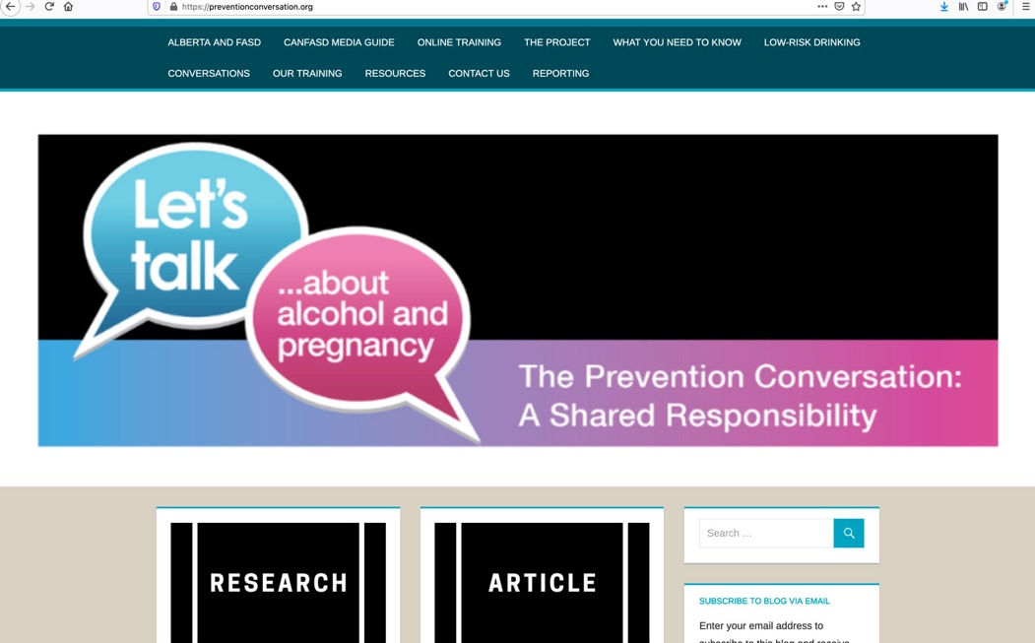
Website: The Prevention Conversation
www.preventionconversation.org

Slide 134
First Name Last Name
Prevention Facilitator
Contact Us
Phone Number
www.preventionconversation.org
Email Address
Network Website
Notes:
Facilitator to fill in their own contact information

