Slide 1




PREVENTION CONVERSATION & TOWARDS HEALTHY OUTCOMES
FOUNDATIONS TRAINING

Slide 2
TOWARDS HEALTHY OUTCOMES
WE GO WHERE WE LOOK
Notes:
Presenters note: Read slide title
Today we are going to be learning about perspectives.
Specifically, we will talk about mindset, the way we usually think. ‘The direction we look in,’ often shapes ways we think and then act.
In simple terms, where we look is often where we go – physically but also in our interactions, planning and support of others. Our mindset tells us what to focus on and can be shaped by fear or worry. So, we may focus on risks in an effort to avoid risks.
Because of this, we may fail to spend time and effort on the things that may protect us from risk or help us to avoid risk.
In other words, by focusing only on fear, we may increase the risk of something bad happening, rather than move in a safer direction.

Slide 3

Notes:
Let’s talk about this using an everyday example:
Note for presenters: if you are able, feel free to adjust this metaphor to a personal story/experience that you have had if it is a good fit here. Otherwise, please use the following example. You can adjust the words to fit your own style as needed.
One day, a little boy is out riding on his bike with his parents. Helmet on and training wheels ready, he is excited to be riding his big boy bike all by himself!
He is riding his bike on the sidewalk while his parents walk behind him and watch his progress.
There are lots of cars parked beside the sidewalk, close enough that the mom, who is watching her son ride, a little unsteady but excited, is beginning to worry that he is going to hit one of the parked cars. So she decides to warn him by saying “watch out, don’t hit the cars!”
Her son hears her and begins to pay more attention to the parked cars. At first, the mom is relieved. But as she watches her son continue to bike along the sidewalk, her worry increases, as do her warnings: “watch out!” “Not so close!” “Look out for the cars!” “Don’t hit anything!”
Despite the mom’s warnings and her son’s concentration, he eventually hits the car. Much to his mom’s dismay.
When asked why he didn’t watch out for the car, the son says, frustrated, “I did mom! I was watching the cars!”
It’s then the mom realizes her mistake: In focusing so much of her attention on the cars, her son also became more focused on the cars than the clear path in front of him.
In focusing on avoiding risks, she had steered him right into one.
The same is true in other parts of life too: Where we put our attention and effort is where we move towards.
Now it is fair to say that life is often not this simple. Sometimes a path is not clear, and we cannot ignore the risks. This example shows the risk of OVER focusing on the worry, rather than clearly defining the desired path.
Even in complicated situations, like addiction, a clear definition of healthy living, healthy coping, self-care and/or stability, can lead to new ideas. It gives people something to work toward.
Also, and perhaps most simply, it reminds all of us that there is something positive to work towards. There is hope. This can change how we interact with other people and can build a foundation towards healthy outcomes.
Today we are going to talk about the impacts of where we look and how we can change where we look in two ways:
1. The way we interpret behaviour and how we interact with other people, and
2. The way we set goals and plan with people with FASD and their support teams.

Slide 4

PRESENTATION
OUTLINE
  Mindset: The Direction We Look Towards
  Activity: Pause, Reflect, Reframe
  Establishing Shared Understandings
  Using Shared Understanding to Pursue Goals
Notes:
Presenters note: read outline.
This presentation is about increasing our brain responsiveness, so that we can promote relationships with the people we are supporting.

Slide 5
ATTITUDES & PERCEPTIONS
THE DIRECTION WE LOOK TOWARDS
Notes:
Our attitudes and beliefs are the foundation for our thinking, or mindset.
Mindset is the direction we look towards.
By thinking about our own mindsets, we become more aware of how our beliefs influence our thinking and our behaviour. Our behaviour then impacts how we interact with others.
This reflective process helps us to explore how small shifts in our thinking may create opportunities in our work with others.

Slide 6

HOW OUR THINKING SHAPES OUR INTERACTIONS
MINDSET IN ACTION
We make assumptions based on behaviours.
For example, what do you assume when...
  Someone cuts you off in traffic?
  A pedestrian yells at you about where you parked your car?
  A friend cancels plans last minute?
  A neighbour ignores you when you wave at them?
  A client no shows an appointment with you?
Notes:
Let’s unpack mindset.
We all hold basic beliefs about what is important. These shape our priorities and interactions.
We also hold beliefs about what we think behaviour means – this is what we refer to as behavioural interpretation.
This means that when we see someone’s behaviour, our brains automatically “make sense” of what we see. We assume something about the person (ex: “they’re rude” or “they don’t care) or something about the situation (ex: “they must be having a bad day, “maybe they didn’t notice me.”)
We interpret what we see through the lens of our own experiences, our current mood or stress level, and often incomplete information.
That process of making sense is guided by our mindset or the internal framework of beliefs, attitudes, and expectations that influence how we understand others.
For example, what sort of assumptions might we make when someone cuts us off in traffic? Or when a pedestrian yells at us about where we parked our car?
Or when a friend cancels plans at the last minute, a neighbour ignores our wave, or a client doesn’t show up for their appointment?
In each of these moments, our mindset is quietly at work - guiding how we interpret what’s happening.
Depending on how we think about the situation, we might feel angry, dismissed, understanding, or simply curious.
The situation doesn’t change, but how we understand it does. That changes how we feel and act.

Slide 7

HOW OUR THINKING SHAPES OUR INTERACTIONS
MINDSET IN ACTION
We make assumptions based on behaviours.
For example, what do you assume when...
  Someone cuts you off in traffic?
  A pedestrian yells at you about where you parked your car?
  A friend cancels plans last minute?
  A neighbour ignores you when you wave at them?
  A client no shows an appointment with you?
RUDE
ENTITLED
FLAKY
SELFISH
DOES NOT CARE
Then we interact with others based on these assumptions.
Notes:
Often in these situations, especially when we are frustrated, we assume a negative motive is behind the behaviour. This assumption of a negative motive changes the way we interpret the behaviour and how we see the person. So, because of the negative interpretation, we may view these people in a negative light.
Presenter’s note: Read slide.
These assumptions then directly inform our interactions and relationships with those people.

Slide 8

HOW OUR THINKING SHAPES OUR INTERACTIONS
MINDSET IN ACTION
When we focus on the negative, we don’t leave room for alternative ways forward.
The behaviour we are seeing is functional - it serves a purpose.
Notes:
We are using simple, day to day examples. These examples show us that even small changes in how we think can make a big difference in how we support people.
This shift reminds us that everyone wants to move towards a clear path forward. Even when their actions do not make sense to us, we can understand that those actions were trying to meet a need.
As we support individuals with FASD on their path to success, we need to understand that what we see (i.e., their behaviour) is not the end of the story. We are building relationships and these relationships become the heart of the support we provide.
The first step is to understand that all behaviour is functional.

Slide 9

ALL BEHAVIOUR IS
FUNCTIONAL
Intent of behaviour
Observed Behaviour
Utility of behaviour
Notes:
It’s important that we understand that we can only see the behaviour; what is missing are the reasons behind the behaviour, and what that behaviour is trying to accomplish.
For example, we might not fully understand why someone is late to an appointment with us, or why a stranger yelled at us when we parked our car. But we definitely won’t understand if we do not consider the reasons behind the behaviour.

Slide 10

ALL BEHAVIOUR IS
FUNCTIONAL
ASK
Intent of behaviour
“WHAT DO I KNOW?”
Observed Behaviour
BEFORE
“WHAT DO I DO?”
Utility of behaviour
Notes:
We will not be able to understand what is causing a behaviour when we then jump right into thinking: What do I do? How do I solve this problem?
When we do that, we are likely to miss two big pieces of information:
The underlying intention or the “why” behind the behaviour and
The function of the behaviour, or the need the behaviour is meeting.
Understanding the underlying causes of behaviour makes our lives easier.
Before trying to fix the problem, we pause and ask “what do we know” about the person and situation.

Slide 11
THE DIRECTION WE LOOK
MATTERS
We make assumptions based on behaviours.
For example, what do you assume when...
  Someone cuts you off in traffic?
  A pedestrian yells at you about where you parked your car?
  A friend cancels plans last minute?
  A neighbour ignores you when you wave at them?
  A client no shows an appointment with you?
Notes:
So going back to our earlier examples with our new mindset of asking “What do I know?’, let’s revisit what we might assume about these people based on these observed behaviours.
Presenters note: read slide

Slide 12

THE DIRECTION WE LOOK
MATTERS
We make assumptions based on behaviours.
For example, what might you assume when...
  Someone cuts you off in traffic?
  A pedestrian yells at you about where you parked your car?
  A friend cancels plans last minute?
  A neighbour ignores you when you wave at them?
  A client no shows an appointment with you?
LATE
MOBILITY LIMITATIONS
EXHAUSTED
WRAPPED UP IN THOUGHT
ANXIOUS
Notes:
Presenters note: Read slide.
As with our bike metaphor, when we only focus on problems, it becomes much harder to think about anything else.
We can always learn to shift our focus, our mindset.
When we start to shift our focus, it becomes easier with practice and time. And growth becomes easier to see.
Instead of feeling offended or disrespected, we may start to feel more curious about why the behaviour is happening.

Slide 13
SHIFTING FROM
WHAT DO I DO?
TO
WHAT DO I KNOW?
Allows us to engage creatively with the people with FASD we support.
With appropriate conditions, growth is possible.
Notes:
This shift is an important first step in working with folks with FASD.
When we take this balanced approach, we can think more creatively about solutions and build on strengths.

Slide 14

ACTIVITY
BREAK
Let’s use what we learned so far to complete this reflection activity.
Notes:
Presenter Note: If time allows, select one of the story options from Activity 1 in the Activity Appendix document.
The best way to shift our mindset is to practice!
Now we’ll take a short activity break to practice what we’ve learned so far.

Slide 15



ACTIVITY
PAUSE, REFLECT, REFRAME
PAUSE
and identify initial thoughts or assumptions about the behaviour. These may include feelings of frustration or perceptions of disrespect.
REFLECT
and consider what else might be happening. Exploring how brain-based differences could influence the behaviour and what the person might be trying to communicate.
REFRAME
through developing alternative interpretations that view the behaviour as functional.
Notes:
Presenter Note: If time allows, include an activity here. Select one of the story options from Activity 1 in the Activity Appendix doc. Can be selected and tailored to the audience.

Slide 16
EVAN’S STORY
PAUSE, REFLECT, REFRAME
During math class, Evan (age 10) frequently calls out answers without raising his hand. He blurts out unrelated comments, interrupts classmates, and leaves his seat several times throughout the lesson. Although his teacher regularly reminds him to stay seated and wait for his turn, these behaviours continue to occur during classroom activities.
Notes:
Presenter Note: Remove or Keep slide depending on selection from Activity Appendix.

Slide 17
DISCUSSION
PAUSE, REFLECT, REFRAME
PAUSE
What was your first impression of Evan’s behaviour?
What assumptions did you make about his intentions?
REFLECT
What else might be going on for Evan (thoughts, feelings, sensations) that you might not have considered at first?
How could brain-based differences influence what we see?
REFRAME
How might this behaviour be functional from Evan’s perspective?
How could understanding his perspective change his teachers response?
Notes:
Presenter Note: Remove or Keep slide depending on selection from Activity Appendix.

Slide 18
LEANNE’S STORY
PAUSE, REFLECT, REFRAME
Leanne, age 22, has been working at a local grocery store for six months. She has been late for several shifts and sometimes missed the start of her scheduled hours. She often misplaces her work schedule and forgets her start times. When her supervisor asked about her being late, she explained, “I didn’t think calling would help because I knew I was already in trouble.”
Notes:
Presenter Note: Remove or Keep slide depending on selection from Activity Appendix.

Slide 19
DISCUSSION
PAUSE, REFLECT, REFRAME
PAUSE
What was your first reaction to Leanne’s actions?
What assumptions might the supervisor be making?
REFLECT
What brain-based differences could explain her difficulties managing work responsibilities?
What emotions might be contributing to her behaviours?
REFRAME
How might this behaviour be functional from Leanne’s perspective?
What strategies might support her success?
Notes:
Presenter Note: Remove or Keep slide depending on selection from Activity Appendix.

Slide 20
FETAL ALCOHOL SPECTRUM DISORDER
ESTABLISHING SHARED UNDERSTANDINGS
Notes:
Now that we have talked about HOW mindset affects what we think and do, let’s shift to building our knowledge about FASD: WHAT we know.
When we build a shared understanding of what FASD is, and how it affects the brain and body, we can better understand daily challenges and how to support healthy outcomes.

Slide 21
FETAL ALCOHOL SPECTRUM DISORDER
FASD IS...
  A neurodevelopmental disorder that is caused by prenatal alcohol exposure (PAE).
  The most common cause of neurodevelopmental disability in Canada. It is estimated that 4% of people in Canada have FASD.
  Characterized by diverse cognitive, behavioural, and physical needs.
  Impacts people and families from all socioeconomic and ethnic backgrounds.
Notes:
FASD is a neurodevelopmental disorder that is caused by prenatal alcohol exposure. It is estimated that approximately 4% of people in Canada have FASD.
Prenatal alcohol exposure is the most common cause of neurodevelopmental disability in Canada, more common than Autism, cerebral palsy, down syndrome, and Tourette’s syndrome combined.
People with FASD are all different: Prenatal alcohol exposure can affect thinking, behaviour, and physical development in many ways.
Each person with FASD has unique strengths and needs.
People from all social, cultural, economic, and ethnic backgrounds can be affected by prenatal alcohol exposure.

Slide 22
FETAL ALCOHOL SPECTRUM DISORDER
FASD IS...
  A neurodevelopmental disorder that is caused by prenatal alcohol exposure (PAE).
  The most common cause of neurodevelopmental disability in Canada. It is estimated that 4% of people in Canada have FASD.
  Characterized by diverse cognitive, behavioural, and physical needs.
  Impacts people and families from all socioeconomic and ethnic backgrounds.
People with FASD experience a wide range of potential strengths & needs in day to day functioning
Notes:
After being diagnosed with FASD, people with FASD and their families may experience a wide range of feelings, like relief, validation, empowerment, or feeling more understood and supported.
They may also experience feelings of grief or worry.
This means that a diagnosis of FASD can also lead to many questions, as people with FASD and their families try to understand how this will impact daily life.
This can be a chance for supporters to help set goals and think about what a healthy and meaningful future looks like.
Supporters can help by finding ways to work together to offer help where it is needed, while drawing on the person’s unique strengths.
Too often though, these questions are accompanied by fear and worry. Sometimes the risks feel serious, and we may react by focusing only on safety. This is called reactive responding – when we focus only on reducing risk and ignore any other goals.
While safety is an important priority, this can sometimes set a pattern of focusing on risks rather than finding a balance between navigating risks and working towards goals.
The mindset shift we have been talking about is an essential early step when we are supporting individuals with FASD to achieve success. By understanding brain-based differences in FASD, we are better prepared to manage risks and work towards meaningful goals.

Slide 23





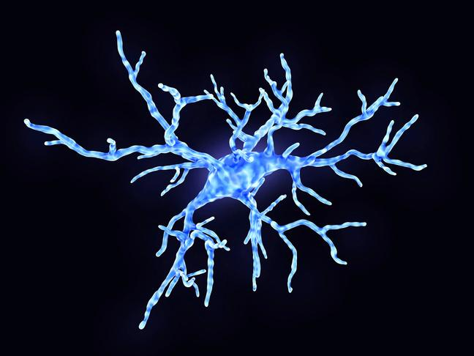




FASD
BRAIN DOMAINS
Notes:
Note for presenters: The pictures of the domains are in the same order as those listed below starting in the top left-hand corner and then moving towards the right. The first picture on the top line represents academic achievement, and the first picture on the bottom line represents neuroanatomy.
The Canadian Guidelines for FASD Diagnosis identify 10 areas of brain functioning that may be affected by prenatal alcohol exposure. These are the areas of functioning that are assessed during the diagnostic process to gain an
understanding of the unique needs of each person with FASD. The areas assessed include academic achievement, attention, cognition, language, memory, neuroanatomy, executive functioning, adaptive behaviour, motor skills, and affect regulation. Even though they are listed separately, these areas are all connected. No part of the brain works by itself.
Your role as supporters is not to recognize brain areas, but to understand how brain-based differences may affect each person’s strengths and challenges. Then you can adjust your support to match their needs. This is called being brain responsive.

Slide 24
FASD
BRAIN DOMAINS
What I might see...
Why I might be seeing this...
What can I do...
Follow-up around medical care and medication.
Do they need help with transportation?
Trouble driving or operating machinery.
Impacts of challenges with attention, focus, and hand eye coordination.
Illegible writing or frequent spelling mistakes when writing.
Underdeveloped academic skills due to disrupted school experiences or specific learning disorders.
Identify academic strengths.
Do they need a referral for assessment?
Develop accommodations for school/work.
Notes:
To connect brain differences to everyday life, we created tables to help guide support.
Here you see three columns. The first What I might see describes some common stories we’ve heard from support workers that they have experienced working alongside folks with FASD.
The next, why I might be seeing this, lists some possible brain-based reasons for the behaviour you are seeing.
Finally, the column what can I do offers some suggestions for discussion prompts and questions to ask the person you are working with.
Presenters note: read through the slide, if time allows open the floor for discussion with the audience as you walk through these points.

Slide 25
FASD
BRAIN DOMAINS
What I might see...
Why I might be seeing this...
What can I do...
Is there a communication barrier?
Present information strategically.
Encourage them to ask for clarification.
Impaired communication skills.
Hearing or visual impairment.
Not following instructions.
Memory impairment that makes it hard for them to transfer new learning into action.
How can I help them remember important tasks/information?
Use concrete language to regularly review information, one piece at a time.
Breaching probation.
Notes:
Presenters note: Read through the content on the slide row by row (rather than going through each column). If time allows, feel free to make this slide more conversational and incorporate audience feedback.
This helps us to understand that the people with FASD we are supporting are likely to interact with the world in a different way than we do.
Brain-responsive approaches encourage creative, and responsive solutions as we navigate towards our goals.
We will return to goals later.

Slide 26
TOWARDS HEALTHY OUTCOMES
USING SHARED UNDERSTANDING TO PURSUE GOALS
Notes:
Now we will shift our focus from one-on-one interactions, to consider broader thinking and planning: how we support people with FASD to set goals in a way that makes sense for their unique strengths and needs.
The framework, Towards Healthy Outcomes, explains how to identify and set goals, and the ways we might adjust strategies in a brain responsive way.
Towards Healthy Outcomes framework, or the THO, offers a different approach to setting goals. It provides guidance on how supports can help people with FASD, and suggestions for future planning – geared towards destination goals.
The Towards Healthy Outcomes framework is meant to be a guide for supporters, like families, caregivers, service providers, and other professionals working to help people with FASD achieve healthy outcomes.

Slide 27
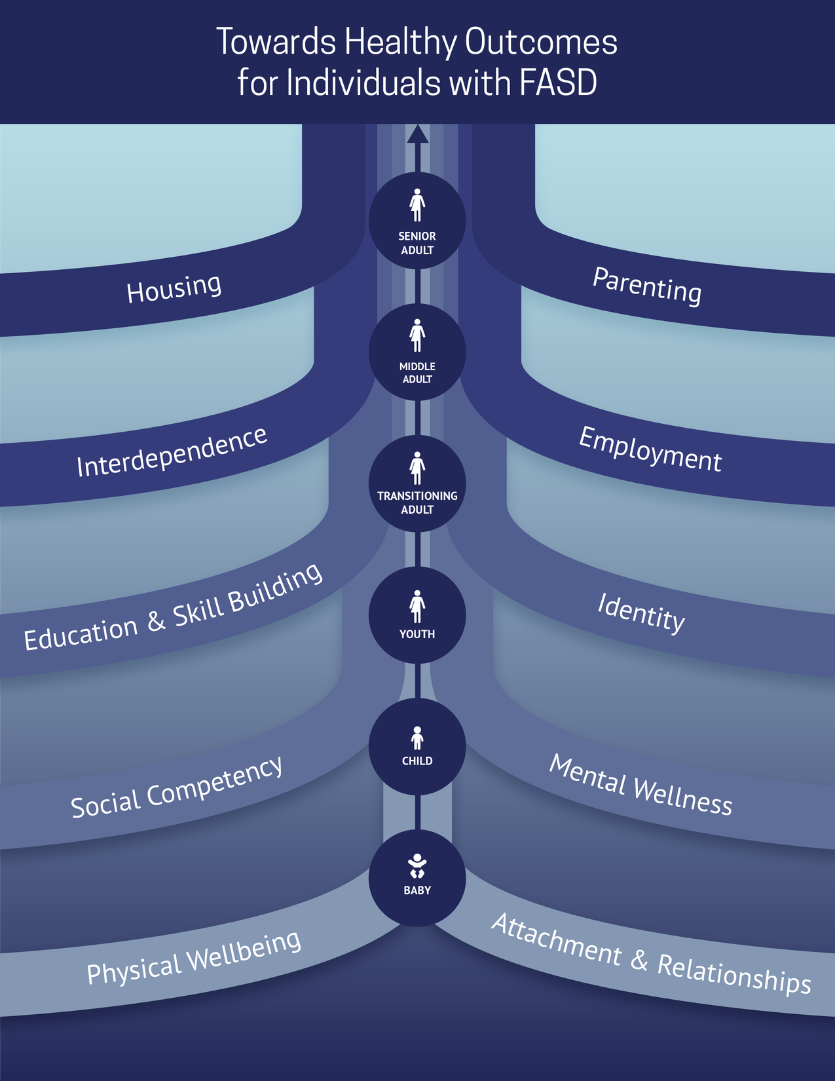
Notes:
The THO framework offers a shared understanding of goals and pathways to success.
Notice we are using the word shared. Understanding must be created through collaboration between the individual with FASD and their support team.
Shared understanding can include knowing why a person may be struggling, how they have experienced success and/or challenges.
Shared understanding allows for flexible and creative goal setting that is tailored to the person.
With this shared understanding, THO provides a map that can help service providers understand the unique developmental considerations that people with FASD experience, and potential areas for growth when planning for the future.
Using a framework like THO allows for greater consistency among service providers. It also helps connect research knowledge with real-world experiences.

Slide 28

TOWARDS HEALTHY OUTCOMES
UNDERLYING PHILOSOPHIES
DEVELOPMENTAL LIFESPAN PERSPECTIVE
All behaviour is functional
INTERACTIVE SYSTEMS
STRENGTHS-BASED & EMPOWERED
Notes:
These three philosophies guide the design and implementation of the THO framework.
Presenter Note: read the three bubbles.
At the heart of these philosophies is the understanding that we have already talked about - all behaviour is functional.
In the following slides, we will review and explain these underlying philosophies.

Slide 29
TOWARDS HEALTHY OUTCOMES
DEVELOPMENTAL LIFESPAN PERSPECTIVE
A person’s past and future impact their functioning.
AGES
Intervention is a lifelong process.
Intervention goals are based on an individual’s strengths & challenges.
DEVELOPMENTAL TRAJECTORY
Notes:
The figures in the middle of the visual represent that we move through developmental stages as we grow. This means we are influenced by the past while also looking towards the future.
Like all of us, people with FASD continue to grow and develop throughout their lives. The 10 THO domains are also represented in an order across the lifespan, showing how development changes over time. This shows that intervention is lifelong; it does not begin or end at any specific point.
Recognizing that development is ongoing, we must also base our goals on the unique strengths and needs of the individual. I wouldn’t set the same goals for myself as another person in this room, so why would we treat people with FASD any differently?

Slide 30
TOWARDS HEALTHY OUTCOMES
INTERACTIVE SYSTEMS
The influence of systems across the lifespan is interactive and additive.
Areas of support must interact fluidly and flexibly.
LAYERS OF COLOURS
Meaningful collaboration and responsivity is necessary.
Notes:
People with FASD often interact with many different systems, such as housing, healthcare and education. As they age, these systems can become more complex.
Each system is connected to both the individual and to other systems. These connections are often interactive and impact each other. For example, someone who struggles with housing may interact with housing systems and mental health and medical systems.
Given the number and complexity of these systems, support workers need to work with these systems in flexible and cooperative ways.

Slide 31
TOWARDS HEALTHY OUTCOMES
STRENGTHS-BASED & EMPOWERED
Mitigate challenges while ALSO promoting strengths.
Combination of individual strengths and engagement with support systems creates conditions for success.
Co-create success alongside individuals with FASD.
INDIVIDUAL IS AT THE CENTER
Notes:
The strengths-based philosophy helps us to consider challenges and strengths.
Our mindset - where we focus our attention and effort - shapes the direction we move.
Remember, everyone has different resources, abilities, and strengths, which can help support areas where someone is struggling.
The strengths-based philosophy of THO reminds us that everyone wants to succeed, even though success may look different for each person.

Slide 32
FASD DIAGNOSTIC
BRAIN DOMAINS
Notes:
When we go back to these brain domains, you might notice that they are slightly different from the THO domains in the previous slides. The goal today is not to match each brain domain with a THO domain, because we would likely find that many domains connect and overlap.
What these brain domains help us to do is to be brain-responsive in our interactions with people with FASD as they work toward the developmental goals in THO.
The THO helps us to see how we might use a developmental and goal-focused lens to seek supports and connect with systems.
So, we go from looking inward - at our own attitudes and beliefs that make up our mindset - to looking outward at how this mindset shapes how we see others.

Slide 33

Notes:
We want to encourage service providers like you to focus on the person we are supporting, and the unique way their brain-based differences affect how they work with services.
Here we have pulled out our little stick figure from our visual to demonstrate that at the centre of this framework is a neurodiverse person.
Because their brain is unique, the way they move toward goals may look different from how we would do it ourselves, but it makes sense for their unique brain.

Slide 34
TOWARDS HEALTHY OUTCOMES
THE DIRECTION WE MOVE TOWARDS
Notes:
So far, we focused on where we look: how our attitudes and beliefs, shape how we interpret behaviour.
Now we want to make it more practical.
To make that shift, we begin with the relational mindset - a collaborative way of thinking about our work that shapes how we interpret, respond to, and work with others.
Relational Mindset shows how our beliefs and experiences affect how we connect and communicate with others.
We can think of the relational mindset as the foundation for two systems that work together:
1. a brain-responsive mindset that helps us understand the “how” and “why” of behaviour, and
2. a growth-oriented mindset that shapes what we expect is possible in learning and growth.

Slide 35

Notes:
In Section 1, we used the bike metaphor to show that where we look shapes where we go.
Now, we are expanding that idea with a new metaphor: driving a car. This metaphor helps us talk about how people move toward healthy outcomes in different ways.
First, imagine the destination. Maybe it is Calgary. The destination represents our growth mindset: the direction we are aiming for and the belief that progress is possible.
Everyone is heading toward healthy outcomes, but each person’s route and pace will look different.
Now, consider the vehicle each person is driving.
Some cars have quick accelerators. Some have soft brakes. Some can handle rough roads, and others need smoother roads.
The vehicle represents our brain-responsive mindset. It reflects each person’s unique brain-based differences and the conditions they need to feel safe, capable, and calm.
Understanding the vehicle helps adjust our expectations.
We are not judging the car. Instead, we are learning what kind of support it needs to drive well.
None of us drive alone. We use a GPS, we ask for directions, or sometimes we need co-pilots: someone who can point out turns, help track the route, or remind us to slow down.
Some people may need someone with an extra brake pedal or someone who can “step in” and help when things feel overwhelming.
These co-pilots represent our relational mindset. They are the supportive people and relationships that make the journey safer and steadier.
A strong relational mindset means understanding when to step in, when to guide, and when to share responsibility along the drive.
It is not about better or worse vehicles. Instead, our hope is you will begin to recognize what each driver needs to stay safely on the road.

Slide 36

THE PATH TO SUCCESS
DESTINATION VS. DETOUR
Success may be defined differently by each person.
Destination Goals: Growth happens when goals fit the person.
Notes:
Progress isn’t straight —it depends on a person’s readiness, the supports available to them, and the environment. That means the process is just as important as the goal, and sometimes the process include barriers.
Success is not the same for everyone.
Growth happens when goals fit the person, when they feel possible and meaningful. These are destination goals; they give us direction and the opportunity to grow.

Slide 37

THE PATH TO SUCCESS
DESTINATION VS. DETOUR
ADJUST
SUPPORTS
Notes:
For people with FASD, barriers may need to be addressed with different timing or tools.
Barriers do not mean failure.

Slide 38
MOTIVATION & READINESS
HOW WE MOVE TOWARDS GOALS
Notes:
Our mindset shapes what we believe we can do.

Slide 39

MINDSET MATTERS
FIXED VS. GROWTH
Fixed mindset: the car is the way it is and the path it is on cannot be changed.
Brain-Responsive Mindset: understanding why the vehicle might run differently, and what it might need to keep going forwad.
Growth mindset: barriers are opportunities for learning and possibility.
Relational Mindset: to travel together, we need trust and shared understanding.
Notes:
A fixed mindset frames abilities as hard to change.
Different mindsets help us think about the journey, the people we work with, and the barriers we meet differently:
A brain-responsive mindset helps us understand why the vehicle may be slowing down or moving too fast. It helps us understand the vehicle’s unique needs.
A growth mindset gives us a destination to move toward, it gives us hope. It helps us see potential - that skills can be developed with consistent and supportive conditions. A growth mindset helps us see barriers as opportunities for learning and helps us to think about possibilities rather than limitations.
A relational mindset shapes how we travel together. It is the part of the journey that involves trust, shared understanding, and creating space for detours when needed. It reminds us to invest time, adjust goals, and celebrate small, but meaningful success.
When we use these mindsets together, we focus on movement, not perfection.

Slide 40
HOW TO SHIFT WHERE WE MOVE
MINDSET
Example Behaviour | Fixed Mindset | Growth Mindset
A student fails several math quizzes. | They will never be good at math. | They need different strategies and supports to learn and apply the material.
A client misses multiple appointments. | They do not care. | There may be barriers to attendance we can problem-solve together.
An individual gives up quickly on a work task. | They are lazy. | They may not yet have the skills or confidence to persist.
Notes:
This slide gives examples of how the same behaviour can be understood very differently depending on our mindset.
If a student fails several math quizzes, a fixed mindset might conclude that they will never be good at math. A growth mindset, on the other hand, sees that with the right strategies and support, students can learn and apply the material more effectively.
When a client misses appointments, a fixed mindset might make us assume they do not care. A growth mindset looks deeper, asking what barriers may be getting in the way, and how we might problem-solve together.
When someone gives up quickly on a work task, a fixed mindset might label them as lazy. A growth mindset recognizes that they may not yet have the skills or confidence to keep trying.

Slide 41
THE DIRECTION WE MOVE TOWARDS
GOAL ATTAINMENT
Notes:
Up to this point, we have considered how goals give us direction, how motivation shapes readiness, and how mindset influences what feels possible.
Now we shift to goal attainment. We focus on the practical aspects of reaching goals:
setting goals that fit for the individual,
collaborating through the process, and
using tools to guide progress and adjust when things do not go as planned.
This shift takes us from thinking about goals to thinking how to move towards them.

Slide 42

COLLABORATION MATTERS
CO-CREATING GOALS
Co-created goals reflect the person and their environment.
Working together builds trust and shared understanding.
Person-centred goals are meaningful, achievable, and flexible.
Notes:
Goal setting is a first step in turning our mindset into action.
As we talked about with the motivation theories, goals are most effective when they are created with the individual, not for them. When we build goals together, we respect their experiences, preferences, and the realities of THEIR daily life by setting goals that are attainable and meaningful.
Co-created goals - meaning goals that we create alongside the person with FASD we are supporting - reflect their unique experiences and goals, and the systems that affect their growth.
When goals are built based on shared understanding, the individual is more likely to stay engaged, even when progress is slow or when plans need to be adjusted.
When we collaborate with setting goals, we are also building connections that will help us move forward in a meaningful way.

Slide 43
ACTIVITY
BREAK
Let’s use what we learned so far to complete this reflection activity.
Notes:
Presenters Note: If time allows, select one activity from Activities 2 or 3 in the Activity Appendix document.

Slide 44
ACTIVITY BREAK
PURSUING GOALS: JORDAN’S STORY
Jordan (age 17) has recently started meeting with a youth employment program. He says he wants to get a job but hasn’t completed any applications yet. When asked about his progress, he shrugs and says, “It’s too much work, and they probably wouldn’t hire me anyway. Jordan attends meetings inconsistently and often forgets the paperwork he needs to bring.
Notes:
Presenter Note: Remove or Keep slide depending on selection from Activity Appendix.

Slide 45
ACTIVITY DISCUSSION
JORDAN’S STORY
Identify:
  A main destination goal for Jordan
  Strengths that could be leveraged
  One area in need of support
Reflect:
  How might the definition of “success” vary between Jordan and the program staff?
  How might applying a growth mindset change how you approach goal-setting?
Notes:
Presenter Note: Remove or Keep slide depending on selection from Activity Appendix.

Slide 46
ACTIVITY BREAK
PURSUING GOALS: RENEE’S STORY
Renee is a parent working with a family-support team to create structure at home. She wants her mornings with her 9-year-old son to be calmer, saying “Every day starts with yelling - I just want peace.” Renee reports trying multiple strategies but gives up quickly when they don’t work right away. She often says things like “Nothing helps him. He’s just like his dad...stubborn.”
Notes:
Presenter Note: Remove or Keep slide depending on selection from Activity Appendix.

Slide 47
ACTIVITY DISCUSSION
RENEE’S STORY
Identify:
  A main destination goal for Renee and her son
  Strengths - of Renee’s and her son’s - that could be leveraged
  One area in need of support
Reflect:
  How might the definition of “success” vary between Renee and her support team?
  How might applying a growth mindset change how you approach goal-setting?
Notes:
Presenter Note: Remove or Keep slide depending on selection from Activity Appendix.

Slide 48
A FRAMEWORK FOR ACTION
MINDSET & POSSIBILITY
Notes:
Up to this point, we have been looking at the direction we move towards in broad terms. We considered how goals give us purpose, how motivation shapes readiness, and how mindset influences what feels possible.
Now we shift into goal attainment. Here, we focus on the practical aspects of moving forward, setting goals that align with the individual, collaborating throughout the process, and utilizing tools to guide progress and adapt when things do not go as planned.
This shift takes us from thinking about goals in theory to considering how they are actioned.

Slide 49
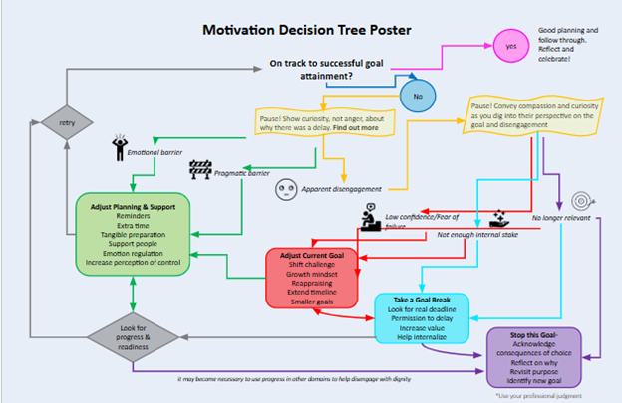
Notes:
Here is an example of a decision tree that supports reflection and action during goal pursuit.
It highlights barriers, adjustments, and options for next steps.
This process helps us move from feeling stuck to making progress with support.
In the next slides, we will review the different components of this decision-making tree.

Slide 50

PAUSING WITH CURIOSITY
RECOGNIZING BARRIERS
Pause with curiosity - what caused these barriers?
Are the barriers:
  emotional,
  practical, or
  signs of disengagement?
Notes:
The first step in the decision tree is to pause with curiosity. Instead of reacting quickly or with blame, we take a moment to ask: what might be getting in the way?
Barriers may be emotional, like anxiety or frustration. Or practical, like transportation or scheduling. Or signs of changes in interest.
When we understand the cause, we have an easier time identifying supports.

Slide 51
ADJUSTING TO
STRENGTHEN READINESS
Emotional barriers ⟶ can be overcome with emotional support, extra time or breaks, emotion regulation strategies.
Practical barriers ⟶ can be overcome with help planning, increased structure, regular routines.
Adjustments create readiness and confidence to overcome barriers.
Notes:
Once barriers have been recognized, the next step is to think about how planning and support can be adjusted:
Emotional barriers may be eased with reminders, supportive people, or extra time.
Practical barriers often need clearer planning, added structure, or helpful routines.
If the client has lost interest in the goal, then the goal can be adjusted. We will discuss this more in a moment.
These adjustments build confidence, reduce frustration, and make it more likely that the person with FASD can continue moving toward their goals.
This is one of the key ways the decision tree helps us visualize progress as possible, even when challenges arise.

Slide 52

ADJUSTING THE GOAL
REFRAMING THE CHALLENGE
Collaboratively adjust the timeline and/or approach.
Smaller steps sustain momentum.
Notes:
At other times, the goal itself needs to shift.
We may need to reduce the challenge, extend the timeline, or change the approach using a growth mindset.
Breaking a larger goal into smaller, more manageable steps helps the person experience success and keep moving forward.
Or perhaps the goal itself needs to be shifted or changed to meet the changing needs of the individual we are supporting.
In these instances, the relationship between people with FASD and their supporters is useful for exploring goals.

Slide 53

TAKING A PAUSE
STEPPING BACK TO RE-ENGAGE
Notes:
Sometimes the best option is to Pause. Whether for a few hours or longer. Sometimes we need time to reflect before returning to the conversation.
Stepping back lowers pressure.
When the goal is revisited later, it can feel more meaningful and thought out.

Slide 54
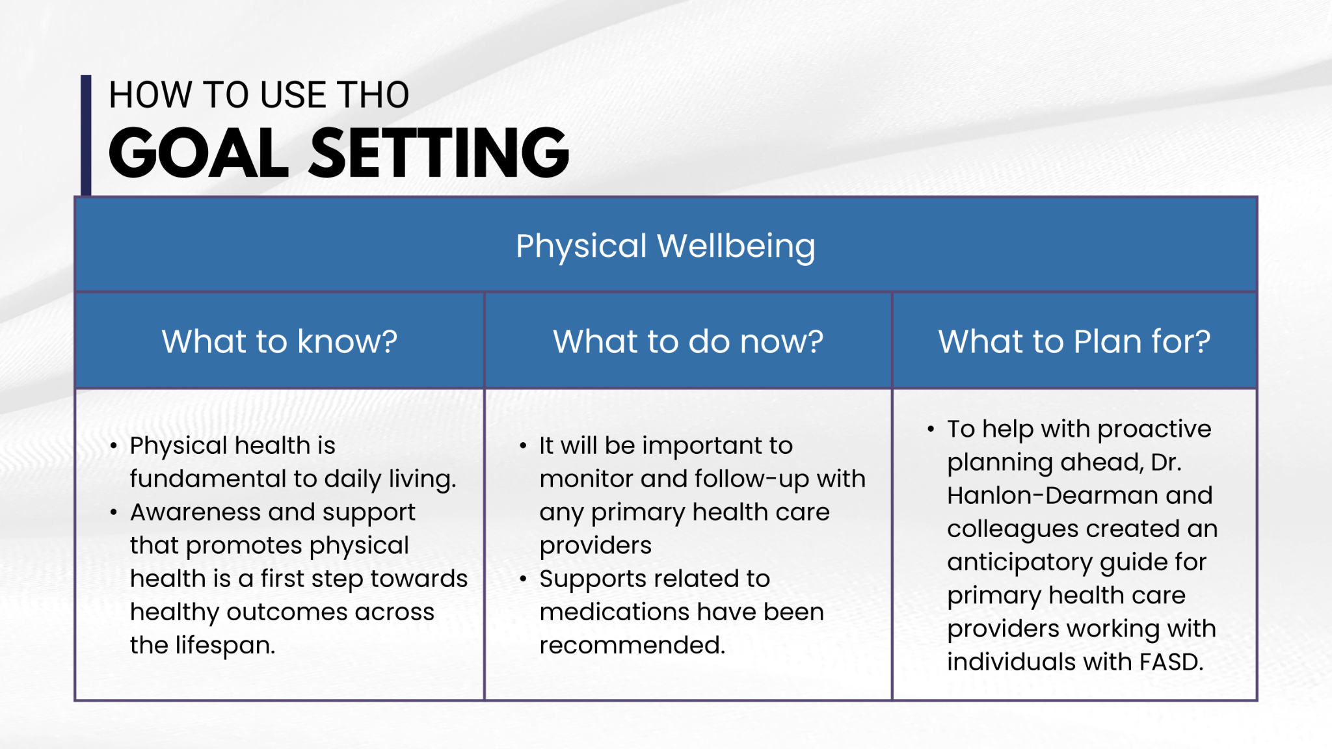
Notes:
Mapping this process onto the Towards Healthy Outcomes framework, whenever we set a goal and step onto the relevant THO pathway, we can set goals using three steps outlined here on this table.
The steps are ‘what to know’, ‘what to do’ and ‘what to plan for’.
What to know covers the basic information about the pathway we are on, in this case physical wellbeing, along with the relevant characteristics, strengths, needs, and areas of interest of the person we are supporting. In this example, that includes understanding the critical foundation of good physical health plays in daily life and the ways to promote physical wellbeing.
What to do is our more immediate, shorter term goals and next steps. Plans for the next year or so. In this example, it can include planning medical appointments, monitoring medications and their effects.
Finally, the last column is what to plan for. This includes our longer term planning. In this example, physical wellness, longer term planning can ongoing healthcare and transitioning between different physicians and health care systems. Planning ahead helps us be proactive and focus on providing supports and achieving goals rather than only solving problems as they arise.

Slide 55
TOWARDS HEALTHY OUTCOMES
PUTTING IT ALL TOGETHER
Notes:
Now we are going to talk about how we can start applying some of the things we’ve learned today.
As we do, it’s important to remember that the more often we think about and apply these new ideas we’ve discussed today, the easier it will be to do.

Slide 56

Notes:
So far, we’ve used metaphors to explain our key takeaways from each section. We talked about learning to ride a bike and driving a far distance. Now we’re going to use a sports metaphor.
Presenters Note: If there is a different sport that you have experience with or would prefer to talk (e.g., golf) about feel free to adjust the metaphor to that experience.
Does anyone remember learning to skate? You probably started off pretty shaky, it probably felt hard to just stay standing upright in your skates when putting them on. And stepping onto the ice felt like such a slow process, it probably took you a long time.
For me, once I’m on the ice, all my focus on is skating. Speeding up or stopping feels impossible.
For some of us, we likely stopped there. So anytime we go skating it feels really hard.
But for others, maybe you went skating more often, maybe you even had parents who set up a rink in your backyard for you.
You’ve slated so much that you’re no longer even thinking about skating. It becomes automatic. Skating becomes like walking or breathing; you don’t have to give it conscious effort.
Maybe now your focus has shifted to skating in a certain direction, or at a certain speed.
You skated enough that you not only increased your abilities and skills, but your underlying belief about your ability to skate has changed.
The same is true in our work.
The automaticity of the practice won't come without the belief - but thinking this way repeatedly over time can help shift our beliefs.

Slide 57
TAKING A BALANCED PERSPECTIVE
MOVING BEYOND BRAIN-BASED DIFFERENCES
Notes:
Historically, supporters have focused on solving problems for people with FASD and avoiding risks, which is important. But by doing that, we have missed parts of the story.
Now, we are looking to shift towards understanding the whole person…

Slide 58
A BALANCED PERSPECTIVE
STRENGTHS & NEEDS
To help the whole person, we need to understand what they are good at and what they are needing support with.
Notes:
To understand and support people with FASD, we must understand the whole person.
When we do that, we can understand what it is they might need help with, and what goals they are working toward.
This is what creates our shared understanding that we talked about earlier.
As we discussed in section 1, the Towards Healthy Outcomes framework helps us take a strengths-based approach that helps us to recognize strengths.
We all have strengths, and our strengths are unique. For some people, that means we might overlook their strengths because they are different from what we might expect.
Strengths are not always “skills.” They may be the ways we relate to other people, our effort, curiosity, connection, or persistence.
Or strengths can show up in more obvious ways in how we live our lives.
What’s important is that we notice strengths because they give us clues about what supports may feel natural for the person.
Like we talked about earlier in our motivation slides, effective support comes from meaningful goals created together.
When supports match each person’s strengths, progress becomes steadier and more predictable.

Slide 59
SYSTEMS & ALLIED PROFESSIONALS
BUILDING RELATIONSHIPS
Notes:
We do not support a person alone. We work with family, school, community, health care, and social services systems. The systems that work together are better set up to respond to challenges.

Slide 60


SYSTEMS & ALLIED PROFESSIONALS
BUILDING RELATIONSHIPS
Shared Understanding
Strengths & Needs
Relational Mindset
Growth Mindset
Brain Responsive
Notes:
With shared understanding of the unique person we are supporting, we set ourselves up to communicate with other supporters and systems in a brain-responsive way.
Relationships help reduce mixed messages and communication problems across systems, which creates clearer paths toward goals.
Instead of solving problems, the focus becomes navigating systems.
When systems work separately or fail to share understanding, people can feel confused or overwhelmed. Systems that have a shared understanding can work together to help the person with FASD navigate their journey towards success.

Slide 61

BUILDING RELATIONSHIPS
NAVIGATING SYSTEMS
What is expected may not align with the individual we are supporting.
Shared understanding between systems helps make navigating systems easier.
Notes:
This table offers strategies for challenging behaviours. It also gives some prompts to ask ourselves and the people we are working with to develop a relationship that builds understanding.
In the first column we have some behaviours that we might see in our work.
In the middle column we have strategies that might be helpful to try in this situation.
In the last column we have suggestions and questions we might ask to build relationship and understanding.
Presenters note: Read slide.
Depending on time, you could make this slide more conversational and accept suggestions for strategies and relationship building tools.

Slide 62
ACTIVITY
BREAK
Let’s use what we learned so far to complete this reflection activity.
Notes:
Presenter Note: If time allows, select activity from 4, 5, or 6 in the Activity Appendix doc.
Now we are going to work through a story. To respond to the discussion prompts, feel free to refer to your notes, the slides, or the decision-tree map.

Slide 63
ACTIVITY BREAK
BRETT’S STORY
Brett is 8-years old and is full of energy from the moment he wakes up in the morning. At school, he usually begins his day in a calm and curious space, especially when he is working with “hands-on” materials. As the classroom becomes louder and the routine is not as predictable, Brett has more difficulty keeping himself organized. When the class is asked to move from one activity to another, he may shout, throw materials off his desk, or kick his chair out of frustration. Brett also has difficulties socializing with his peers. For example, if a peer accidentally bumps him or tries to join his game without warning, he may respond by pushing or hitting them.
During recess, Brett often plays alone. He watches other children but is unsure how to join in. When he tries and it does not go well, he becomes upset and says that everyone is mean to him. At home, he sometimes cries after school and says he feels like he is always in trouble. His caregiver tries to understand what he needs but finds it difficult to predict when he will become overwhelmed. The school staff have been supportive, but rely mostly on reminders, consequences, and behaviour expectations which do not seem to change patterns.
Notes:
Presenter Note: Remove or Keep slide depending on selection from Activity Appendix.

Slide 64
ACTIVITY BREAK
BRETT’S STORY
In breakout rooms, you will:
  Identify at least two strengths and two needs demonstrated by Brett.
  Develop one meaningful destination goal for Brett.
  Generate 2-3 strategies that can leverage Brett’s unique strengths and involve collaboration within their support team
Notes:
Presenter Note: Remove or Keep slide depending on selection from Activity Appendix.

Slide 65
ACTIVITY BREAK
MARISSA’S STORY
Marissa has FASD and is 33 years old. She is a single mother, raising two children who are both in elementary school. She describes feeling pulled in many directions and often becomes overwhelmed by daily routines. On school mornings, she may misplace items, forget forms, or lose track of time, which sometimes results in the family running late. When her children ask for help at the same time, she becomes flustered and may respond sharply or shut down. Later, she feels guilty and wishes she could regulate her emotions and remain calm the way other parents seem to.
Marissa wants support, but often hesitates to reach out because previous experiences with services left her feeling judged. Some professionals have described her as inconsistent or hard to engage when she forgets appointments or has difficulty following through on multi-step plans. At the same time, she cares deeply about her children and is trying to understand what might help her feel more capable. She explains that when the world feels “too fast,” she becomes confused and embarrassed, which makes it harder for her to ask for guidance.
Notes:
Presenter Note: Remove or Keep slide depending on selection from Activity Appendix.

Slide 66
ACTIVITY BREAK
MARISSA’S STORY
In breakout rooms, you will:
  Identify at least two strengths and two needs demonstrated by Marissa.
  Develop one meaningful destination goal for Marissa.
  Generate 2-3 strategies that can leverage Marissa’s unique strengths and involve collaboration within their support team
Notes:
Presenter Note: Remove or Keep slide depending on selection from Activity Appendix.

Slide 67
ACTIVITY
XANDER’S STORY
Xander is 19 and he recently moved out on his own. He was excited about being independent, but quickly found that managing daily tasks is more complicated than he expected. He misplaced essential documents, missed a rent deadline, and has received warnings from his landlord. He wants steady welding work and tries his best on the job, but often forgets instructions or becomes confused when several tasks are given at once. Employers have let him go from jobs with feedback such as that he needs too much direction.
Xander spends a lot of time trying to figure out how to organize his bills, groceries, and appointments, but he becomes overwhelmed and sometimes avoids dealing with them. He says he feels like he is letting people down and is afraid to ask for help because he does not want to seem incapable. He has dreams of having stable housing, a welding job he enjoys, and a sense of routine, but does not know how to get there. He explains that adulthood feels like a test that he keeps failing.
Notes:
Presenter Note: Remove or Keep slide depending on selection from Activity Appendix.

Slide 68
ACTIVITY
XANDER’S STORY
In breakout rooms, you will:
  Identify at least two strengths and two needs demonstrated by Xander.
  Develop one meaningful destination goal for Xander.
  Generate 2-3 strategies that can leverage Marissa’s unique strengths and involve collaboration within their support team
Notes:
Presenter Note: Remove or Keep slide depending on selection from Activity Appendix.

Slide 69
ACTIVITY
BREAK
Let’s reflect on what we’ve learned together today...
Notes:
Presenter Note: Refer to Activity 7 in the Activity Appendix document.

Slide 70
PERSONAL REFLECTION ACTIVITY
YOUR STORY
Reflect by yourself about a client you worked with who was challenging. Based on what we’ve learned today, how would your approach change?
  What strengths did this person demonstrate?
  What needs did I focus on at the time?
  How could I have improved upon my ability to integrate strengths into strategy planning?
  What system/allied professional barriers were present and how could I have addressed them differently?
Notes:
Recall a client or individual with FASD that you worked with who was challenging for you.
With the information presented today, how would your approach change?
Reflect and answer the questions/prompts and please share if you feel comfortable.

Slide 71
PREVENTION CONVERSATION & TOWARDS HEALTHY OUTCOMES
FOUNDATIONS TRAINING
Notes:
That brings us to the end of this presentation.
Are there any questions?
Presenter Note: Provide resources and glossary of key terms if needed.

