Slide 1




PREVENTION CONVERSATION & TOWARDS HEALTHY OUTCOMES
FOUNDATIONS TRAINING
Notes:
Hello, welcome. Presenters note: Introduce yourself.

Slide 2
TOWARDS HEALTHY OUTCOMES
WE GO WHERE WE LOOK
Notes:
Presenter note: Read slide title
Today we are going to be learning about perspectives. Specifically, we will talk about mindset, or how the way in which we think about things, or ‘the direction we look in,’ often shapes ways we think and then act.
Put practically, where we look is often where we go – physically but also in our interactions, planning and support provision. Our mindset sets our focus, and this sets the direction we invest our energies in moving towards. What is really interesting is that sometimes our mindset is shaped by fear or worry. As a result, we invest in focusing on or looking at risks in an effort to avoid risks.
Unfortunately, in doing so, we often fail to invest energy in those things that may actually protect us from risk or help us to avoid risk.
In other words, by focusing solely on fear, we may actually increase risk rather than move in a safer direction.

Slide 3

Notes:
Let’s talk about this using an everyday example:
Note for presenters: if you are able, feel free to adjust this metaphor to a personal story/experience that you have had if it is a good fit here. Otherwise, please use the following example. You can adjust the words to fit your own style as needed.
One day, a little boy is out riding on his bike with his parents. Helmet on and training wheels locked and loaded, he is excited to be riding his big boy bike all by himself!
He is riding his bike on the sidewalk while his parents walk behind him and watch his progress. There are lots of cars parked beside the sidewalk, close enough that the mom, who is watching her son’s excited and somewhat unsteady ride, is beginning to worry that he is going to hit one of the parked cars. So she decides to warn him by saying “watch out, don’t hit the cars!”
Her son hears her and begins to pay more attention to the parked cars. At first, the mom is relieved. But as she watches her son continue to bike along the sidewalk, her worry increases, as do her warnings: “watch out!” “Not so close!” “Look out for the cars!” “Don’t hit anything!”
Despite the mom’s warnings and her son’s apparent concentration, he does eventually hit the car. Much to the mom’s dismay. When asked why he didn’t watch out for the car, the son says, frustratedly, “I did mom! I was watching the cars!”
It’s then the mom realizes her mistake: In focusing so much of her and eventually her son’s attention on avoiding making a mistake – rather than highlighting the clear path ahead, she had limited his view. He became more focused on the cars than the clear path in front of him.
In focusing on avoiding risks, she had steered him right into one.
The same is true in other parts of life to:. The direction we direct our attention and effort is the direction we move towards. The way we set goals and view challenges shapes how we move forward.
Now it is fair to say that life is often not this simple, and the clear path is not so clear – and we cannot simply ignore the risks. But working from this example we simply highlight the risk of OVER focusing on the worry – rather than clearly defining the desired path.
Even in complicated spaces, like addiction, a clear definition of healthy living, healthy coping, self-care and/or stability, may help to reveal an alternative to the risk. It offers something to aim towards. And it gives us a way to consider how we support progress (remember those training wheels).
Also, and perhaps at a more basic level, it reminds all of us that there is something positive to work towards. There is hope. And although it may be a windy, and bumpy road, together we can navigate forward. This perspective can change the way we interact with others and the foundations we set for movement towards healthy outcomes.
Today we are going to talk about the impacts of where we look and how we can change where we look in two ways:
is the way we interpret behaviour and how we interact with other people, and
2. is the way we set goals and plan for the future with the people with FASD we are working with alongside their support teams.

Slide 4

PRESENTATION
OUTLINE
  Mindset: The Direction We Look Towards
  Activity: Pause, Reflect, Reframe
  Establishing Shared Understandings
  Using Shared Understanding to Pursue Goals
Notes:
Presenter note: read outline
By the end of the presentation, participants will be able to:
Learn how our beliefs and attitudes can shape the interpretation of behaviours and decision-making in practice - what we believe matters!
Be able to understand that all behaviour is a way of communicating what we need, or in other words, all behaviour is functional: how we act is a way of communicating what we need. This includes understanding the unique ways people with brain-based differences may show up in their day-to-day functioning.
Be able to describe the Towards Healthy Outcomes framework, otherwise referred to as THO throughout this presentation, and its pathways of healthy functioning.
Begin to apply principles of the towards healthy outcomes framework to their understanding of people with FASD. ’
This section is about increasing our brain responsiveness, so that we can promote relationships with the people we are supporting that underlie our ability to provide supports.

Slide 5
ATTITUDES & PERCEPTIONS
THE DIRECTION WE LOOK TOWARDS
Notes:
Our attitudes and beliefs are the foundation for our thinking, or mindset. They influence the way we think about or make sense of others – and in doing so what we focus our attention on, and then how we interact with others.
Our attitudes and beliefs can be considered “me” factors in our interactions with others. This means that our attitudes and beliefs reside in each of us and are shaped by our experiences, values and learning, creating the foundation for our mindset.
Mindset is the direction we look towards.
By reflecting on our mindsets we become more aware of how our beliefs influence our thinking and in turn our behaviour – which impacts our interactions with others.
This reflective process helps us to explore how subtle shifts to our thinking may create opportunities in our work with others.
By recognizing that our mindset guides what we notice and how we make sense of behaviour, we open the door to exploring ways that changing our thinking may impact how we interact with others, and ultimately support their success.

Slide 6

ATTITUDES & PERCEPTIONS
WHAT WE BELIEVE MATTERS
How do you feel when...
  you make a mistake?
  you get something wrong?
  someone gets mad at you?
  people focus on your flaws over your successes?
  you are able to contribute meaningfully to your community?
Notes:
It’s important to understand that what we believe matters - and so where we look matters.
Our beliefs shape a lot of the ways we experience day to day life.
Let’s all take a moment to reflect on the following experiences that we have all had, and how you feel after each of these kinds of experiences.
How do you feel when you make a mistake? When you get something wrong? How does it feel if someone gets mad at you about that mistake? It probably doesn’t feel very good, does it?
Well, how do you feel when someone is always focusing on your flaws? Not even considering your strengths and all the good things you can do but instead focuses on where you messed up. That probably feels pretty bad right?
What about times when you have been able to contribute meaningfully to your community? Maybe it’s through your job or vocation or maybe training you’ve done. Or perhaps it’s just small random acts of kindness. Being able to leave a positive impact on the people and environment around you, that probably feels pretty good, doesn’t it?

Slide 7

ATTITUDES & PERCEPTIONS
WHAT WE BELIEVE MATTERS
The ways we answer these questions shape the ways we think about...
Notes:
The ways we think about the mistakes of ourselves and others is very important, because it can shape the ways we think about…

Slide 8
ATTITUDES & PERCEPTIONS
WHAT WE BELIEVE MATTERS
The ways we answer these questions shape the ways we think about...
...ourselves.
Notes:
Ourselves

Slide 9

ATTITUDES & PERCEPTIONS
WHAT WE BELIEVE MATTERS
The ways we answer these questions shape the ways we think about...
...ourselves.
...others.
Notes:
Others

Slide 10

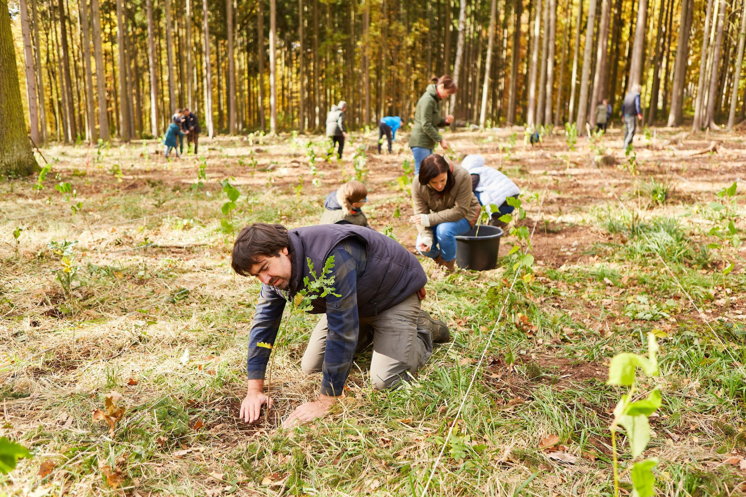
ATTITUDES & PERCEPTIONS
WHAT WE BELIEVE MATTERS
The ways we answer these questions shape the ways we think about...
...ourselves.
...others.
...the people with FASD we work with.
Notes:
The people with FASD we work with.

Slide 11

HOW OUR THINKING SHAPES OUR INTERACTIONS
MINDSET IN ACTION
We make assumptions based on behaviours.
For example, what do you assume when...
  Someone cuts you off in traffic?
  A pedestrian yells at you about where you parked your car?
  A friend cancels plans last minute?
  A neighbour ignores you when you wave at them?
  A client no shows an appointment with you?
Notes:
Let’s unpack mindset a bit more.
We all hold basic beliefs about what is important. These shape our priorities and interactions.
We also hold beliefs about what different behaviours might mean or message to us – this is what we refer to as behavioural interpretation.
This means that when we interact with someone, or observe behaviour, our brains automatically “make sense” of what we see - assuming the interaction or behaviour occurred because of something about the person (ex: “they’re rude” or “they don’t care) or something about the situation (ex: “they must be having a bad day, “maybe they didn’t notice me.”)
We interpret what we see through the lens of our own experiences, our current mood or stress level, and often incomplete information.
That process of making sense is guided by our mindset or the internal framework of beliefs, attitudes, and expectations that influence how we understand others.
For example, what sort of assumptions might we make when someone cuts us off in traffic? Or when a pedestrian yells at us about where we parked our car?
Or when a friend cancels plans at the last minute, a neighbour ignores our wave, or a client doesn’t show up for their appointment?
In each of these moments, our mindset is quietly at work - guiding how we interpret what’s happening.
Depending on how we think about the situation, we might feel angry, dismissed, understanding, or simply curious.
The situation doesn’t change, but our interpretation of it - and so does our emotional and behavioural response.

Slide 12

HOW OUR THINKING SHAPES OUR INTERACTIONS
MINDSET IN ACTION
We make assumptions based on behaviours.
For example, what do you assume when...
  Someone cuts you off in traffic?
  A pedestrian yells at you about where you parked your car?
  A friend cancels plans last minute?
  A neighbour ignores you when you wave at them?
  A client no shows an appointment with you?
RUDE
ENTITLED
FLAKY
SELFISH
DOES NOT CARE
Then we interact with others based on these assumptions.
Notes:
Often in these situations, especially when we are frustrated, we assume a negative motive is behind the behaviour, which changes the way we not only interpret the behaviour, but how we see the person. So as a result of the negative interpretation, we may view these people in a negative light.
Presenter’s note: Read slide.
These assumptions then go on to directly inform our interactions and relationships with those people.

Slide 13

HOW OUR THINKING SHAPES OUR INTERACTIONS
MINDSET IN ACTION
When we focus on the negative, we don’t leave room for alternative ways forward.
The behaviour we are seeing is functional - it serves a purpose.
Notes:
When we focus on the negative, we don’t leave room for different understandings or ways of thinking about the person’s behaviour. Reframing how we interpret behaviour can not only change our feelings about what happened but also how we think about the person.
Although we are using familiar, day to day examples, reframing the way we understand people’s actions can have a radical impact on the way we offer support.
In fact, shifting our perspective in this way creates space for us to consider that everyone is trying to move towards the open road. If we believe that then we can ask what might be a barrier.
When trying to understand why someone might be acting a certain way, try to understand that the behaviour seemed to help meet a need, even when it did not lead to the desired results.
If we want to walk alongside folks with FASD as they achieve success, we need to understand that what we see (i.e., their behaviour) is not the end of the story. By doing so, we are set up to build relationships with the people with FASD we are supporting. These relationships become the heart of the support we provide.
So the first step is to understand that all behaviour is functional.

Slide 14
Notes:
This was demonstrated by our earlier metaphor of the boy on his big boy bike. Where the mom saw him struggling and eventually making a mistake, what the boy experienced was different. He worked so hard to avoid making a mistake, he knew it was important to listen to his mom, he became more nervous as he heard her anxiety, and biologically, physically, his arms steered in the direction he looked.
In other words, despite his best efforts – and maybe even because of his intention and efforts – his body took him in the direction of his focus.
What if instead, the mom had said “look straight ahead, pay attention to the road in front of you”, or even “look at how much space you have on the sidewalk”. What do you think would have been the outcome in that case? The boy’s attention might have been on the sidewalk and the path ahead rather than the car beside him.

Slide 15

ALL BEHAVIOUR IS
FUNCTIONAL
Intent of behaviour
Observed Behaviour
Utility of behaviour
Notes:
It’s important that we understand that we as other people can only see the observed behaviour; what is missing (usually) are the underlying intentions around the behaviour, along with its usefulness.
We might not fully understand why someone is late to an appointment with us, or why a stranger yelled at us when we parked our car.
But we especially won’t be able to understand when we look at their behaviour and don’t consider what might be underlying it.

Slide 16

ALL BEHAVIOUR IS
FUNCTIONAL
ASK
Intent of behaviour
“WHAT DO I KNOW?”
Observed Behaviour
BEFORE
“WHAT DO I DO?”
Utility of behaviour
Notes:
And we certainly won’t be able to develop that understanding of the underlying causes of behaviour when we then jump right into thinking: What do I do? How do I solve this problem?
When we do that, we are likely to miss two crucial underlying pieces of information:
The underlying intention or the “why” behind the behaviour and
The function of the behaviour, or the need the behaviour is meeting.
Understanding the underlying causes of behaviour makes our lives easier. We can take a moment to pause before moving into action and first ask ourselves, “What do I know” about this person, this situation, this behaviour?
It gives us some space to understand the behaviour. It provides more information that will be super useful when it's time for us to begin considering solutions.

Slide 17

SHIFTING FROM
WHAT DO I DO?
TO
WHAT DO I KNOW?
helps us to approach situations with curiosity and understanding, rather than judgment.
Notes:
By shifting our initial thinking from “what do I do” to “what do I know”, we are setting ourselves up to think about the situation from a mindset of curiosity and openness, which helps to inform our understanding and way forward, rather than jumping into judgment and action.
When we can think of ourselves as explorers or scientists who are curious about what we are seeing, we can approach situations with openness and understanding.

Slide 18
THE DIRECTION WE LOOK
MATTERS
We make assumptions based on behaviours.
For example, what do you assume when...
  Someone cuts you off in traffic?
  A pedestrian yells at you about where you parked your car?
  A friend cancels plans last minute?
  A neighbour ignores you when you wave at them?
  A client no shows an appointment with you?
Notes:
So going back to our earlier examples with our new mindset of asking “What do I know?’, let’s revisit what we might assume about these people based on these observed behaviours.
Note for presenters: depending on time you can make this an open discussion and include responses from the audience.

Slide 19

THE DIRECTION WE LOOK
MATTERS
We make assumptions based on behaviours.
For example, what might you assume when...
  Someone cuts you off in traffic?
  A pedestrian yells at you about where you parked your car?
  A friend cancels plans last minute?
  A neighbour ignores you when you wave at them?
  A client no shows an appointment with you?
LATE
MOBILITY LIMITATIONS
EXHAUSTED
WRAPPED UP IN THOUGHT
ANXIOUS
Notes:
Presenter note: Read slide
As discussed earlier with our bike metaphor, when we focus only on problems and challenges, it becomes much harder to see or think of anything else.
We can always learn to look somewhere new, and sometimes all we need is to know that there is another way to look - we can get so stuck in our habits and ways of doing things that we forget that there are different options.
But when we do start looking at things differently, it becomes easier and easier over time.
And growth becomes easier and easier to see.
So where we might have been feeling offended or even disrespected with our old assumptions, now we might be feeling more curious and open minded to the function of these behaviours.

Slide 20
SHIFTING FROM
WHAT DO I DO?
TO
WHAT DO I KNOW?
Allows us to engage creatively with the people with FASD we support.
With appropriate conditions, growth is possible.
Notes:
This shift is a critical first step in working with folks with FASD.
By making this shift towards “What do I know” we are better equipped to be able to think about the person we’re supporting from a more balanced perspective that allows us to consider both strengths and challenges.
Developing an understanding of the person we are supporting, including their unique areas of strength and weakness is necessary to walking alongside folks with FASD as they strive towards success.
Without a balanced understanding, it is much harder to identify the ideal conditions needed for growth and success for each person with FASD.
From this balanced position, we are better able to think in creative ways about solutions and leveraging strengths when supporting people with FASD.

Slide 21

ACTIVITY
BREAK
Let’s use what we learned so far to complete this reflection activity.
Notes:
The best way to shift our mindset is to practice!
Now it’s time for a brief activity break to give us a chance to apply what we’ve been learning so far.

Slide 22



ACTIVITY
PAUSE, REFLECT, REFRAME
PAUSE
and identify initial thoughts or assumptions about the behaviour. These may include feelings of frustration or perceptions of disrespect.
REFLECT
and consider what else might be happening. Exploring how brain-based differences could influence the behaviour and what the person might be trying to communicate.
REFRAME
through developing alternative interpretations that view the behaviour as functional.
Notes:
This activity will give us a chance to put the “all behaviour is functional” perspective into practice.
Often, professionals working with individuals with FASD deal with situations where behaviour can feel confusing, frustrating, or even disrespectful.
This activity is designed to help us support others in slowing that process down and practice using an FASD-informed lens before jumping to conclusions.
Presenter note: Depending on time, you can always shorten this activity only to include one story. Depending on your audience you could select the story that best fits their roles and then present that story and the corresponding discussion points.
We’re going to work through one or two short stories from everyday settings. For each, we’ll move through the three steps you see on the screen: Pause, Reflect, and Reframe.
First, we pause and notice our initial reactions to the behaviour(s). These reactions might include irritation, confusion, or assumptions about intent such as “they’re not trying” or “they’re being rude.”
Next, we reflect by asking, “What else might be going on?” We’ll consider how brain-based differences related to FASD, like difficulties with memory, regulation, or executive functioning, might be influencing the behaviours we are seeing.
Then we reframe by exploring an alternative interpretation. An interpretation that views the behaviour as functional or as an attempt to communicate a need.
This final step helps us shift our thinking from judgment to understanding and allows us to imagine how our response might change with this new perspective.
The goal here is NOT to excuse behaviour but instead to strengthen our ability to respond in ways that support regulation, dignity, and connection.
After we introduce each story, we’ll work together as a group to identify the brain-based differences that could be contributing to the observed behaviours, discuss what the person might be trying to communicate, and consider how this new understanding might change how we respond.

Slide 23
EVAN’S STORY
PAUSE, REFLECT, REFRAME
During math class, Evan (age 10) frequently calls out answers without raising his hand. He blurts out unrelated comments, interrupts classmates, and leaves his seat several times throughout the lesson. Although his teacher regularly reminds him to stay seated and wait for his turn, these behaviours continue to occur during classroom activities.
Notes:
Presenter’ Note: Present Story on Slide

Slide 24
DISCUSSION
PAUSE, REFLECT, REFRAME
PAUSE
What was your first impression of Evan’s behaviour?
What assumptions did you make about his intentions?
REFLECT
What else might be going on for Evan (thoughts, feelings, sensations) that you might not have considered at first?
How could brain-based differences influence what we see?
REFRAME
How might this behaviour be functional from Evan’s perspective?
How could understanding his perspective change his teachers response?
Notes:
Presenter Note: Present information on the slide and encourage the audience to answer the questions, either as a group or in smaller breakout groups.
Presenter Note: Potential prompts for discussion:
What might Evan think of this behaviour? What might his reactions be to your prompts/reminders?
Have you ever interrupted someone before? If so, what was your rationale/reason? Presenter’s note: feel free to share some reasons you may have interrupted someone in the past.
What do you think Evan’s teacher might be thinking or feeling when trying to help Evan stay on task? (e.g., frustrated, overwhelmed, disrespected) How might these thoughts and feelings be impacting the teacher’s ability to adapt and respond to Evan’s needs?

Slide 25
LEANNE’S STORY
PAUSE, REFLECT, REFRAME
Leanne, age 22, has been working at a local grocery store for six months. She has been late for several shifts and sometimes missed the start of her scheduled hours. She often misplaces her work schedule and forgets her start times. When her supervisor asked about her being late, she explained, “I didn’t think calling would help because I knew I was already in trouble.”
Notes:
Presenter Note: Present the story on the slide

Slide 26
DISCUSSION
PAUSE, REFLECT, REFRAME
PAUSE
What was your first reaction to Leanne’s actions?
What assumptions might the supervisor be making?
REFLECT
What brain-based differences could explain her difficulties managing work responsibilities?
What emotions might be contributing to her behaviours?
REFRAME
How might this behaviour be functional from Leanne’s perspective?
What strategies might support her success?
Notes:
Presenter Note: Present information on the slide and encourage the audience to answer the questions, either as a group or in smaller break out groups.
Potential prompts for discussion:
It sounds like Leanne is aware of the problems that her being late causes, what might some of her feelings about this be? (e.g., negative, self-defeating, negative self-talk). Could those feelings be making it hard for her to be proactive or responsive when she is late?
What might be some potential roadblocks to Leanne being proactive to her difficulties with time management?
It is likely that if Leanne is late so often for work that this may be a pattern that presents in other parts of her life. How could you help work with Leanne’s employer to understand that her being late is not personal or specific to the job, but rather a reflection of the unique ways Leanne sees the world. What might be helpful reframes for the employer to understand when working with Leanne? What might be some roadblocks to Leanne being able to be proactive and start to implement strategies for time management?

Slide 27
FETAL ALCOHOL SPECTRUM DISORDER
ESTABLISHING SHARED UNDERSTANDINGS
Notes:
Now that we have established the importance of reflecting on and being aware of the impacts of HOW we know, and ways our perceptions (mindset) have influence, let’s shift to building our knowledge base about FASD. The WHAT we know.
By establishing a shared understanding about what FASD is, and how it impacts brains and bodies, we can better understand impacts on daily living and ways in which we might help them strive towards healthy outcomes.

Slide 28
FETAL ALCOHOL SPECTRUM DISORDER
FASD IS...
  A neurodevelopmental disorder that is caused by prenatal alcohol exposure (PAE).
  The most common cause of neurodevelopmental disability in Canada. It is estimated that 4% of people in Canada have FASD.
  Characterized by diverse cognitive, behavioural, and physical needs.
  Impacts people and families from all socioeconomic and ethnic backgrounds.
Notes:
FASD is a neurodevelopmental disorder that is caused by prenatal alcohol exposure. It is estimated that approximately 4% of people in Canada have FASD.
Prenatal alcohol exposure is the most common cause of neurodevelopmental disability in Canada, more common than Autism, cerebral palsy, down syndrome, and Tourette’s syndrome combined.
People with FASD are diverse: multiple areas of cognitive, behavioural, and physical functioning can be impacted by prenatal alcohol exposure. How it affects each person is different = each person with FASD has unique strengths and needs.
People from all social, cultural, economic, and ethnic backgrounds can be affected by prenatal alcohol exposure.

Slide 29
FETAL ALCOHOL SPECTRUM DISORDER
FASD IS...
  A neurodevelopmental disorder that is caused by prenatal alcohol exposure (PAE).
  The most common cause of neurodevelopmental disability in Canada. It is estimated that 4% of people in Canada have FASD.
  Characterized by diverse cognitive, behavioural, and physical needs.
  Impacts people and families from all socioeconomic and ethnic backgrounds.
People with FASD experience a wide range of potential strengths & needs in day to day functioning
Notes:
Individuals with FASD, like all people, have a wide range of potential strengths that, when identified, can inform goal setting and supports. Success is easier when people are equipped to use their strengths within systems of support.
After receiving a diagnosis of FASD, people with FASD and their families are likely to have a wide range of thoughts and feelings, like feeling validated, empowerment, and increased understanding and support from others. They may also experience feelings of grief, worry, and concern for the future.
This means that a diagnosis of FASD can also lead to many questions, as people with FASD and their families seek to understand how this will impact daily life.
This can be an opportunity for supporters to help set goals and begin thinking broadly about what it means to work towards a happy and healthy future.
Supporters can be very helpful in finding ways to work together to offer help where it is needed, while drawing on the person’s unique strength.
Too often though, these questions are accompanied by strong feelings of fear and worry, so the focus may be how to address a potential risk. In many cases this risk is very significant and it leads us into reactive responding – where we overly lean into ensuring safety as a priority and ignore any other goals.
While safety is an important priority, this can sometimes set a pattern of focusing on risks rather than finding a balance between navigating risks and working towards goals.
The mindset shift we have been talking about is essential early steps in supporting individuals with FASD to achieve success, no matter your role. By understanding the unique brain-based differences that may be present for those with FASD, we may be poised to best address risk and identify and work towards meaningful goals.

Slide 30




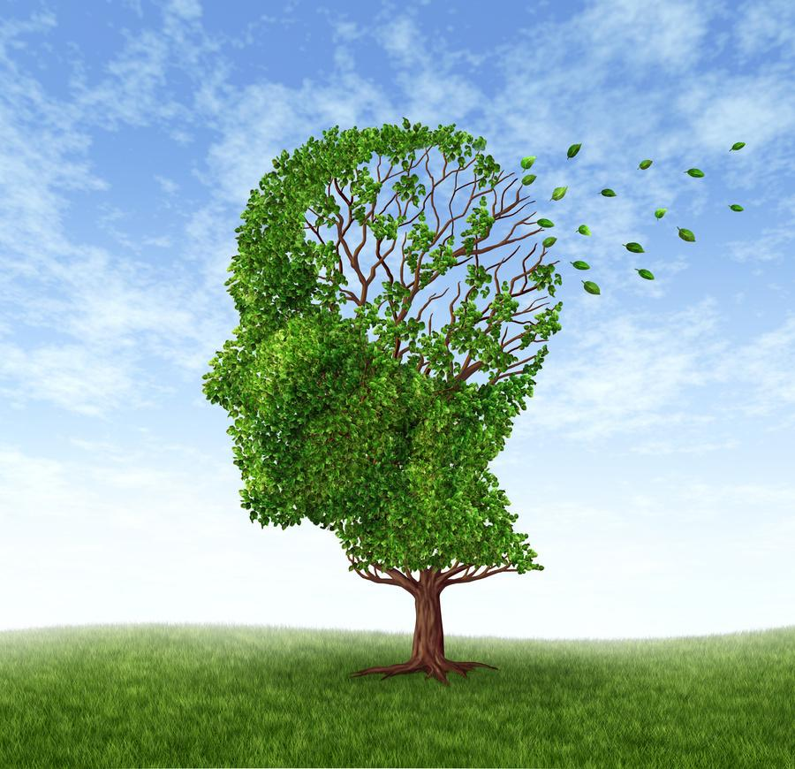
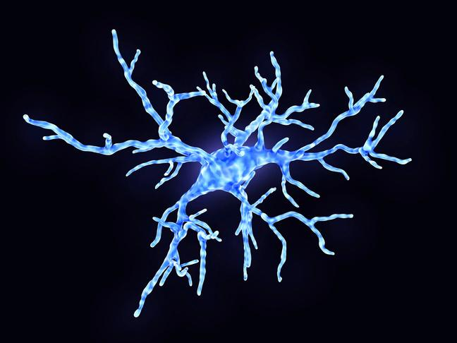




FASD
BRAIN DOMAINS
Notes:
Presenter note: The pictures of the domains are in the same order as those listed below starting in the top left hand corner and then moving towards the right. The first picture on the top line represents academic achievement, and the first picture on the bottom line represents neuroanatomy.
The Canadian Guidelines for FASD Diagnosis identify 10 brain domains that are affected by prenatal alcohol exposure. These are the areas of functioning that are assessed during the diagnostic process to gain an understanding of the unique needs of each individual with FASD. The areas assessed include academic achievement, attention, cognition, language, memory, neuroanatomy, executive functioning, adaptive behaviour, motor skills, and affect regulation. Although these are presented as individual domains, in reality, they are highly connected - no part of the brain works on its own.
Clinicians know this and will often share information about patterns of functioning and how that may impact daily living. If you have access to this information it can be helpful. Often however, you will not see this information.
That means that you may have to use your knowledge of the brain domains, as shared here, as a way to generate possible explanations for the questions you may have. As we discuss the domains we will highlight how this knowledge can help you to imagine alternative ways to interpret behaviour, identify strengths, and offer meaningful support to individuals with FASD in a way that is brain responsive.
In short, your job as supporters is not to be able to identify which brain domain is directly responsible for a certain behaviour that we might be seeing. Rather, your job is to understand possible brain-based contributions that lead to the unique strengths and needs in each person with FASD to help you to modify your responses and build relationships.

Slide 31
FASD
BRAIN DOMAINS
What I might see...
Why I might be seeing this...
What can I do...
Follow-up around medical care and medication.
Do they need help with transportation?
Trouble driving or operating machinery.
Impacts of challenges with attention, focus, and hand eye coordination.
Illegible writing or frequent spelling mistakes when writing.
Underdeveloped academic skills due to disrupted school experiences or specific learning disorders.
Identify academic strengths.
Do they need a referral for assessment?
Develop accommodations for school/work.
Notes:
One way we have helped to bridge the gap between brain-based differences and daily living was to create some tables that help us to compare how brain responsive thinking sets us up to explore alternative supports and strategies.
Here you see three columns. The first What I might see describes some common stories we’ve heard from support workers that they have experience working alongside folks with FASD.
The next, why I might be seeing this, lists some potential underlying brain-based differences that may account for what you are seeing.
Finally, the column what can I do offers some suggestions for discussion prompts and questions to ask the person you are working with.
Presenter note: read through the slide, if time allows feel free to allow for conversation with the audience as you walk through these points.

Slide 32
FASD
BRAIN DOMAINS
What I might see...
Why I might be seeing this...
What can I do...
Is there a communication barrier?
Present information strategically.
Encourage them to ask for clarification.
Impaired communication skills.
Hearing or visual impairment.
Not following instructions.
Memory impairment that makes it hard for them to transfer new learning into action.
How can I help them remember important tasks/information?
Use concrete language to regularly review information, one piece at a time.
Breaching probation.
Notes:
Presenter note: Read through the content on the slide row by row (rather than going through each column). If time allows, feel free to make this slide more conversational and incorporate audience feedback.
This helps us to understand that the people with FASD we are supporting are likely to interact with the world in a different way than we do.
Brain-responsive approaches encourage creative, and responsive solution finding as we navigate towards our goals.
We will return to goals later.

Slide 33
TOWARDS HEALTHY OUTCOMES
USING SHARED UNDERSTANDING TO PURSUE GOALS
Notes:
So far, we have been talking about how we might reflect on our attitudes and beliefs and apply knowledge of FASD to reframing our interpretations of behaviour – to create space for positive interactions with individuals with FASD.
Such positive interactions can balance strengths alongside our understanding of brain-based differences within our interactions with people with FASD. This can shape the ways we provide supports.
Now we will shift our focus from one-on-one interactions, to consider broader thinking and planning – how we support individuals with FASD in goal setting in a way that makes sense for their unique strengths and needs.
The framework, Towards Healthy Outcomes, highlights goals, including how to identify and set goals, and the ways we might modify strategies in a brain responsive way.
Towards Healthy Outcomes framework, or the THO, offers a different approach to setting goals. It offers insights into how supports can help people with FASD, and suggestions for future planning – geared towards destination goals.
The Towards Healthy Outcomes framework is meant to be a guide for supports, such as families, caregivers, service providers, and other professionals working to help individuals with FASD achieve healthy outcomes.

Slide 34
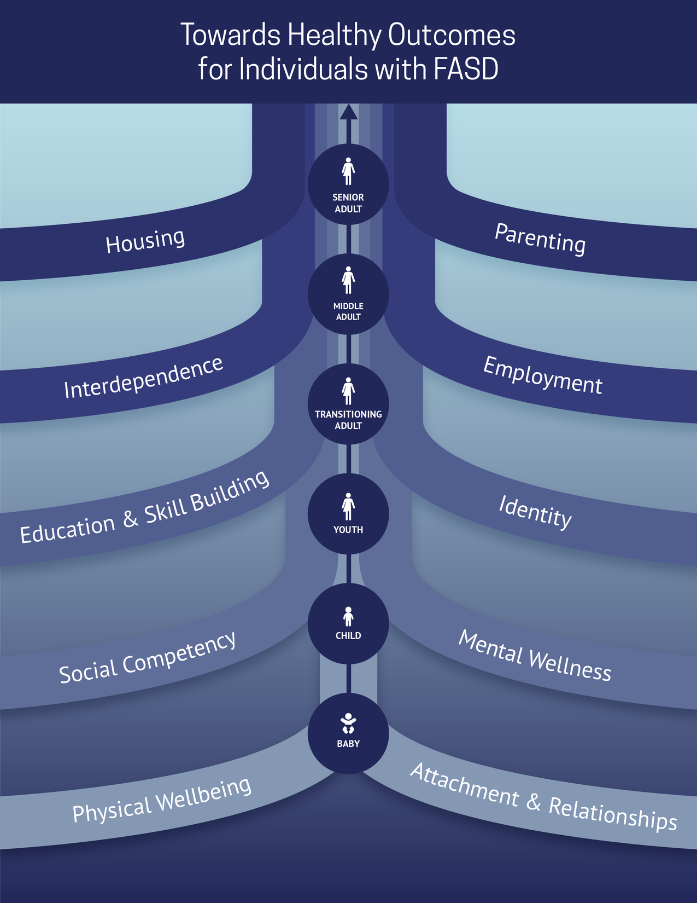
Notes:
The THO framework does this by offering a shared understanding of goals and pathways to success.
Notice we are using the word shared. Understanding needs to be more than a word. Understanding must be created through collaboration between the individual with FASD and their support team. Shared understanding can include knowing why an individual may be struggling, how they have experienced success and/or challenges.
Shared understanding creates space for creative and responsive support and goal setting tailored to the person’s unique strengths and needs.
Shared understanding includes a shared language that can be used by people with FASD, caregivers, and support workers to help create mutual understanding of not just FASD, but the unique people we are working to support.
With this shared understanding, THO provides a road map that can help service providers understand the unique developmental considerations that people with FASD experience, and potential areas for growth when planning for the future.
THO helps guide our goal setting and planning: When we are thinking about navigating towards an outcome or goal within a system, what we are doing is stepping on to one of the 10 THO pathways.
Our brain responsive mindset sets up our readiness to navigate the THO pathways.
By shifting some of my foundational competencies, that is my mindset, I am better set up to meet my client on their particular pathway, and the framework helps me identify goals to navigate within THO.
Using a framework like THO allows for greater consistency among service providers. It can also act as a mechanism that can streamline the link between research evidence and community wisdom

Slide 35

TOWARDS HEALTHY OUTCOMES
EMPHASIZES
QUALITY OF LIFE
GROWTH
APPROPRIATE EXPECTATIONS & GOALS
HEALTHY LIVING
STRENGTHS
Notes:
THO emphasizes quality of life! We are looking beyond worries and fears for the future, and instead focusing on our goals. Like the boy on his big boy bike, we are helping the people we are supporting focus on the road ahead, not the barriers around them. By shifting our mindset, we are set up to focus on growth, healthy living, and considering strengths.
By setting goals focused on healthy outcomes, we must consider strengths and new ways of understanding needs.
That’s not to say we don’t consider needs and challenges, but they are not our focus. That’s why THO emphasizes appropriate expectations and goal setting. We must consider strengths alongside areas of need to understand the person with FASD we are supporting and help them move towards success.

Slide 36

TOWARDS HEALTHY OUTCOMES
UNDERLYING PHILOSOPHIES
DEVELOPMENTAL LIFESPAN PERSPECTIVE
All behaviour is functional
INTERACTIVE SYSTEMS
STRENGTHS-BASED & EMPOWERED
Notes:
These three tenets guide the design and implementation of the THO framework.
Presenter note: read the three bubbles.
At the heart of these philosophies is the understanding that we have already developed that all behaviour is functional. So after today’s presentation we are all one step closer to implementing the THO.
In the following few slides, we will review and explain these underlying philosophies.

Slide 37
TOWARDS HEALTHY OUTCOMES
DEVELOPMENTAL LIFESPAN PERSPECTIVE
A person’s past and future impact their functioning.
AGES
Intervention is a lifelong process.
Intervention goals are based on an individual’s strengths & challenges.
DEVELOPMENTAL TRAJECTORY
Notes:
As represented by the figures in the middle of the framework, we move through developmental stages as we grow. This means we are influenced by the past while also looking towards the future. Our past and our future influence the way we are acting today.
Like all of us, people with FASD continue to grow and develop throughout their lives. The 10 THO pathways are also represented in an order across the lifespan, showing a developmental trajectory of intervention needs. This highlights that intervention is lifelong; it does not begin or end at any specific point.
Recognizing this ongoing development, we must also base our goals on the unique strengths and needs that each person we are working with possesses. I wouldn’t set the same goals for myself as another person in this room, so why would we treat people with FASD any differently?

Slide 38
TOWARDS HEALTHY OUTCOMES
INTERACTIVE SYSTEMS
The influence of systems across the lifespan is interactive and additive.
Areas of support must interact fluidly and flexibly.
LAYERS OF COLOURS
Meaningful collaboration and responsivity is necessary.
Notes:
People with FASD often depend on multiple, complex systems over their lives. As they age, these systems can actually become more complex. The influence of these systems is crucial to consider, along with the understanding that each system is connected to both the individual as well as to other systems.
These connections are often interactive; they impact each other . For example, someone who struggles with housing may interact with housing systems and mental health and medical systems.
At the same time, housing requirements, mental health service delivery models and health systems often interact. When they work together see coordinated and brain responsive care, when they do not we often see people unhoused due to restrictions or conditions that impact mental health needs and ultimately compromise housing success.
Given the number and complexity of these systems, support workers need to try their best to work alongside those systems fluidly and flexibly.

Slide 39
TOWARDS HEALTHY OUTCOMES
STRENGTHS-BASED & EMPOWERED
Mitigate challenges while ALSO promoting strengths.
Combination of individual strengths and engagement with support systems creates conditions for success.
Co-create success alongside individuals with FASD.
INDIVIDUAL IS AT THE CENTER
Notes:
The strengths-based philosophy helps us think about areas of need AND strengths.
Like we have said earlier, our mindset - where we focus our attention and efforts, shapes the direction we move toward.
Remember, everyone has access to different resources, abilities, and strengths, and these strengths can be used to support areas of need and difficulty.
The strengths and empowered approach used by THO helps us recognize that all people want to achieve success, however we define that for ourselves.
It also helps the client feel their voice is heard throughout the decision-making and intervention process.

Slide 40
FASD DIAGNOSTIC
BRAIN DOMAINS
Notes:
When we go back to these brain domains, you might notice that they are slightly different from the THO pathways in the previous slides. The goal today is not to map out which domain here exactly maps onto the THO pathways, because many domains intersect and overlap with one another.
What these brain domains help us to do is to be brain-responsive in our interactions with people with FASD as they strive towards goals.
The THO helps us to see how we might use a developmental and goal focused lens to support seeking and system connections. We go from looking inward - at our own attitudes and beliefs that make up our mindset - to looking outward at how this mindset informs how we work with others.
THO incorporates brain-responsive thinking by putting the person at the center of their lives within developmentally informed systems of support and offering service providers ways to expand their thinking to modify navigation of these systems as needed to be brain-responsive.
As we said earlier, the goal for service providers is to understand that the ways people with FASD see and engage in the world around them is likely different from how you or I do those things.

Slide 41

Notes:
We want to encourage service providers like you to focus on the person we are supporting, and the unique way their brain-based differences impact the ways they engage with services.
Here we have pulled out our little stick figure from our visual to demonstrate that at the centre of this framework is a neurodiverse person.
Because their brain is unique, the way they're moving towards these goals might be different from one we would use for ourselves, but it fits for them and their unique brain.

Slide 42


END OF CONTENT AREA 1

Slide 43
TOWARDS HEALTHY OUTCOMES
THE DIRECTION WE MOVE TOWARDS

Slide 44
PRESENTATION
OUTLINE
  Setting the Direction and Moving Forward.
  Motivation and Readiness.
  Activity Break!
  Mindset and Possibility.
  Collaboration and Co-Creating Goals.
  Tools for Goal Pursuit.
Notes:
Presenter Note: Read Slide
By the end of this presentation section, participants will:
Begin evaluating current goals, considering both strengths and areas in need of support across multiple interacting systems.
Be able to differentiate between a growth and a fixed mindset in the context of supporting goal attainment. Also increased understanding of different ways to define “success” and recognition that success is possible when we set meaningful, individualized goals.
Consider the role of collaboration alongside the person being supported in co-creating and pursuing goals.
Prepare to design meaningful, uniquely tailored goals that are feasible, useful, and impactful for the individual, moving beyond the limitations of standard SMART goals.
This section builds on our new mindset and the brain-responsive approach to help us build meaningful relationships that shape the ways we as supporters work together with people with FASD to set achievable, destination goals.

Slide 45
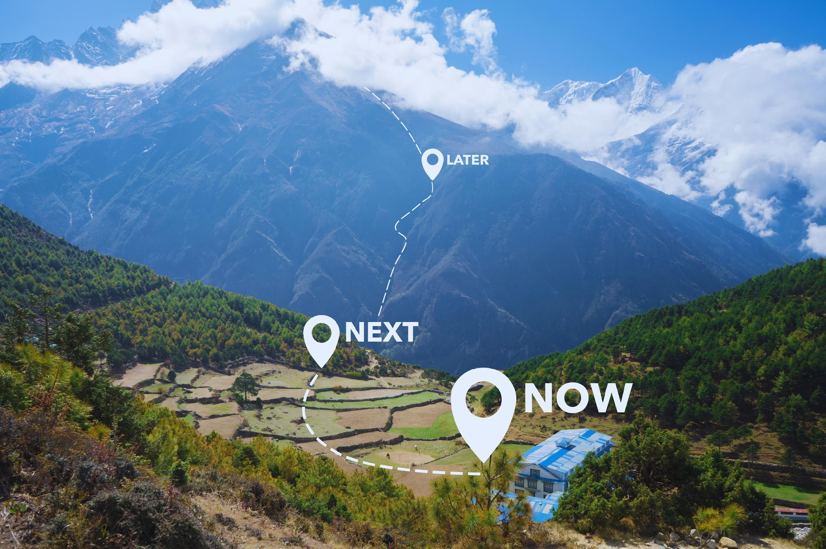
THE ROAD AHEAD
REVIEW
Meaningful goals are grounded in context and shaped through strengths and supports.
THO provides direction with goals that are:
  purposeful,
  flexible, and
  person-centered.
We can always learn to move somewhere new...
Notes:
In Section 1, we focused on where we look - how our attitudes, beliefs, and perceptions shape our interpretation of behaviour. We introduced growth mindsets and brain responsive mindsets. And we offered some frameworks that might help us action these mindsets.
Now we want to make it more applied.
To make that shift, we begin with the relational mindset - which is a collaborative way of seeing our work that shapes how we interpret, respond to, and engage with other people.
It reflects how our beliefs and experiences influence the ways we connect, communicate, and collaborate.
We can think of the relational mindset as the foundation for two systems that work together:
1. a brain-responsive mindset that helps us understand the “how” and “why” of behaviour, and
2. a growth-oriented mindset that informs our expectations for healthy outcomes and learning.

Slide 46

Notes:
In Section 1, we used the bike metaphor to show that where we look shapes where we end up.
Now, we are expanding that idea with a new metaphor: driving a car. This metaphor helps us talk about how people move toward healthy outcomes in different ways.
Presenter Note: Destination = Growth Mindset
First, imagine the destination. Maybe it is Calgary. The destination represents our growth mindset: the direction we are aiming for and the belief that progress is possible.
Everyone is heading toward healthy outcomes, but each person’s route and pace will look different.
Presenter Note: Vehicle = Brain Responsive Mindset
Now, consider the vehicle each person is driving. Some cars have quick accelerators. Some have soft brakes. Some can handle rough roads, and others need smoother roads.
The vehicle represents our brain-responsive mindset. It reflects each person’s unique brain-based profile and the conditions they need to feel safe, capable, and regulated.
Understanding that the vehicle helps us adjust expectations. We are not judging the car. Instead, we are learning what kind of support it needs to drive well.
Presenter Note: Supports and Guidance = Relational Mindset
None of us drive alone. We use a GPS, we ask for directions, or sometimes we need co-pilots: someone who can point out turns, help track the route, or remind them to slow down.
Some people may need someone with an extra brake pedal or someone who can “step in” and help when things feel overwhelming.
These co-pilots represent our relational mindset. They are the supportive others, guides, and relationships that make the journey safer and more predictable.
A strong relational mindset means understanding when to step in, when to guide, and when to share responsibility during the drive.
It is not about better or worse vehicles. Instead, our hope is you will begin to recognize what each driver needs to stay safely on the road or move toward healthy outcomes.

Slide 47
THE ROAD AHEAD
SETTING A DIRECTION & MOVING FORWARD
Notes:
Presenter Note: Read Slide
Knowing the destination gives us direction, but every journey includes construction zones and detours.

Slide 48

THE PATH TO SUCCESS
DESTINATION VS. DETOUR
Success may be defined differently by each person.
Destination Goals: Growth happens when goals fit the person.
Notes:
Progress isn’t straight —it depends on a person’s readiness, their access to supports, and the environment. That means the journey is just as important as the destination, and sometimes those journeys include barriers.
Success is not the same for everyone: it looks different for each of us, and different than what the systems they’re involved in might expect.
Growth happens when the goals fit the person, when they feel possible and meaningful. These are destination goals, they give us direction and the opportunity to grow.

Slide 49

THE PATH TO SUCCESS
DESTINATION VS. DETOUR
ADJUST
SUPPORTS
Notes:
For people with FASD, barriers may need to be addressed with different timing, tools, or signs. Barriers do not mean failure - they show us when supports need to be adjusted to move towards success.

Slide 50
MOTIVATION & READINESS
HOW WE MOVE TOWARDS GOALS
Notes:
Mindsets shape what we believe we are capable of. As supporters, we need to invest time, create space, and detour as needed when working towards a goal. Our mindset helps us do that.

Slide 51

MINDSET MATTERS
FIXED VS. GROWTH
Fixed mindset: the car is the way it is and the path it is on cannot be changed.
Brain-Responsive Mindset: understanding why the vehicle might run differently, and what it might need to keep going forwad.
Growth mindset: barriers are opportunities for learning and possibility.
Relational Mindset: to travel together, we need trust and shared understanding.
Notes:
A fixed mindset frames abilities and people as hard to change.
Different mindsets help us think about the journey, the people we work with, and the barriers we meet differently:
A brain-responsive mindset helps us understand why the vehicle may be slowing down or moving too fast. It gives us insight into the vehicle’s unique needs.
A growth mindset gives us a destination to move toward, it gives us hope. It helps us see potential - that skills can be developed with effort, support, and reliable conditions. A growth mindset helps us see barriers as opportunities for learning and helps us to think about possibilities instead of limitations.
A relational mindset shapes how we travel together. It is the part of the journey that involves trust, shared understanding, and creating space for detours when needed. It reminds us to invest time, adjust goals, and celebrate small, but meaningful accomplishments.
When we use these mindsets together, we focus on movement, not perfection. Every safe turn, every pause to rest, and every small adjustment along the journey is a success.

Slide 52
HOW TO SHIFT WHERE WE MOVE
MINDSET
Example Behaviour | Fixed Mindset | Growth Mindset
A student fails several math quizzes. | They will never be good at math. | They need different strategies and supports to learn and apply the material.
A client misses multiple appointments. | They do not care. | There may be barriers to attendance we can problem-solve together.
An individual gives up quickly on a work task. | They are lazy. | They may not yet have the skills or confidence to persist.
Notes:
This slide gives examples of how the same behaviour can be understood differently depending on our mindset.
If a student fails a few math quizzes, a fixed mindset might conclude that they will never be good at math. A growth mindset, on the other hand, sees that with the right strategies and support, students can learn and apply the material more effectively.
When a client misses appointments, a fixed mindset might lead to the assumption that they do not care. A growth mindset looks deeper, asking whether barriers are getting in the way, and how we might problem-solve together.
When someone gives up quickly on a work task, a fixed mindset might label them as lazy. A growth mindset recognizes that they may not yet have the skills or confidence to persist and that these can be developed over time.

Slide 53
HOW TO SHIFT WHERE WE MOVE
MINDSET SHIFT
Example Behaviour | Fixed Mindset | Growth Mindset
An adult becomes frustrated during therapy. | They will never be able to regulate their emotions. | With support, they can learn new ways to manage frustration.
A parent resists new recommendations. | They are unwilling to change. | They may need more time, trust, or clarity to feel ready.
Notes:
This slide gives us two more examples of how mindset can shape interpretation.
When an adult becomes frustrated during therapy, a fixed mindset might say they will never be able to regulate their emotions. A growth mindset reframes it.
With the right support, they can learn new ways to manage frustration.
When a parent resists new recommendations, a fixed mindset might assume they are unwilling to change. A growth-oriented mindset helps us recognize that they may need more time, trust, or clarity before they feel ready to take the next step.
These examples show how shifting from fixed to growth helps us see possibilities for progress, support, and growth.

Slide 54


MINDSET & MOTIVATION
PURSUING GOALS
Notes:
Aside from mindset, other theories of motivation can help us understand how people move towards goals.
Before we talk about a couple of theories of motivation, it is important to know that motivation does not happen by itself. Our environment, relationships, and supports shape our motivation.
Motivation is also informed by our mindsets about ability, behaviour, and growth.
A mindset-informed approach helps shift how we look at motivation. Instead of asking, “why aren’t they motivated?”, we begin to ask, “what do they need to feel motivated?”
Our role as supporters is to create the conditions that make movement toward goals possible. This means investing time, adjusting expectations, and allowing for detours. Motivation becomes about supporting meaningful, achievable progress.
The theories we are about to review help us understand how motivation develops and how we can support it. In the context of FASD, we must apply these theories with a flexible, brain-responsive lens.

Slide 55
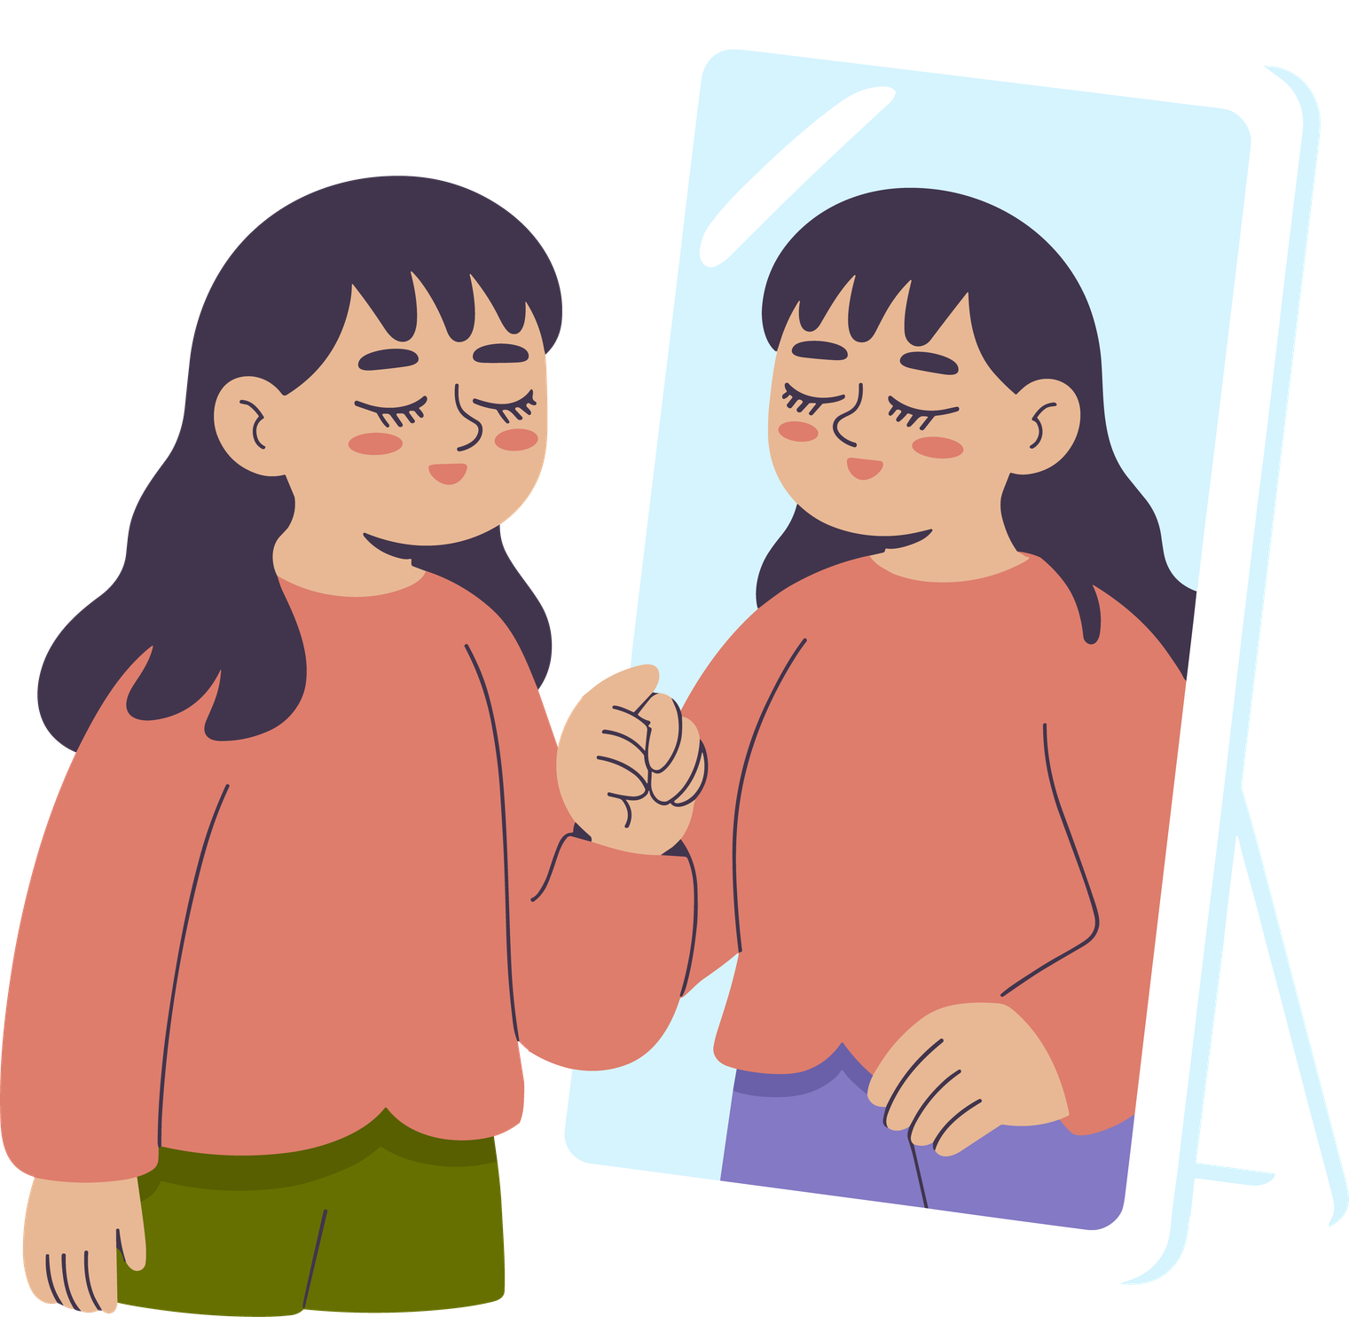
MOTIVATION
SELF-DETERMINATION THEORY
People are more motivated when their actions come from themselves.
External motivators do not help with long-term success.
Create environments where choice is possible and relationships feel safe.
Notes:
Aside from mindset, other theories of motivation can help us understand how people move towards goals.
One theory, self-determination theory, explains that people are more motivated when their actions feel like they come from themselves, not from outside pressure, rewards, or fear of consequences.
Having external motivators, like grades or money, might get quick results; but external motivators do not help long-term.
Goals must be meaningful and connected to what the person cares about. Their motivation increases when they are involved in decision-making.
Self-determination theory for people with FASD would include creating environments where choice is possible and relationships feel safe.
Self-determination keeps us moving forward over time, especially when goals feel big.

Slide 56

MOTIVATION
ACHIEVEMENT GOAL THEORY
What drives motivation and goal pursuit? Feeling capable
Different kinds of capability:
Mastery: Learning & skill building
Performance: Comparing to others
Shift away from comparison towards learning, skill building.
Progress > Perfection
Notes:
Achievement goal theory helps us understand what drives motivation. This theory explains that people pursue goals in different ways, based on how capable they think they are. It describes capability in two ways:
Mastery: Focusing on learning, improving, and building skills
Performance: Focusing on how my performance compares to someone else.
Some people look to grow their skills, that is take a mastery approach, and others try to avoid mistakes or negative judgement, which is the performance avoidance approach.
The Achievement Goal Theory helps us understand that people with FASD likely experience many comparisons with others, and pressure from systems. It provides support for our brain-responsive approach, growth mindset and relational mindset we’ve been talking about so far.
A mastery approach is a better fit when working with people with FASD. It helps shift away from comparison and toward practice and personal progress.

Slide 57
THE DIRECTION WE MOVE TOWARDS
GOAL ATTAINMENT
Notes:
Up to this point, we have considered how goals give us purpose, how motivation shapes readiness, and how mindset influences what feels possible.
Now we shift to goal attainment. We focus on the practical aspects of moving forward:
setting goals that fit for the individual,
collaborating through the process, and
using tools to guide progress and adapt when things do not go as planned.
This shift takes us from thinking about goals to thinking how to move towards them.

Slide 58

COLLABORATION MATTERS
CO-CREATING GOALS
Co-created goals reflect the person and their environment.
Working together builds trust and shared understanding.
Person-centred goals are meaningful, achievable, and flexible.
Notes:
Goal setting is a first step in turning our mindset into action.
As we talked about with the motivation theories, goals are most effective when they are created with the individual, not for them. When we build goals together, we honour their experiences, preferences, and the realities of THEIR day-to-day life by setting goals that are attainable and meaningful.
Co-created goals - meaning goals that we create alongside the person with FASD we are supporting - reflect their unique experiences and goals, and the systems that shape their development.
Co-created goals are easier to sustain: When goals are built based on shared understanding, the individual is more likely to stay engaged, even when progress is slow or when plans need to be adjusted.
When goals are person-centred, they become flexible, responsive, and tailored to what best suits the unique person we are supporting.
When we collaborate with setting goals, we are also building connections that will help us move forward in a meaningful way.

Slide 59

PATHWAYS FORWARD
PURSUING GOALS
Notes:
Progress is easier to notice when we regularly look for it. Regular progress monitoring helps us decide if our goals are still realistic, useful, and meaningful.
Regular progress monitoring helps us notice when progress slows, so we can reflect on what may need to change:
Sometimes it is the goal itself,
sometimes the supports around the person, and
sometimes the way progress is being measured.
This leads us into a framework that helps us think through these decisions step by step.

Slide 60
ACTIVITY
BREAK
Let’s use what we learned so far to complete this reflection activity.

Slide 61
ACTIVITY BREAK
PURSUING GOALS: JORDAN’S STORY
Jordan (age 17) has recently started meeting with a youth employment program. He says he wants to get a job but hasn’t completed any applications yet. When asked about his progress, he shrugs and says, “It’s too much work, and they probably wouldn’t hire me anyway. Jordan attends meetings inconsistently and often forgets the paperwork he needs to bring.
Notes:
Presenter Note: Read Slide
This story explores how readiness, confidence, and mindset influence goal pursuit. We’ll think about how to identify a destination goal, what strengths Jordan brings, and where he may need support. The goal here is to look beyond what’s not happening and consider what might help him move forward meaningfully.

Slide 62
ACTIVITY DISCUSSION
JORDAN’S STORY
Identify:
  A main destination goal for Jordan
  Strengths that could be leveraged
  One area in need of support
Reflect:
  How might the definition of “success” vary between Jordan and the program staff?
  How might applying a growth mindset change how you approach goal-setting?
Notes:
Activity/Discussion Prompts:
Identify a main destination goal for Jordan.
Identify strengths that could be leveraged.
Identify one area in need of support.
How might the definition of “success” vary between Jordan and the program staff?
How might applying a growth mindset change how you approach his goal setting.
Notes on Scenario (if discussion is brief):
Ask: Might Jordan’s destination goal be to find and maintain meaningful employment?
Identify strengths, such as a desire for independence, social interest, and some insight into his challenges.
Areas in need of support could include planning, organization and confidence.
Success may look different. For staff, it could mean securing a job.
For Jordan, it might simply mean taking the first step: completing one application or practicing an interview.
Using a growth mindset, we might focus on progress over perfection - acknowledging small wins, helping Jordan see effort as learning, and scaffolding steps to build readiness.

Slide 63
ACTIVITY BREAK
PURSUING GOALS: RENEE’S STORY
Renee is a parent working with a family-support team to create structure at home. She wants her mornings with her 9-year-old son to be calmer, saying “Every day starts with yelling - I just want peace.” Renee reports trying multiple strategies but gives up quickly when they don’t work right away. She often says things like “Nothing helps him. He’s just like his dad...stubborn.”
Notes:
Presenter Note: Read Slide
Renee’s story highlights motivation, frustration, and mindset in goal pursuit.
We’ll use it to consider how a fixed mindset might influence persistence and how collaborative, strengths-based goal-setting can shift direction.

Slide 64
ACTIVITY DISCUSSION
RENEE’S STORY
Identify:
  A main destination goal for Renee and her son
  Strengths - of Renee’s and her son’s - that could be leveraged
  One area in need of support
Reflect:
  How might the definition of “success” vary between Renee and her support team?
  How might applying a growth mindset change how you approach goal-setting?
Notes:
Discussion Prompts to be used as needed:
Identify a main destination goal for Rennee.
Identify strengths that could be leveraged.
Identify one area that needs support.
How might the definition of “success” vary between Jordan and the program staff?
How might applying a growth mindset change how you approach goal-setting?
Potential discussion prompts if needed:
Renee’s destination goal could be calmer, more positive morning routines with her child.
Her strengths might include commitment, insight, and care for her child.
Her area of support might be sustaining strategies over time and shifting from “quick fixes” to skill-building.
Success for Renee might mean fewer conflicts or feeling less overwhelmed, while the system may define success as consistent routines.
Ask about opportunities for applying a growth mindset. It could involve reframing setbacks as learning opportunities, highlighting her progress, and celebrating moments of calm rather than expecting perfection.

Slide 65
A FRAMEWORK FOR ACTION
MINDSET & POSSIBILITY
Notes:
Up to this point, we have been looking at the direction we move towards in broad terms. We considered how goals give us purpose, how motivation shapes readiness, and how mindset influences what feels possible.
Now we shift into goal attainment. Here, we focus on the practical aspects of moving forward, setting goals that align with the individual, collaborating throughout the process, and utilizing tools to guide progress and adapt when things do not go as planned.
This shift takes us from thinking about goals in theory to considering how they are actioned.

Slide 66
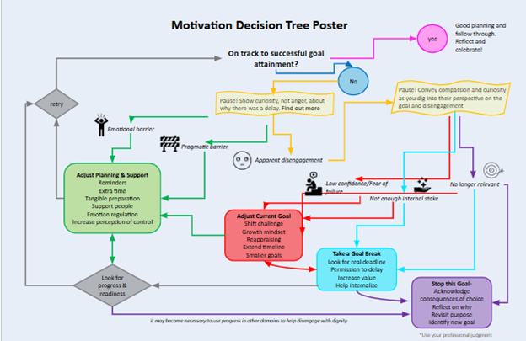
Notes:
The decision tree supports reflection and action during goal pursuit.
It highlights barriers, adjustments, and options for next steps.
This process helps us move from feeling stuck to finding supported progress.
In the next series of slides, we will review the different components of the decision-making tree.

Slide 67

PAUSING WITH CURIOSITY
RECOGNIZING BARRIERS
Pause with curiosity - what caused these barriers?
Are the barriers:
  emotional,
  practical, or
  signs of disengagement?
Notes:
The first step in the decision tree is to pause with curiosity. Instead of reacting with judgment, we take a moment to ask: what might be getting in the way?
Barriers may be emotional, like anxiety or frustration. Or practical, like transportation or scheduling. Or signs of disengagement or changes in interest.
When we understand the cause, we have an easier time identifying supports.

Slide 68
ADJUSTING TO
STRENGTHEN READINESS
Emotional barriers ⟶ can be overcome with emotional support, extra time or breaks, emotion regulation strategies.
Practical barriers ⟶ can be overcome with help planning, increased structure, regular routines.
Adjustments create readiness and confidence to overcome barriers.
Notes:
Once barriers have been recognized, the next step is to think about how planning and support can be adjusted:
Emotional barriers may be eased with reminders, supportive people, or extra time.
Practical barriers often need more precise planning, added structure, or helpful routines.
If the client has lost interest in the goal, then the goal can be adjusted. We will discuss this more in a moment.
These adjustments build confidence, reduce frustration, and increase the likelihood that the person with FASD can continue moving toward their goals.
This is one of the key ways the decision tree helps us visualize progress as possible, even when challenges arise.

Slide 69

ADJUSTING THE GOAL
REFRAMING THE CHALLENGE
Collaboratively adjust the timeline and/or approach.
Smaller steps sustain momentum.
Notes:
At other times, the goal itself is what needs to shift.
We may need to reduce the challenge, extend the timeline, or reframe the approach with a growth mindset.
Breaking a larger goal into smaller, more manageable steps helps the person experience success and keep moving forward.
Or perhaps the goal itself needs to be shifted or changed to meet the evolving needs of the individual we are supporting.
In these instances, the relationship between people with FASD and their supporters is useful for exploring goals.

Slide 70

TAKING A PAUSE
STEPPING BACK TO RE-ENGAGE
Notes:
Sometimes the best option is to pause for a few hours or maybe longer. Sometimes we need time to regulate and reflect before returning to the conversation.
Stepping back lowers pressure.
When the goal is revisited later, it can feel more meaningful and thought out.

Slide 71
HOW TO USE THO
GOAL SETTING
Physical Wellbeing | Physical Wellbeing | Physical Wellbeing
What to know? | What to do now? | What to plan for?
Physical health is fundamental to daily living. Awareness and support that promotes physical health is a first step towards healthy outcomes across the lifespan. | It will be important to monitor and follow-up with any primary health care providers Supports related to medications have been recommended. | To help with proactive planning ahead, Dr. Hanlon-Dearman and colleagues created an anticipatory guide for primary health care providers working with individuals with FASD.
Notes:
Mapping this process onto the Towards Healthy Outcomes framework, whenever we set a goal and step onto the relevant THO pathway, we can set goals using three steps outlined here on this table.
The steps are ‘what to know’, ‘what to do’ and ‘what to plan for’.
Within THO, each pathway, for example here we have Physical Wellbeing, starts with basic information about the importance of health care across multiple areas of functioning, and then goes on to include resources and recommendations. Using this information, short- and long-term goals can be set.
What to know covers the basic information about the pathway we are on, in this case physical wellbeing, along with the relevant characteristics, strengths, needs, and areas of interest of the person we are supporting. In this example, that includes understanding the critical foundation of good physical health plays in daily life and the ways to promote physical wellbeing.
What to do now is our more immediate, shorter term goals and next steps; plans for the next year or so. This also includes current resources and other evidence-based support and recommendations. In this example, it includes planning medical appointments, monitoring medications and their effects.
Finally, the last column is what to plan for. This includes our longer term planning and considerations related to continuity of care. In this example, physical wellness, includes longer term planning, ongoing healthcare, and transitioning between different physicians and health care systems.
Planning ahead helps us be proactive and focus on providing supports and achieving goals rather than only solving problems as they arise.

Slide 72
END OF CONTENT AREA 2

Slide 73
TOWARDS HEALTHY OUTCOMES
PUTTING IT ALL TOGETHER
Notes:
Now we are going to talk about how we can start applying some of the things we’ve learned today. As we do, it’s important to remember that the more often we think about and apply these new ideas we’ve discussed today, the easier it will be to do.
Or, practice makes perfect.

Slide 74
PRESENTATION
OUTLINE
  Taking a Balanced Perspective: Moving Beyond Brain-Based Differences
  Systems & Allied Professionals: Building Relationships
  Putting it All Together: Activity
Notes:
Presenter Note: Read slide
By the end of this section, participants will be able to:
Demonstrate increased confidence in applying success-oriented, developmentally focused, goal-oriented supports in real-world scenarios.
Identify and apply creative strategies that may be helpful for the unique person we are supporting, and make practice shifts that can influence and contribute to healthy outcomes for individuals with FASD.
Integrate knowledge from previous presentation sections into actionable steps, strengthening the connection between “head knowledge” and practice.
This section builds on our brain-responsive approach, growth and relational mindsets, and goal setting knowledge to understand how they can be applied, practiced, and increasingly integrated in our work moving forward.

Slide 75

Notes:
In our previous sections, we’ve used metaphors to explain our key takeaways from each section. So we talked about learning to ride a bike and driving. Now we’re going to use a sports metaphor.
Presenter Note: If there is a different sport that you have experience with or would prefer to talk (e.g., golf) about feel free to adjust the metaphor to that experience.
Does anyone remember learning to skate? You probably started off pretty shaky, it probably felt hard to just stay standing upright in your skates when putting them on. And stepping onto the ice felt like such a slow process, it probably took you a long time to even put a foot on the ice.
Once I am on the ice, all I’m focused on is skating. Speeding up or stopping feels impossible.
For some of us, we likely stopped there. So anytime we go skating it feels laborious and really hard.
But for others, maybe you went skating more often, maybe you even had parents who set up a rink in your backyard for you. Then you skate often enough that you come to believe that you can skate - in fact you’re no longer concerned about skating at all anymore.
You go so much that you’re no longer even think about skating. It becomes so automatic that skating becomes like walking or breathing, and you don’t even have to give it conscious effort.
Maybe now your focus has shifted to skating in a certain direction, or at a certain speed.
You skated enough that you not only increased your abilities and skills, but your underlying belief about your ability to skate has changed.
The same is true in our work. As professionals, there is a process of practicing certain ways of thinking and acting to boost our foundational belief systems and recognize how these things go together.
The automaticity of the practice comes with the belief - but thinking this way again and again over time can help shift the beliefs.

Slide 76
TAKING A BALANCED PERSPECTIVE
MOVING BEYOND BRAIN-BASED DIFFERENCES
Notes:
Historically, supporters have focused on solving problems for people with FASD and avoiding risks, which is important. But by doing that, we have overlooked crucial parts of the story.
Now, we are looking to shift towards understanding the whole person…
Presenter Note: Read slide.

Slide 77
NOT THE END OF THE STORY
BRAIN-BASED DIFFERENCES
Notes:
So far, we have talked about the spectrum of strengths and needs by reviewing the ten diagnostic domains used to assess folks with FASD.
Presenter Note: The pictures of the domains are in the same order as those listed below starting in the top left hand corner and then moving towards the right. The first picture on the top line represents academic achievement, and the first picture on the bottom line represents neuroanatomy.
These areas assessed include: academic achievement, attention, cognition, language, memory, neuroanatomy, executive functioning, adaptive behaviour, motor skills, and affect regulation. Our main takeaway from this conversation earlier was that these brain domains are highly connected - no part of the brain works on its own.
This understanding shapes our brain-responsive approach to providing supports.

Slide 78
A BALANCED PERSPECTIVE
STRENGTHS & NEEDS
To help the whole person, we need to understand what they are good at and what they are needing support with.
Notes:
To understand and support people with FASD, we must understand the whole person. When we do that, we can understand what it is they might need help with, and what goals they are striving towards.
This is what creates our shared understanding that we talked about earlier.
As we discussed in section 1, the Towards Healthy Outcomes framework helps us take a strengths-based approach that helps us to recognize strengths.
We all have strengths, and our strengths are unique. For some people, that means we can overlook their strengths because they are different from what we might expect.
Strengths are not always “skills.” They may be the ways we relate to other people, our effort, curiosity, connection, or persistence.
Or strengths can show up in more obvious ways in how we live our lives.
What’s important is that we notice strengths because they give us clues about what supports may feel natural for the person. Like we talked about earlier in our motivation slides, effective support develops from what meaningful goals that are created in collaboration.
When supports are aligned with each person’s unique strengths, progress becomes steadier and more predictable.

Slide 79
SYSTEMS & ALLIED PROFESSIONALS
BUILDING RELATIONSHIPS
Notes:
We do not support a person alone. We work with their family, school, community, health care, and/or social services systems. The systems that work together are better set up to respond to challenges.

Slide 80


SYSTEMS & ALLIED PROFESSIONALS
BUILDING RELATIONSHIPS
Shared Understanding
Strengths & Needs
Relational Mindset
Growth Mindset
Brain Responsive
Notes:
Professional collaboration means systems talking to each other, sharing information, and planning together. It lowers the chance of interpreting behaviour as defiance or lack of effort. It creates that shared understanding we talked about in section 1.
Shared understanding means that all systems understand the unique strengths and support needs of the person with FASD they work with.
When professionals collaborate, expectations become clearer and more predictable. Even small changes in communication can improve day to day life.

Slide 81

BUILDING RELATIONSHIPS
NAVIGATING SYSTEMS
What is expected may not align with the individual we are supporting.
Shared understanding between systems helps make navigating systems easier.
Notes:
Armed with shared understanding of the unique person we are supporting, we set ourselves up to communicate with other supporters and systems in a brain-responsive way.
Relationships help reduce mixed messages and offset communication breakdowns across systems which creates clearer pathways towards goals.
Instead of solving problems, the focus becomes navigating systems.
When systems operate independently or fail to share understanding, people can feel confused or overwhelmed. Systems that have a shared understanding can work together to help the person with FASD navigate their journey towards success.

Slide 82
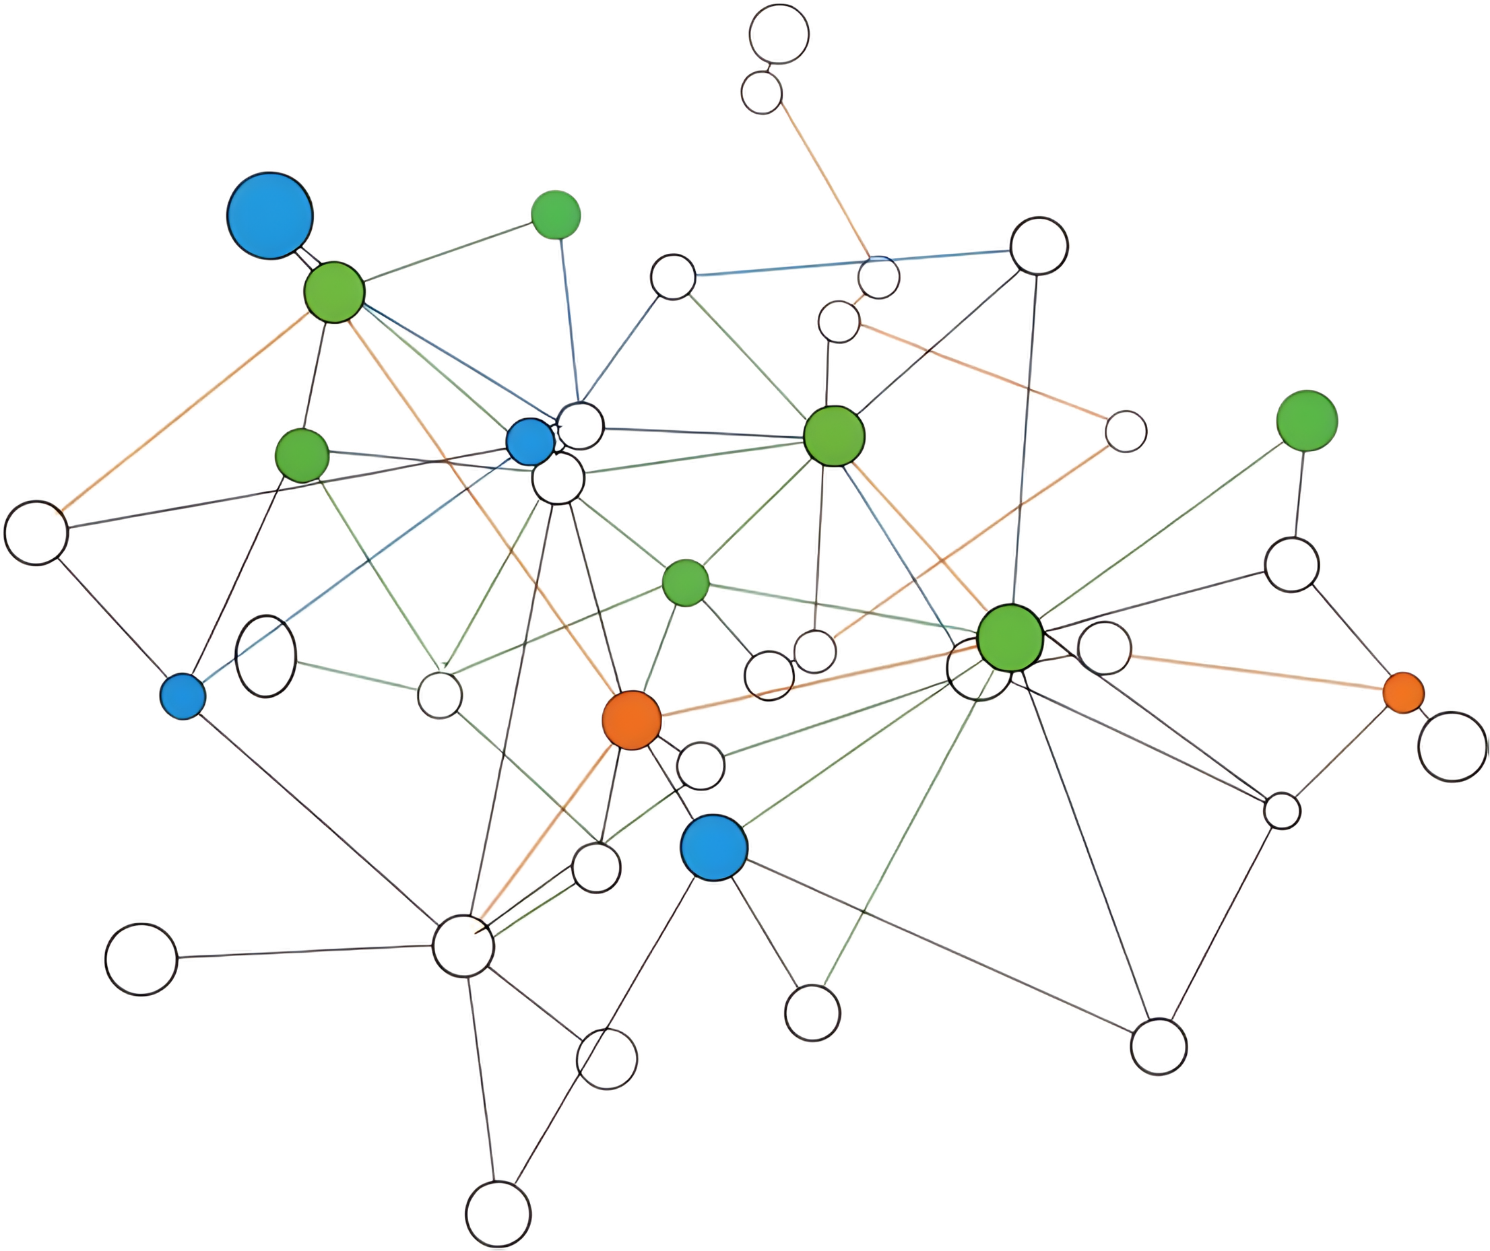
BUILDING RELATIONSHIPS
NAVIGATING SYSTEMS
How to navigate complex systems....
Shared Understanding
Understanding is fostered through...
Relationships
Notes:
Shared understanding is crucial to navigating complex systems.
And as we’ve talked about so far, understanding is fostered through relationships.
But how do we got about establishing those relationships? Sometimes it can be tricky given the limitations of our roles and environments.

Slide 83
NAVIGATING SYSTEMS & BARRIERS
BUILDING RELATIONSHIPS
What I Might See | Brain Responsive Approach | Relational Mindset
Often late or missing appointments | Written and verbal reminders Calendar or text prompts Wrist watch Shuttle services | Ask and Consider: Are they having trouble remembering appointments? Are they avoiding the doctor? Why? What might help them manage their time better?
Notes:
This table offers not only some strategy suggestions for challenging behaviours it also provides some prompts to ask ourselves and the people we are working to support to start to develop that relationship to foster understanding.
In the first column we have some behaviours that we might see in our work.
Then in the middle column we have strategies that might be helpful to implement for this situation.
In the last column we have suggestions and questions we can ask to build relationship and understanding.
Presenter note: Read slide. Depending on time and the audience, you could make this slide more conversational and accept suggestions for strategies and relationship building tools.

Slide 84
NAVIGATING SYSTEMS & BARRIERS
BUILDING RELATIONSHIPS
What I Might See | Brain Responsive Approach | Relational Mindset
Overly friendly towards strangers/not knowing personal boundaries | Verbal reminders Education about social norms/boundaries Mentorship Roleplay and rehearsal about how to talk to strangers and friends | Ask questions to connect, like... Are you trying to make new friends? Do other people ever make you feel uncomfortable? If so, when? What does that feel like? How might we notice if we are making someone else uncomfortable?
Notes:
Presenter note: Read slide. Depending on time and the audience, you could make this slide more conversational and accept suggestions for strategies and relationship building tools.

Slide 85
NAVIGATING SYSTEMS & BARRIERS
BUILDING RELATIONSHIPS
What I Might See | Brain Responsive Approach | Relational Mindset
Struggles to stay regulated and focused at school or work | Use fidget toys Pair them with a peer who is not easily distracted Reminders to stay focused Setting a timer for work tasks | Ask questions to connect, like... Do you ever feel frustrated at school or work? When do you find it hard to focus at school or work? What might make it easier for you to focus? What has worked in the past?
Notes:
Presenter note: Read slide. Depending on time and the audience, you could make this slide more conversational and accept suggestions for strategies and relationship building tools.

Slide 86

BUILDING RELATIONSHIPS REQUIRES THAT WE
SEEK UNDERSTANDING
BY APPROACHING SITUATIONS WITH
CURIOSITY AND OPENNESS
to work alongside individuals with FASD towards success.
Notes:
Presenter note: Read slide.

Slide 87
ACTIVITY
BREAK
Let’s use what we learned so far to complete this reflection activity.
Notes:
Now we are going to work through an example. To respond to the discussion prompts, feel free to refer to your notes, the slides, or the decision-tree map.

Slide 88
ACTIVITY BREAK
BRETT’S STORY
Brett is 8-years old and is full of energy from the moment he wakes up in the morning. At school, he usually begins his day in a calm and curious space, especially when he is working with “hands-on” materials. As the classroom becomes louder and the routine is not as predictable, Brett has more difficulty keeping himself organized. When the class is asked to move from one activity to another, he may shout, throw materials off his desk, or kick his chair out of frustration. Brett also has difficulties socializing with his peers. For example, if a peer accidentally bumps him or tries to join his game without warning, he may respond by pushing or hitting them.
During recess, Brett often plays alone. He watches other children but is unsure how to join in. When he tries and it does not go well, he becomes upset and says that everyone is mean to him. At home, he sometimes cries after school and says he feels like he is always in trouble. His caregiver tries to understand what he needs but finds it difficult to predict when he will become overwhelmed. The school staff have been supportive, but rely mostly on reminders, consequences, and behaviour expectations which do not seem to change patterns.
Notes:
Presenter Note: Read Slide.

Slide 89
ACTIVITY BREAK
BRETT’S STORY
In breakout rooms, you will:
  Identify at least two strengths and two needs demonstrated by Brett.
  Develop one meaningful destination goal for Brett.
  Generate 2-3 strategies that can leverage Brett’s unique strengths and involve collaboration within their support team
Notes:
Presenter note: Potential discussion prompts/topics:
Invite participants to name what brain-based differences might be shaping these patterns, such as difficulties with transitions, sensory overload, or social skills.
Ask what might make the classroom or school environment challenging for him and where he might feel more capable.
Encourage reflection on how behaviour communicates needs.
Connect to the idea that this is “not the end of the story.” What could shift if expectations matched his developmental abilities?
Explore how enhanced collaboration between caregivers and school might create more consistency.
Prompt discussion on relationship building and how small supportive interactions could change Brett’s daily experience.
Link to systems and barriers by asking how traditional school responses might miss the underlying needs.

Slide 90
ACTIVITY BREAK
MARISSA’S STORY
Marissa has FASD and is 33 years old. She is a single mother, raising two children who are both in elementary school. She describes feeling pulled in many directions and often becomes overwhelmed by daily routines. On school mornings, she may misplace items, forget forms, or lose track of time, which sometimes results in the family running late. When her children ask for help at the same time, she becomes flustered and may respond sharply or shut down. Later, she feels guilty and wishes she could regulate her emotions and remain calm the way other parents seem to.
Marissa wants support, but often hesitates to reach out because previous experiences with services left her feeling judged. Some professionals have described her as inconsistent or hard to engage when she forgets appointments or has difficulty following through on multi-step plans. At the same time, she cares deeply about her children and is trying to understand what might help her feel more capable. She explains that when the world feels “too fast,” she becomes confused and embarrassed, which makes it harder for her to ask for guidance.
Notes:
Presenter Note: Read Slide

Slide 91
ACTIVITY BREAK
MARISSA’S STORY
In breakout rooms, you will:
  Identify at least two strengths and two needs demonstrated by Marissa.
  Develop one meaningful destination goal for Marissa.
  Generate 2-3 strategies that can leverage Marissa’s unique strengths and involve collaboration within their support team
Notes:
Presenter note: Potential discussion prompts/topics:
Invite participants to notice behaviours that might be connected to brain-based differences related to planning, memory, or emotion regulation.
Ask what daily tasks or expectations might feel especially demanding for her.
Explore how service providers might misinterpret her behaviour and how this can create barriers rather than support.
Encourage thinking about what helps build trusting relationships with adults who she is afraid are judging her.
Presenter Note: Highlight opportunities for collaboration where instructions are clear, predictable, and paced in manageable steps. Connect back to “not the end of the story” by asking what could shift if Marissa received support that truly matched her needs.

Slide 92
ACTIVITY
XANDER’S STORY
Xander is 19 and he recently moved out on his own. He was excited about being independent, but quickly found that managing daily tasks is more complicated than he expected. He misplaced essential documents, missed a rent deadline, and has received warnings from his landlord. He wants steady welding work and tries his best on the job, but often forgets instructions or becomes confused when several tasks are given at once. Employers have let him go from jobs with feedback such as that he needs too much direction.
Xander spends a lot of time trying to figure out how to organize his bills, groceries, and appointments, but he becomes overwhelmed and sometimes avoids dealing with them. He says he feels like he is letting people down and is afraid to ask for help because he does not want to seem incapable. He has dreams of having stable housing, a welding job he enjoys, and a sense of routine, but does not know how to get there. He explains that adulthood feels like a test that he keeps failing.
Notes:
Presenter Note: Read Slide

Slide 93
ACTIVITY
XANDER’S STORY
In breakout rooms, you will:
  Identify at least two strengths and two needs demonstrated by Xander.
  Develop one meaningful destination goal for Xander.
  Generate 2-3 strategies that can leverage Marissa’s unique strengths and involve collaboration within their support team
Notes:
Presenter note: Potential discussion prompts/topics:
Ask participants to identify which brain-based differences might influence his challenges with independence, money management, and work routines.
Invite discussion around how the transition to adulthood often removes structure and support, creating system-level barriers.
Encourage participants to name moments in Xander’s story where he is trying, even if it does not appear successful.
Explore how relationships with supportive adults or mentors could support his goals.
Prompt thinking about collaboration across systems, such as employment programs, housing supports, or community coaching.
Reinforce “not the end of the story” by asking what could change if Xander received consistent, predictable, hands-on support.

Slide 94
ACTIVITY
BREAK
Let’s reflect on what we’ve learned together today...
Notes:
Now we are going to use what we have learned today to think about some of our own experiences and clients.

Slide 95
PERSONAL REFLECTION ACTIVITY
YOUR STORY
Reflect by yourself about a client you worked with who was challenging. Based on what we’ve learned today, how would your approach change?
  What strengths did this person demonstrate?
  What needs did I focus on at the time?
  How could I have improved upon my ability to integrate strengths into strategy planning?
  What system/allied professional barriers were present and how could I have addressed them differently?
Notes:
Recall a client or individual with FASD that you worked with who was challenging for you.
With the information presented today, how would your approach change?
Reflect and answer the questions/prompts and please share if you feel comfortable.

Slide 96
END OF CONTENT AREA 3
Notes:
That brings us to the end of this presentation.
Are there any questions?
Presenter Note: Provide resources and glossary of key terms if needed.

